Slide 1
Rotation effects in MGI rapid shutdown simulations
V.A. Izzo, P.B. Parks, D. Shiraki, N. Eidietis, E. Hollmann, N. Commaux
TSD Workshop 2015
Princeton, NJ

Slide 2
Outline
Overview of MHD, radiation asymmetry, and impurity spreading results from non-rotating NIMROD MGI simulations
DIII-D observations regarding the role of toroidal rotation in MGI experiments
Results from NIMROD simulations with rotation
  Evolution of the rotation profile
  Effect on impurity spreading
  Effect on radiation peaking
Summary and Future Work

Slide 3
Outline
Overview of MHD, radiation asymmetry, and impurity spreading results from non-rotating NIMROD MGI simulations
DIII-D observations regarding the role of toroidal rotation in MGI experiments
Results from NIMROD simulations with rotation
  Evolution of the rotation profile
  Effect on impurity spreading
  Effect on radiation peaking
Summary and Future Work

Slide 4
Sequence of events for a (non-rotating) NIMROD MGI simulation: 1) Neutral impurity source turned on
Impurities are injected as a volumetric source into the region outside the separatrix. They penetrate into the plasma region by diffusion and any radial flows generated during the simulation.
Cases presented are Ne MGI using only the upper (MEDUSA) SPI valve on DIII-D
As Ne mixes into the plasma, ionization, recombination and radiation cooling is calculated
φ=15⁰

Slide 5
2) Ionized Ne spreads helically along field lines
Spreading is driven by parallel pressure gradient—large χ|| equilibrates T. Pressure gradient roughly density gradient.
Spreading is asymmetric, strongly preferring propagation toward the HFS poloidally→

Slide 6
2) Ionized Ne spreads helically along field lines
Nozzle equation explains preferential HFS spreading:
Continuity
Momentum
Flow starts at M<1, is thwarted where dB/B<0, accelerates where dB/B>0

Slide 7
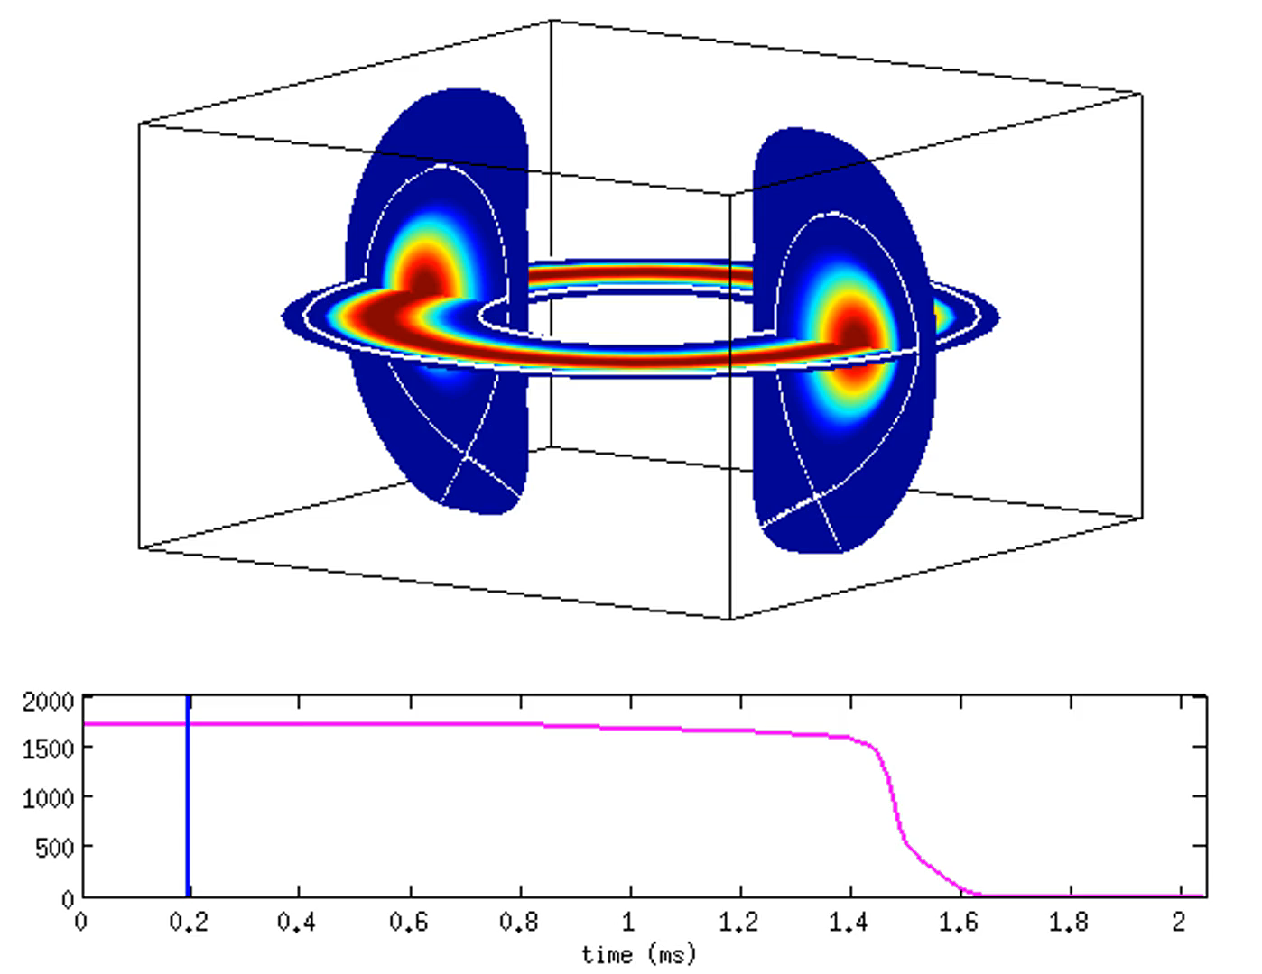
3) MHD modes grow and saturate → core thermal quench
m=1/n=1 mode primarily responsible for core TQ, dumps core heat to the radiating edge asymmetrically by convection, not conduction

Slide 8
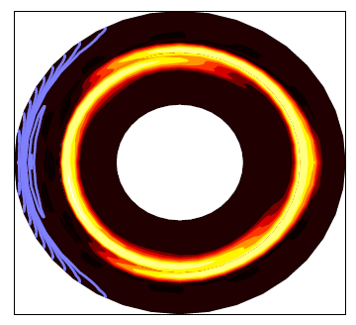
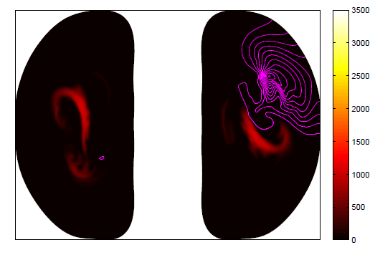
3) MHD modes grow and saturate → core thermal quench
Absent plasma rotation, 1/1 mode dumps core heat directly away from gas injection location→ counterintuitive result that radiation is peaked 180⁰ away from gas jet
180º
MGI
m/n=1/1
0º
MEDUSA
Temperature contours
135º
15º

Slide 9
Outline
Overview of MHD, radiation asymmetry, and impurity spreading results from non-rotating NIMROD MGI simulations
DIII-D observations regarding the role of toroidal rotation in MGI experiments
Results from NIMROD simulations with rotation
  Evolution of the rotation profile
  Effect on impurity spreading
  Effect on radiation peaking
Summary and Future Work

Slide 10
DIII-D experiments: Initial n=1 phase corresponds to NIMROD prediction, then phase rotates
Initial n=1 phase
Phase of n=1 mode when it first appears (prior to the TQ) is 180 degrees from gas jet location, in agreement with NIMROD prediction
Between initial appearance and TQ, n=1 phase rotates. Higher pre-MGI plasma rotation → more pre-TQ mode rotation

Slide 11
DIII-D experiments: n=1 phase at TQ can be controlled with error fields (particularly at low rotation)
Use of error fields to control final phase of mode is useful to measure radiation toroidal peaking factor with limited diagnostic set. Same TPF found at 90 and 210 degrees suggests impurity distribution not a large factor in TPF (uniform?)

Slide 12
Outline
Overview of MHD, radiation asymmetry, and impurity spreading results from non-rotating NIMROD MGI simulations
DIII-D observations regarding the role of toroidal rotation in MGI experiments
Results from NIMROD simulations with rotation
  Evolution of the rotation profile
  Effect on impurity spreading
  Effect on radiation peaking
Summary and Future Work

Slide 13
Sharp drop in core rotation, slight uptick in edge

Slide 14
Impurity spreading follows rotation direction (reverse of stationary case)
No Rotation
Rotation (+φ direction)
Ne ions
Ne ions

Slide 15
Rotating structure appears beginning at jet location, TQ flash is ~180⁰ from structure phase at TQ time
Prad (W)
No Rotation
180⁰
Prad (W)
Rotation
180⁰
Time (ms)

Slide 16
MHD activity is more complicated in the rotating case
No Rotation
Rotation
<δB/B> = sqrt(W_{n}/W₀)

Slide 17
Field lines show fully stochastic fields at time of TQ- later for rotating case
Non-rotating
1.75 ms
2.00 ms
2.25 ms
2.50 ms
Rotating

Slide 18
Some preliminary conclusions on the effects of rotation
Direction of impurity spreading reverses to align with rotation direction, and impurities spread more quickly overall
Core rotation drops rapidly before significant impurities reach the core.
Thermal quench onset is somewhat delayed, and TQ shorter in duration. Well defined spike in radiated power more consistent with measurements.
Evolution of P_{rad} seems consistent with DIII-D magnetics analysis: mode is born aligned with gas jet and rotates, determining toroidal location of P_{rad} maximum

Slide 19
Some questions and future work
Why does radiation pattern begin rotating at 1.5 ms?
How does interaction of various modes effect the rotation profile?
What is the role of the higher-n modes in the rotating case?
Future work:
Do detailed magnetics analysis to separate m/n components
Examine effects of viscosity in rotating simulation with no MGI

Slide 20
Significant effect of higher n modes in the core
No Rotation (1.0 ms)
Rotation (1.0 ms)

