Slide 1
Role of Integrated Simulations in Disruption Physics Research
P. T. Bonoli (MIT) Lois Curfman McInnes (ANL)
C. Sovinec (U. of Wisconsin) D. Brennan (Princeton U.)
B. Breizman (UT-Austin) L. Chacon (LANL)
N. Ferraro (GA) R. Fitzpatrick (UT-Austin)
G.-Y. Fu (PPPL) S. Gerhardt (PPPL)
E. Hollman (UCSD) V. Izzo (UCSD)
S. Jardin (PPPL) S. Kruger (Tech-X)
H. Strauss (HRS Fusion) A. Turnbull (GA)
R. Samtaney (KAIST)
Princeton Plasma Physics Laboratory
July 13-15, 2015

Slide 2
Outline
This is actually a summary of the DOE Workshop and Report on Integrated Simulations in Magnetic Fusion Energy Sciences as it pertains to disruptions.
Review Background and Process
  DoE charge letter, panel structure
  Call for whitepapers, community teleconference, writing workshop
  Goals of the workshop
Review of Recent Progress
Gaps and Opportunities
  Physics / Applied mathematics / Computer Science
Strategy and Path Forward:
  Priority Research Directions

Slide 3
Background
Integrated Simulation Workshop is one of the four FES Community Planning Workshops conducted in 2015:
  https://www.burningplasma.org/activities/?article=Integrated%20Simulations
  DOE Points of Contact:
    John Mandrekas (FES)
    Randall Laviolette (ASCR)
Workshops were held on Transients and Plasma-Material-Interactions, with Plasma Science Frontiers Workshops to be held in (August & October, 2015):
  https://www.burningplasma.org/activities/?article=FES%20Community%20Planning%20Workshops%202015

Slide 4
Charge from DOE
“Review recent progress and identify gaps and challenges in fusion theory and computation directly relevant to the topic of disruption prevention, avoidance, and mitigation and that of plasma boundary physics, with whole device modeling as the long-term goal.”
“Reassess these opportunities and adjust or broaden them appropriately, taking into consideration recent progress and using the criteria of
  Urgency
  Leadership computing benefit
  Readiness for progress within a ten-year time frame
  World-leading potential

Slide 5
Goals of this Workshop
Identify theory/simulation advances since RENEW (2009) and more recently the 2011 FSP Execution Plan.
Identify gaps in theory/simulation, especially related to integration of multiple processes and regions:
  How could these gaps be addressed in the shorter (5 year) and longer (10 year) timeframes ?
  Identify new opportunities for integrated simulation including the roles of physics, applied mathematics, and computer science
  Emphasize crosscutting fusion / applied math / computer science connections
  Identify potential applications for extreme-scale computing

Slide 6
Integrated Simulation for
Magnetic Fusion Energy Sciences
Integrated Science Applications
Disruptions (prevention, avoidance, mitigation)
Plasma Boundary
(including pedestal, scrape off layer, plasma-materials interactions)
Whole Device Modeling
New Opportunities
Mathematical and Computational Enabling Technologies
Multiphysics and Multiscale Coupling
Beyond Interpretive Simulation
Data Management, Analysis, and Assimilation
Software Integration and Performance
Focus: Integration

Slide 7
Integrated Science Applications
Disruption Physics (prevention, avoidance, characterization, and mitigation) Chair: Carl Sovinec (UW) Co-chair: Dylan Brennan (Princeton) Focus: gaps and challenges in theory, guidance from experiment, status of simulation capabilities, status of validation and measurement capabilities
B. Boundary Physics (pedestal, scrape off layer, and PMI) Chair: Tom Rognlien (LLNL) Co-chair: Phil Snyder (GA) Focus: gaps and challenges in theory, guidance from experiment, status of simulation capabilities, status of validation and measurement capabilities
C. Whole Device Modeling Chair: Jeff Candy (GA) Co-chair: Chuck Kessel (PPPL) Focus: software, status of integrated modeling, validation and measurement capabilities, the roles of first-principles models (e.g., requiring extreme-scale computing platforms) and reduced models
Common focus for all panels: Looking for new opportunities for integrated simulation.

Slide 8
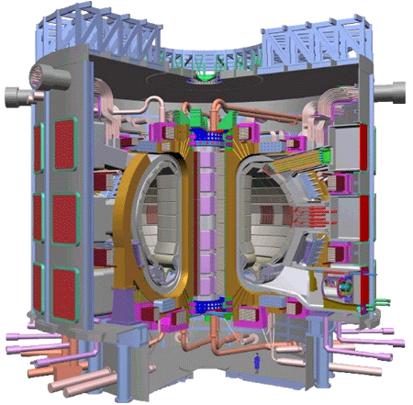
Interaction with Mathematical and Computational Enabling Technologies
Magnetic Fusion Energy
Integrated Science Applications (ISAs) drive
ISA Use Cases
Enabling technologies respond to all
Applied Math
Computer Science

Slide 9
Mathematical and Computational Enabling Technologies
D: Multiphysics and Multiscale Coupling Chair: Jeff Hittinger (LLNL) Co-­chair: Luis Chacon​ (LANL) Focus:​ mathematical formulations (e.g., models, meshing, discretization), algorithms (e.g., solvers and time advancement, coupling between scales and domains), quantitative a posteriori error analysis, verification | F: Data Management, Analysis, and Assimilation Chair: Wes Bethel​ (LBNL) Co-chair: Martin Greenwald​ (MIT) Focus:​ integrated data analysis & assimilation that support end­ to­ end scientific workflows; knowledge discovery methods in multi­modal, high­-dimensional data; integrating data management and knowledge discovery software architectures and systems
E: Beyond Interpretive Simulations Chair: Donald Estep​ (Colorado State Univ) Co-chair: Todd Munson​ (ANL) Focus:​ stochastic inverse problems for parameter determination, sensitivity analysis, uncertainty quantification, optimization, design, control. | G: Software Integration and Performance Chair: David Bernholdt​ (ORNL) Co-chair: Bob Lucas​ (USC/ISI) Focus:​ workflows and code coupling software, performance portability, software productivity and software engineering, governance models for the fusion integrated modeling community

Slide 10
Process Thus Far
Community wide call for whitepapers ending on April 24, 2015:
  Panels received 121 whitepapers
Community Teleconference, May 18–19, 2015:
  Oral presentations from 45 whitepaper submissions.
  Discussions of whitepapers by panels.
Teleconferences among panel chairs / co-chairs and individual panels:
  About 35 teleconferences thus far (March, 2015 – present).
“Writing” workshop held June 2-4, 2015:
  Attended by panel members and “participants at large”.
Workshop report is now being finalized.
Notes:
From 2007 FSP plan: The primary role of simulations at the petascale level in the Fusion Simulation Program will be in off-line computations based on high fidelity, full-dimensional formulations, to produce quantitatively accurate results that will inform the design and operation of expensive experimental systems, such as ITER, and will flow into the construction of more affordable reduced-order models.

Slide 11
Disruption Panel (A): Process
Panel members were selected to balance experimental, theoretical, computational, and applied mathematics perspectives.
The panel held conference calls and exchanged information through e-mail, web postings, and the video conference.
11 whitepapers were invited to ensure coverage of critical topics.
The community submitted a total of 28 whitepapers that listed disruption simulation as primary or secondary area.
  Topics include avoidance, characterization, mitigation, kinetic stability, runaway electron physics, halo currents, external structures, fast linear computation, reduced models, multi-scale modeling, data analytics, and validation.

Slide 12
Workshop Process for Identifying Compelling FES-ASCR Research Directions
Day 2
Day 3
Day 1
Refined FES research directions
(A,B,C)
Refined ASCR research directions
(D,E,F,G)
Preliminary FES research directions
(A,B,C)
Preliminary ASCR research directions
(D,E,F,G)
FES
Breakouts
(A,B,C)
ASCR input
FES
Breakouts
(A,B,C)
ASCR
Breakouts
(D,E,F,G)
Compelling FES- ASCR research directions
FES input
Emphasis:
Role of integrated simulations
Potential for extreme-scale computing
Fusion physics panels: A,B,C
ASCR math/CS panels: D,E,F,G

Slide 13
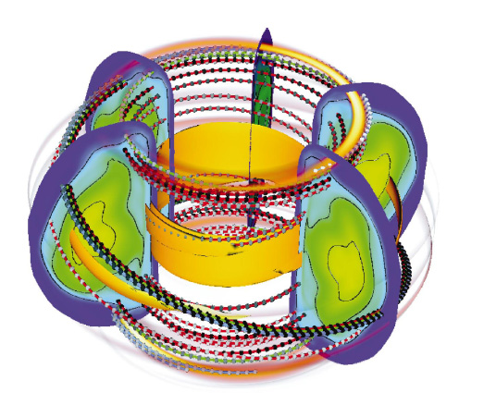
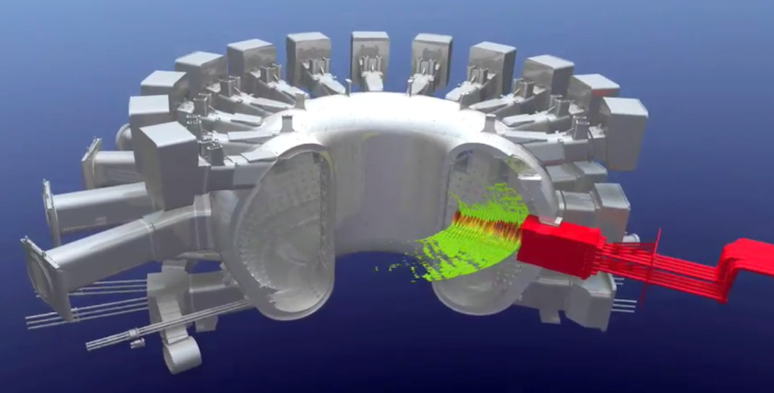
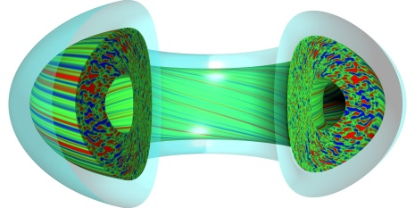
Today’s Approach: Scale Separation
10⁻¹⁰
10⁻⁸
10⁻⁶
10⁻⁴
10⁻²
10⁰
10²
10⁴
sec
RF codes: wave heating & current drive; Fokker-Planck equation for particle response
Average over gyromotion (5D) → Gyrokinetic codes (PIC & continuum): plasma turbulence and transport
Velocity moments of kinetic equation (3D); neglect electron inertia → extended MHD codes: macroscopic stability
Flux surface averaging → 1½ D transport codes: discharge time scales
Adapted from: D.E. Post, J. Fusion Energy, 2005
A number of critical effects (Neoclassical Tearing Modes, Energetic Particles, Disruptions, etc.) are inherently multiscale

Slide 14
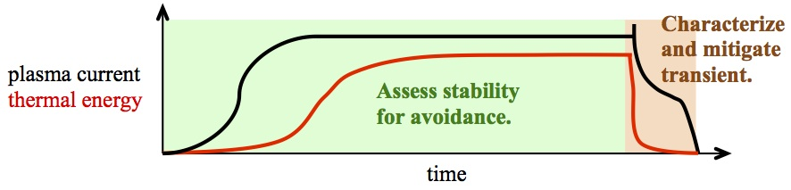
Approach
Two distinct categories of numerical computation are needed:
  Assess macroscopic stability for avoidance.
  Understand and characterize disruptive transients.
“Avoidance” is used to mean both the routine maintenance of the discharge trajectory and last-minute redirection of the discharge if disruption becomes likely.
Disruptive evolution involves nonlinear macroscopic dynamics, relativistic and non-relativistic particle kinetics, electromagnetic responses of external structures, radiation, neutral dynamics, and plasma-surface interaction.

Slide 15
Recent Progress in Disruption Modeling - Highlights
The understanding of externally imposed non-axisymmetric perturbations has improved through validation and benchmarking campaigns.
Synchrotron radiation and scattering effects on the runaway-electron threshold voltage have been analyzed theoretically.
Drift and energetic-ion effects are now considered in linear stability computations and in nonlinear simulation.
Progress on modeling vertical displacement events including:
  2D simulation benchmarking
  Asymmetric wall-force predictions for ITER
  Development of reduced modeling and detailed external electromagnetics.
Majority-species drift kinetics for macroscopic dynamics have progressed analytically and computationally.
Modeling and validation of mitigation through massive gas injection (MGI) reveal causes of toroidal localization.

Slide 16
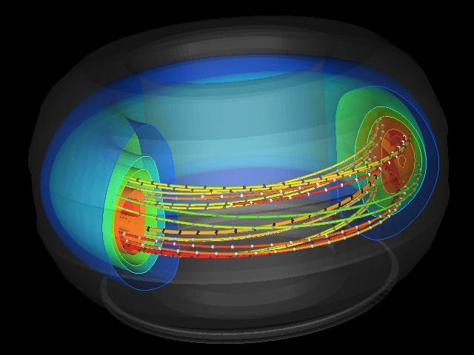
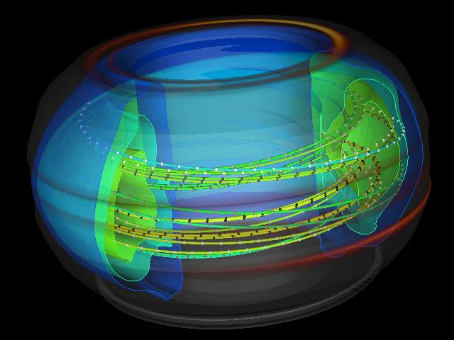
Recent progress in simulating disruptive transients
Nonlinear MHD simulation of global instability leading to thermal quench and localized heat deposition on the surrounding wall (S. Kruger).

Slide 17
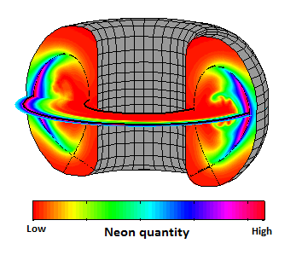
Recent progress in simulating disruption mitigation
Nonlinear 3D MHD simulation combined with radiation modeling of mitigation via massive gas injection (MGI) in DIII-D (V. Izzo).
Simulation shows concentration of edge-injected Ne impurity after dynamic mixing

Slide 18
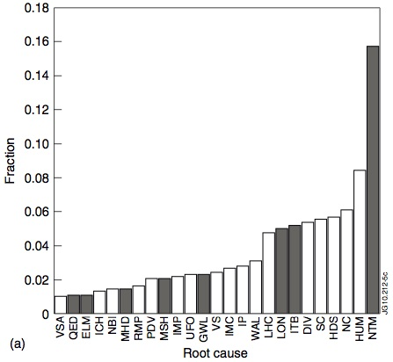
The challenge: JET data base indicates a number of root causes of disruptions in JET
Root causes of disruptions include:
  Inadequate operations planning.
  Failure of feedback control or other systems.
  Natural fluctuations that exceed the nonlinear meta-stability of a confinement state.
NTM’s
P. C. deVries, M. F. Johnson, B. Alper, et al., Nucl. Fusion 51, 053018 (2011).
Notes:
From 2007 FSP plan: The primary role of simulations at the petascale level in the Fusion Simulation Program will be in off-line computations based on high fidelity, full-dimensional formulations, to produce quantitatively accurate results that will inform the design and operation of expensive experimental systems, such as ITER, and will flow into the construction of more affordable reduced-order models.

Slide 19
Challenges and Opportunities - Physics
Avoidance and onset
  The predictive capability of linear stability computation needs validation.
  Locking of resonant magnetic perturbations is a common, yet poorly understood, precursor to disruption.
  Stability at low rotation is less robust than the best numerical predictions.
Thermal quench
  The primary channel of electron energy transport is not known.
  Plasma-surface interaction likely affects the dynamics of disrupting discharges.
Current quench
  Electrical current paths depend on the geometric details of external conductors.
  The experimentally observed electric field for runaway electron generation has not been explained.
  The interaction of relativistic particles with matter is of broad scientific interest.
Mitigation
  The penetration capability of shattered-pellets is not known.
  The significance of rotation and neutral dynamics needs to be studied.

Slide 20
Challenges and Opportunities - Computation
Multiple scales
  Distortions are device-scale; resonant layer thickness is 100 – 1000 times smaller.
  Equilibration is fast relative to island development, wall time, and quench times.
  Modeling kinetic effects increases the dimensionality of the system.
Multi-physics effects
  Present-day 3D simulations use implicit single- and two-fluid modeling with limited external electromagnetics, radiation, and fast-ion kinetics.
  Comprehensive characterization needs plasma-surface interaction, neutral dynamics, majority-species and runaway-electron kinetics.
Data analysis
  Linear stability analysis and initial conditions for nonlinear simulations are based on profiles fitted to experimental discharges.
  Incorporating “kinetic” data and adjusting for quality need to be automated.
  Stability is sensitive to profiles, and uncertainties have not been quantified.

Slide 21
Challenges – Computation (continued)
Code integration
  Radiation and external electromagnetics software have been coupled for mitigation and wall-force studies.
  Coupling RF propagation and deposition has been demonstrated and required significant development.
  Plasma-surface interaction, neutral dynamics, and more detailed external electromagnetics are needed.
Plasma control
  Fast linear stability computation for real-time control may be feasible.
  Accurate and fast profile fitting would be the most challenging aspect.

Slide 22
Crosscutting Issues Identified for ASCR
Validation
  Databases have not been systematically analyzed for linear stability.
  Nonlinear modeling without reduced modeling is computationally expensive.
Multi-scale computation
  Advances in time-integration can facilitate studies of characterization and mitigation.
  Computational performance depends on algebraic solvers.
Implicit computation on new architectures
  Implicit computation provides as much as 4 orders of magnitude performance improvement over explicit computation.
  Wave-propagation physics leads to mathematical stiffness and ill-conditioned algebraic systems.
Data analysis
  Profile reconstruction uses a number of input channels.
Software integration
  New combinations for multi-physics computation are expected.

Slide 23
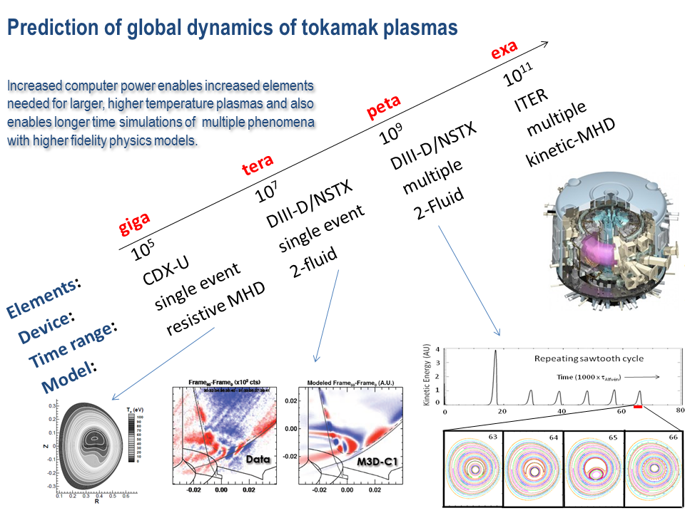
Impact of HPC Advances on Macroscopic Stability: from CDX-U to ITER
HPC has enabled significant advances in Extended MHD
CEMM (S. Jardin, PPPL)

Slide 24
Recommendations and Path Forward
“Priority Research Directions”
Develop integrated simulation that models all forms of tokamak disruption from instability through thermal and current quenches to the final deposition of energy with and without mitigation.
  Modeling capable of addressing fundamental questions on mode locking, runaway-electron generation and evolution, and open-field currents.
  Integrated modeling will facilitate the engineering of effective mitigation systems.
Develop a profile-analysis system that automates reconstruction and coordinates transport modeling and stability assessment for disruption studies.
  Automated profile analysis will benefit all forms of disruption modeling.
  Automation is a necessary step for real-time analysis.
Verify and validate linear and nonlinear computational models to establish confidence in the prediction and understanding of tokamak disruption physics with and without mitigation..
  Validation methodology will help judge what effects are most important.
  Prospect for predictability need to be addressed.

