Slide 1
Wall current calculations for an NSTX VDE
J. A. Breslau, J. Bialek, A.H. Boozer, and A. Bhattacharjee
Workshop on Theory and Simulation of Disruptions
Princeton, NJ
July 13, 2015

Slide 2
Outline
Verification of M3D with the DSC test problem
Equilibrium & stability
Nonlinear saturation of free boundary kink
Nonlinear saturation of wall-touching kink
NSTX VDE study
Experimental observations
M3D results
IVB results
Conclusions

Slide 3
The DSC Test Problem
Straight cylinder equilibrium, circular cross-section
Plasma minor radius at r=0.6, tile surface at r=0.7, ideal wall at r=1.0.
Tile surface behaves as a perfect insulator before plasma reaches it; perfect conductor thereafter.
Plasma interior q≡1.0; edge q=0.75.
Plasma pressure low, flat; conductivity infinite.
Evolve 1,1 external kink mode with 2D version of Disruption Simulation Code (DSC) called Cbwtk.
Implements Kadomtsev-Pogutse single helicity MHD model.
Eliminates inertia by replacing the momentum equation with

Slide 4
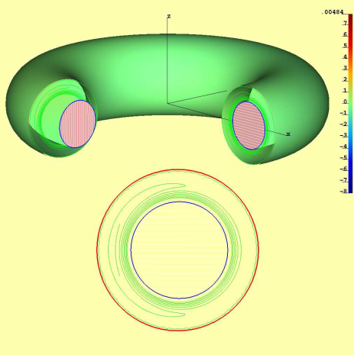
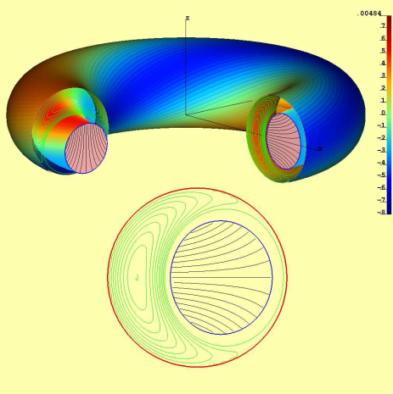
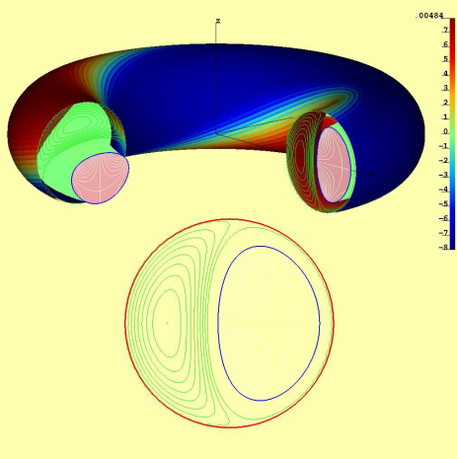
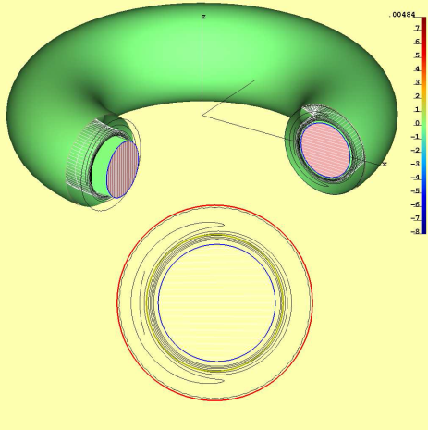
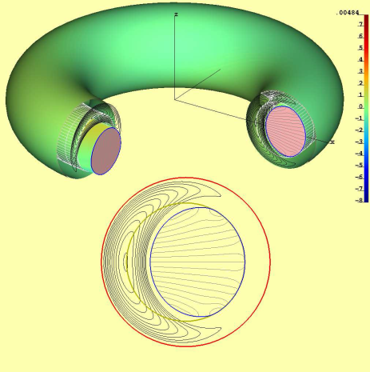
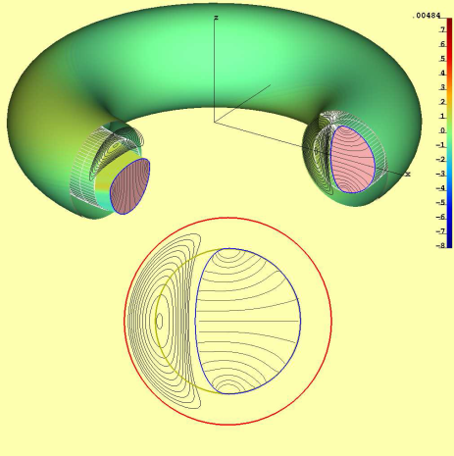
DSC Results
Free boundary kink (FBK) with ideal wall
Initial perturbed plasma
Fast phase of instability
Saturation of the mode
Wall-touching kink (WTK) at tile surface
Initial perturbed plasma
Fast phase of instability,
excitation of Hiro currents
Saturation of the mode
due to Hiro currents
L. Zakharov

Slide 5
Approximation used for M3D equilibrium
Large-aspect-ratio torus, circular cross-section.
In plasma (0 ≤ r ≤ a-δ), constant p and q provided by :
In boundary layer (a-δ ≤ r ≤ a) q→q_{a}, p drops linearly:
In vacuum, p is low, J vanishes, fields are continuous:
Here, q₀=B₀=1, q_{a}=0.75, a=0.6; the aspect ratio R₀, layer thickness δ, and pressure ratio p₀/ε are free parameters, and

Slide 6
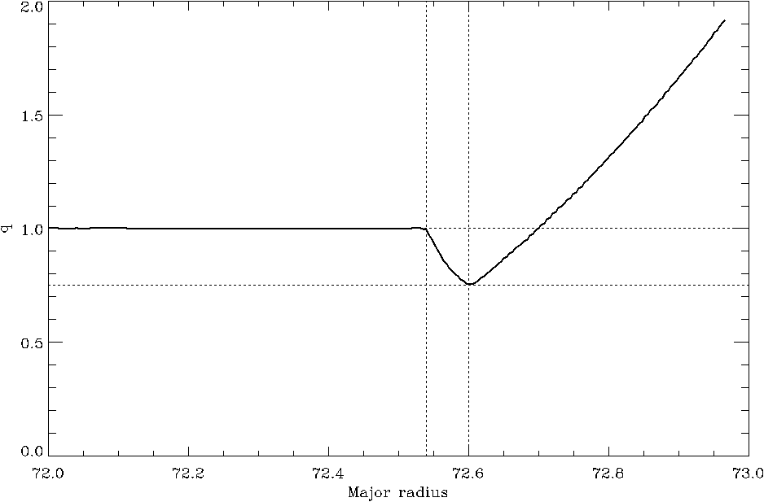
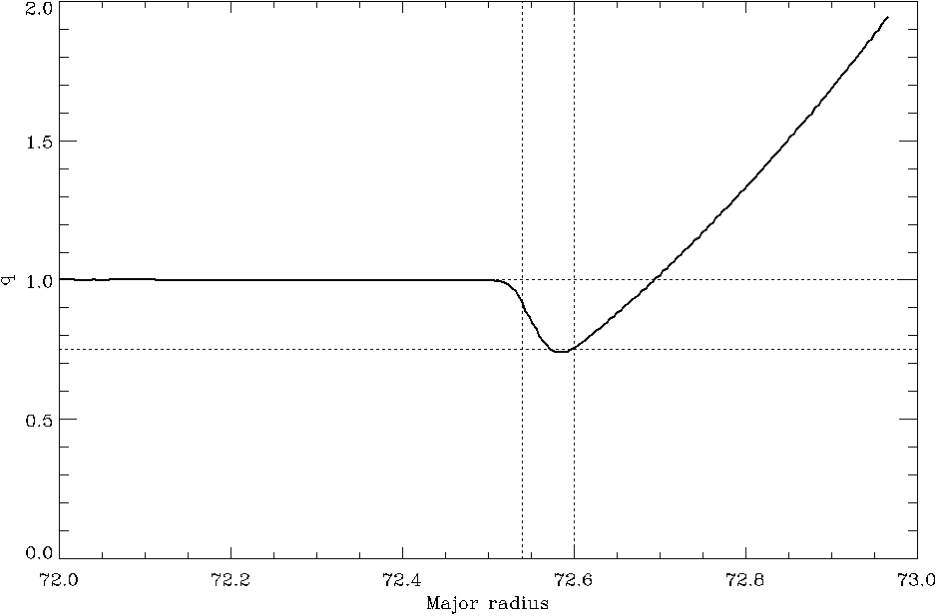
Profiles
R₀=72, δ/a=0.1, p₀/ε=100, n₀/n_{vac}=1 → T₀/T_{vac} = 100
191 radial zones
10% boundary, 190 radial, before relaxation
pressure
q
10% boundary, 190 radial, after relaxation
toroidal
current
density
q

Slide 7
The kink perturbation
The DSC perturbation is a small helical deformation of the plasma surface:
This is a rigid rightward displacement of the plasma column.
M3D perturbs the incompressible poloidal velocity stream function to achieve the same effect:
Run linearly to find eigenmode, then use it as small initial perturbation for 3D nonlinear calculation.

Slide 8
Linear eigenmode calculation
n=1 eigenmode
is a 1,1 external kink
current and flow patterns
γτ_{A} = 0.00583
Details:
η_{plas} = 10⁻⁶; η_{vac} ≈ 9.5 × 10⁻⁴; η_{wall} = 0
μ = 10⁻⁵; μ_{H_tor} = 0
κ⊥ = 10⁻⁶; κ|| = 500
density evolution off
Rigid displacement of plasma column
Rearrangement of “vacuum” to avoid compression
1,1 toroidal current sheets of both signs at plasma boundary

Slide 9
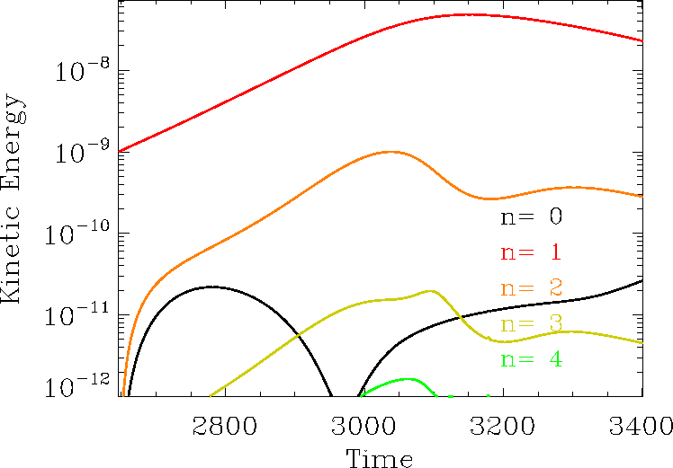
3D nonlinear behavior, ideal wall only (FBK)
Details:
η_{plas} = 10⁻⁶; η_{vac} ≈ 9.5 × 10⁻⁴; η_{wall} = 0
μ = 10⁻⁵; μ_{H_tor} = 10⁻³
κ⊥ = 10⁻⁶; κ|| = 5 × 10²
initial pert.: n=1 only
density evolution off
ohmic heating on
0 ≤ n ≤ 20 (64 planes)
γτ_{A} = 4.60 × 10⁻³
n=1 KE saturates at 4.804 × 10⁻⁸
in 504 Alfvén times.

Slide 10
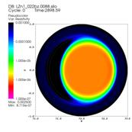
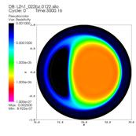
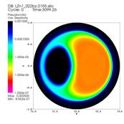
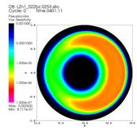
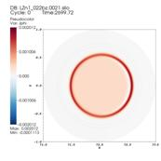
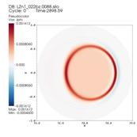
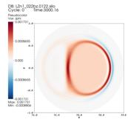
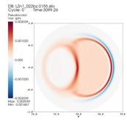
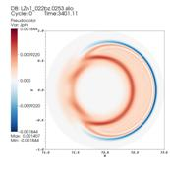
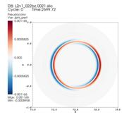
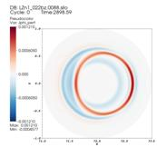
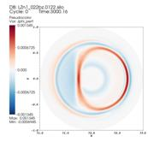
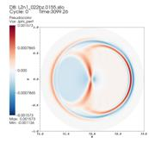
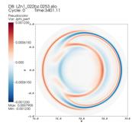
Snapshots of FBK
 | t = 2700 | t = 2900 | t = 3000 | t = 3100 | t = 3400
Resistivity
Net J_{ϕ}
Perturbed J_{ϕ}

Slide 11
Segmented Tile Model
Tiles are modeled as an annular region inside the computational domain from r=0.7 to r=0.7+δ.
When not wetted, tiles behave as ordinary vacuum/plasma (η ∝ T^{-3/2}).
For wetted region of tile surface (0.7 < r < 0.7+δ AND p > [p_{max} + 3p_{min}]/4), we set η ≡ η_{tile} ≤ η_{plasma}.
Outer boundary of annulus is cold (T = ε for r > 0.7+δ), chills plasma when in thermal contact.
No special conditions are imposed on velocity or force balance in tile region.

Slide 12
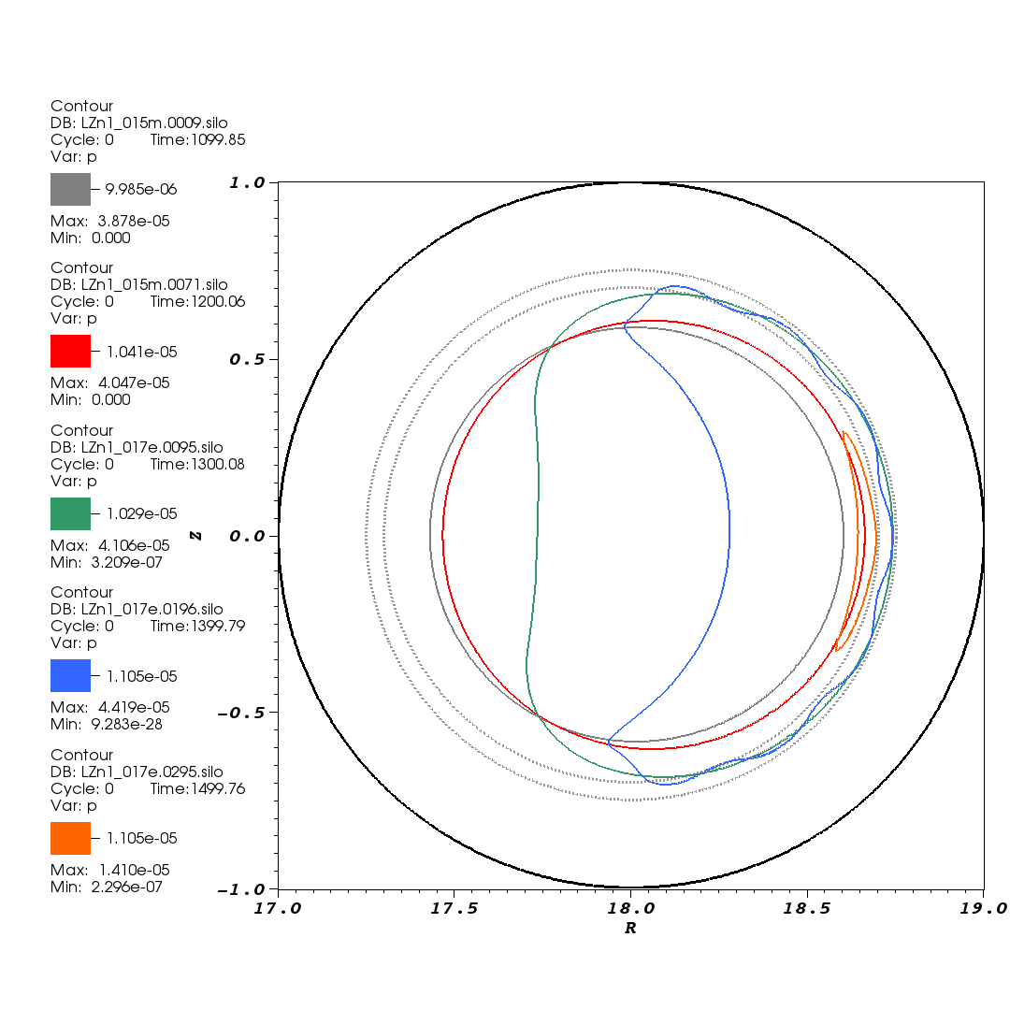
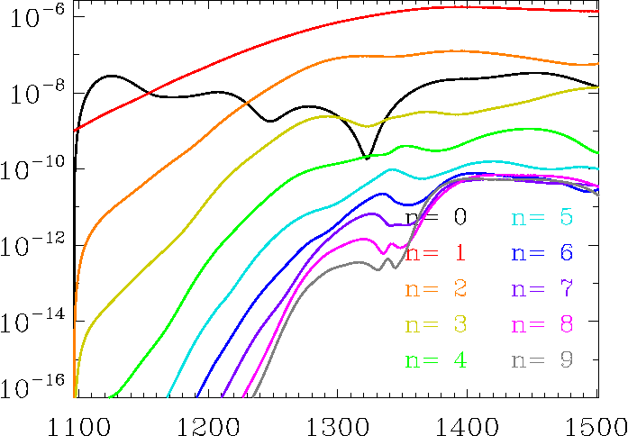
3D Nonlinear behavior with tile surface at 0.7<r<0.75, only wetted part conducting, outer edge cold, 0 ≤ n ≤ 9 (WTK)
Approx. plasma boundary vs. time
Ideal wall
LZn1_017e
Tile
annulus
γτ_{A} = 1.83 × 10⁻²
γτ_{A} = 3.13 × 10⁻²
Details:
η_{plas} = 10⁻⁶; η_{vac} ≈ 9.5 × 10⁻⁴; η_{wall} = 0; η_{tile} ≈ 10⁻⁷
μ = 10⁻⁵; μ_{H_tor} = 10⁻³
κ⊥ = 10⁻⁶; κ|| = 5 × 10²
density evolution off
ohmic heating on
Saturates in 300 Alfvén times,
develops higher-m corrugations, then annihilates on tile surface.

Slide 13
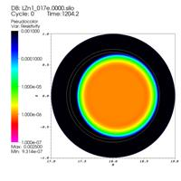
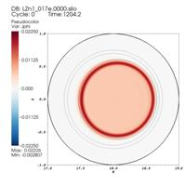
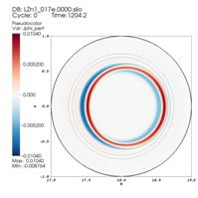
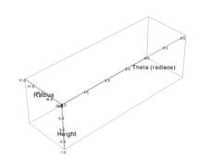
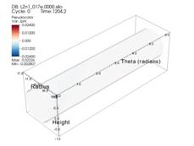
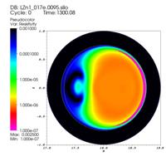
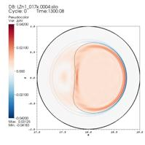
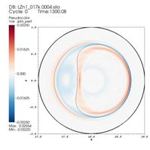
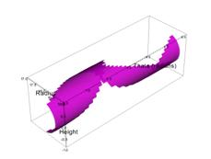
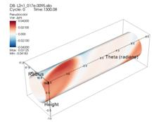
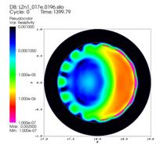
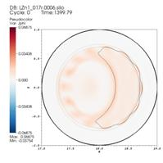
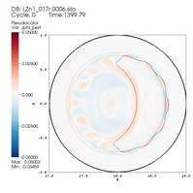
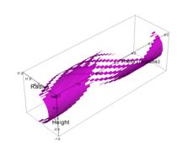
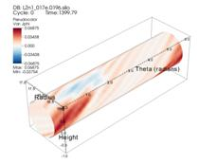
Snapshots of WTK
 | Resistivity | Net J_{ϕ} | Perturbed J_{ϕ} | Wetted region | Net J_{ϕ} on tiles
t = 1204
t = 1300
t = 1400

Slide 14
Summary of verification results
The M3D code can represent a reasonable facsimile of the ideal straight-cylinder equilibrium with surface current.
M3D sees more complex behavior than the idealized saturated kink solution, namely unstable modes with n>1 and the formation of a vacuum bubble.
The interaction of the plasma surface currents with the ideal wall in the free boundary kink case is in line with the DSC result.
In the wall-touching kink case, tile currents interact with the plasma surface (“Hiro”) current to slow plasma motion, as in the DSC result. As in DSC, the plasma retains finite velocity normal to the tile surface, and can penetrate it on a time scale longer than that of the ideal kink.

Slide 15
Outline
Verification of M3D with the DSC test problem
Equilibrium & stability
Nonlinear saturation of free boundary kink
Nonlinear saturation of wall-touching kink
NSTX VDE study
Experimental observations
M3D results
IVB results
Conclusions

Slide 16
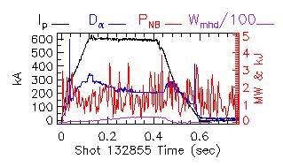
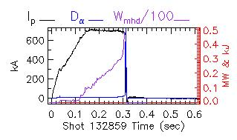
NSTX XP833 (2010): Halo current dependencies on I_{p}/q₉₅, vertical velocity, and halo resistance
Reference shot without forced disruption drive, based on 129416:
Shot 132859, with deliberately misadjusted vertical field control, terminates in VDE:
S. Gerhardt

Slide 17
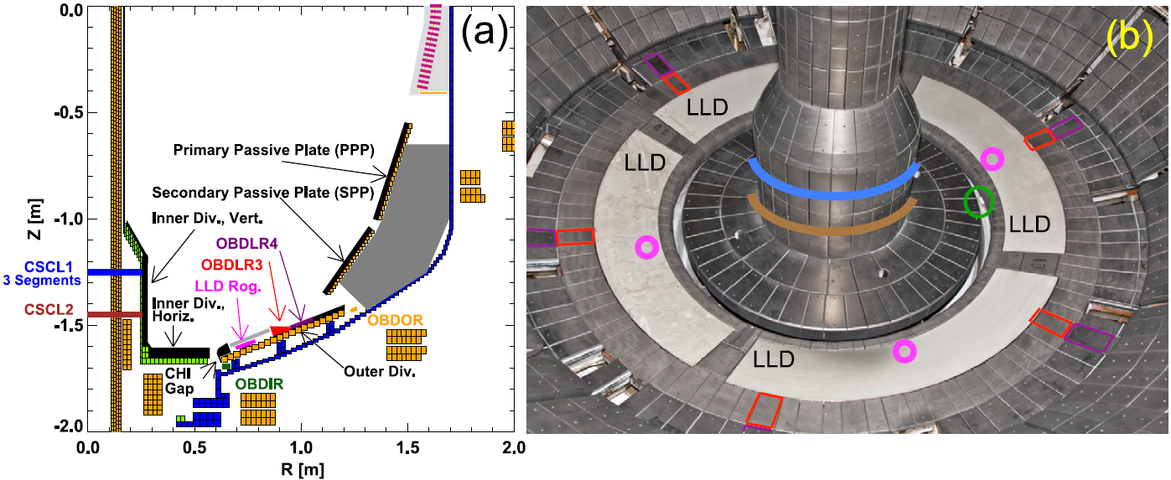
Layout of NSTX halo current diagnostics
Halo current is inferred from transient TF measurements under several divertor tiles and plates at about six toroidal locations. Transient vessel forces are not measured.
Figure reproduced from S.P. Gerhardt, J. Menard, S. Sabbagh and F. Scotti, Nucl. Fusion 52 (2012).

Slide 18
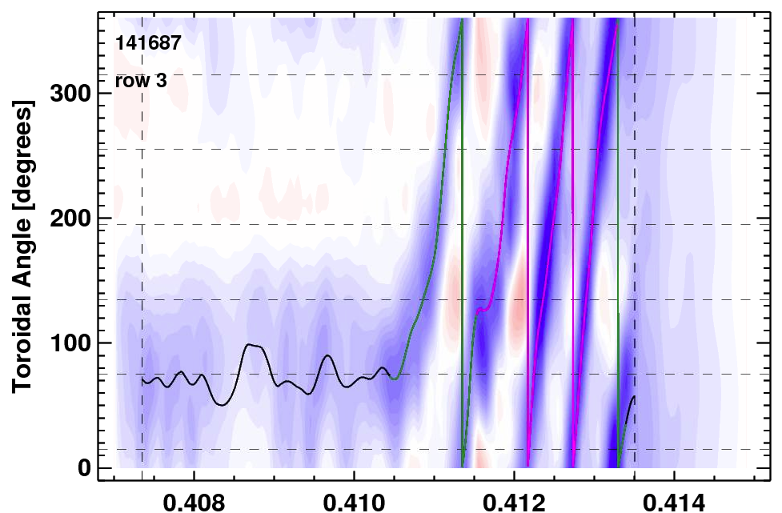
Strongly Non-Axisymmetric Halo Currents Detected in the NSTX Lower Divertor
141687
Row 3
300
200
100
0
Toroidal Angle φ [degrees]
0.408 0.410 0.412 0.414
Time [s]
Infer strong toroidal asymmetry, often with significant rotation, at locations where currents enter the divertor floor.
Key Observations
Dominant structure is typically a toroidally-rotating lobe.
Rotation is typically in the counter-direction, except for short bursts.
S. Gerhardt

Slide 19
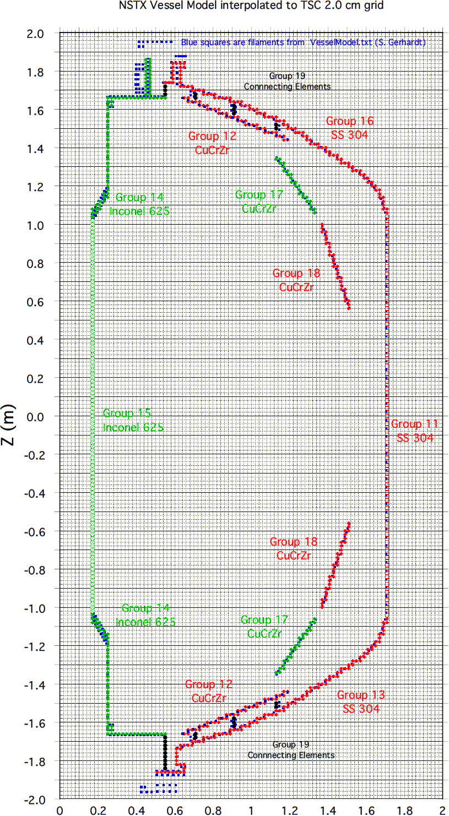
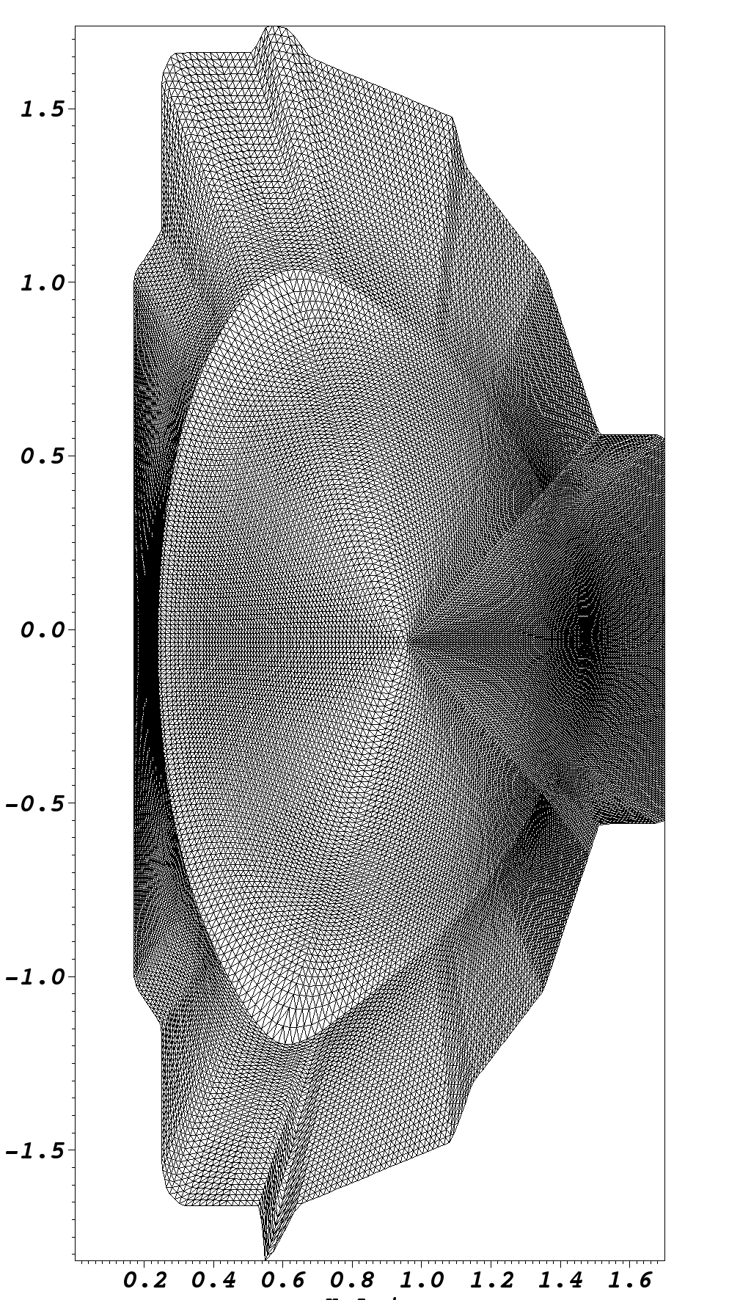
Meshing the NSTX Vessel for Simulation
Mesh aligned to equilibrium flux surfaces inside separatrix
Fairly uniform spacing in vacuum region
Thin, axisymmetric uniformly resistive shell
Each poloidal section has up to
115 radial zones
79,350 triangular elements
40,021 vertices
690 boundary vertices
R (m)

Slide 20
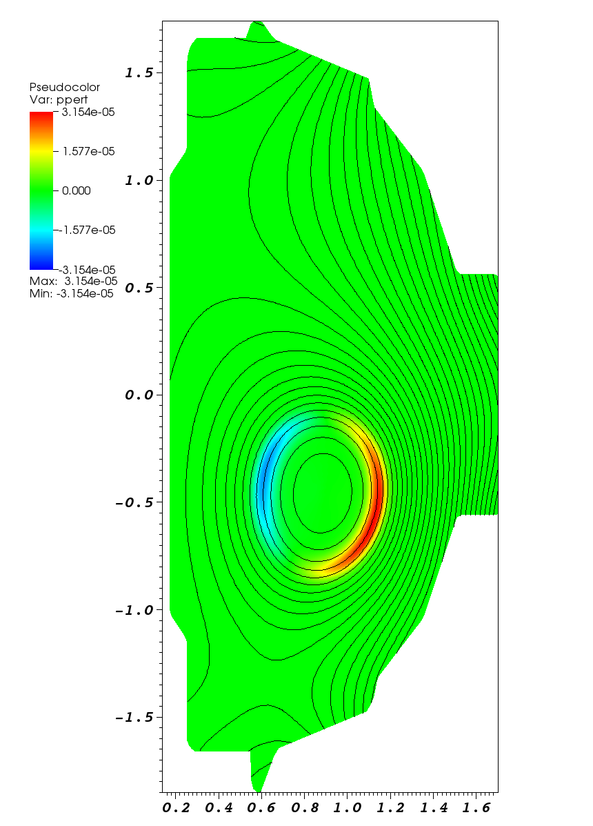
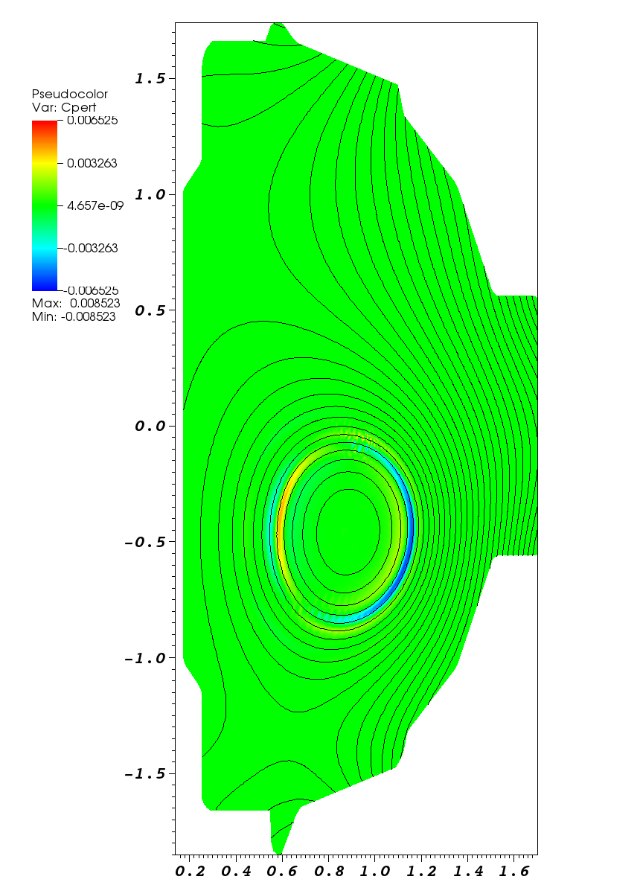
n=1 eigenmode
η₀ | 5 × 10⁻⁸
η_{vac} | 1.67 × 10⁻⁴
η_{wall} | 0
μ₀ | 5 × 10⁻⁷
μ_{edge} | 10⁻⁴
κ⊥ | 10⁻⁵
κ|| | 10⁻¹
Perturbed pressure
Perturbed current
z
z
Predominantly 1,1
mode at q=1 surface.
γ ≈ 6.5 × 10⁻²
R
R

Slide 21
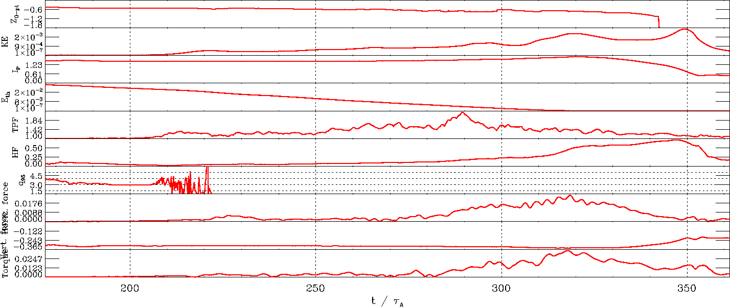
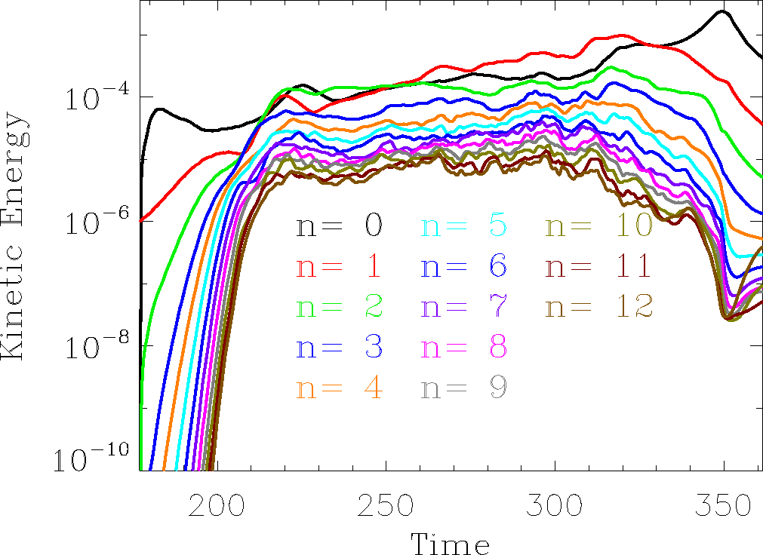
Time History (nonlinear 3D phase)
Peak F_{h} = 0.025
Peak F_{v} = -0.347
η₀ | 5 × 10⁻⁸
η_{vac} | 1.67 × 10⁻⁴
η_{wall} | 10⁻⁴
μ₀ | 5 × 10⁻⁷
μ_{edge} | 10⁻⁴
κ⊥ | 10⁻⁵
κ|| | 10⁻¹
By Mode Number
By Mode Number

Slide 22
Snapshots of Nonlinear Evolution
t = 177.14
t = 222.99
t = 284.15
t = 361.49
Ideally unstable displaced plasma
Instability couples many toroidal & poloidal modes…
…leading to rapid thermal quench.
Current quench follows.

Slide 23
Halo Current Distribution at Peak
t = 323.88
n=1 component strongly dominates over n=0.
Current peaks on lower Group 12 plate.

Slide 24
Halo Current Distribution vs. Time

Slide 25
Coupling to IVB
To assess plausibility, self-consistency of halo current results.
Current-voltage branch code developed by J. Bialek to explore halo current distributions in vessel components.
User supplies exterior dB/dt, J_{normal}, and reference nodal voltages.
IVB solves for time-dependent current and voltage in arbitrary conducting structures composed of 1D, 2D, and 3D elements.
M3D simulation data selected from two representative time slices.
Frame 132, t = 205.07: linear phase of instability; halo currents still axisymmetric.
Frame 676, t = 323.88: peak KE & current, high HF, peaking factor.
J_{normal} on axisymmetric shell interpolated onto 2D and 3D engineering models; plasma current distribution ignored for first pass.

Slide 26
Axisymmetric IVB Model
Conforms to M3D boundary.

Slide 27
Frame 132 current distribution
Cutaway view
Bottom view
Arrow scale: surface current density
up to 12 kA/m
Arrow scale: surface current density
up to 3.5 kA/m

Slide 28
Frame 676 current distribution
Cutaway view
Bottom view
Arrow scale: surface current density
up to 142 kA/m
Arrow scale: surface current density
up to 172 kA/m

Slide 29
3D IVB Model
Vacuum vessel
Stabilizer plates
&
mounting brackets
Center stack
Midplane control
coils
Midplane ports
not modeled
Poloidal breaks
Four ground points via CHI busbar system

Slide 30
Mapping frame 132 J_{normal} onto 3D model
Cutaway view
Bottom view

Slide 31
Frame 132 current distribution
Cutaway view
Exterior view
Arrow scale: surface current density
up to 6 kA/m
Arrow scale: surface current density
up to 6 kA/m

Slide 32
Mapping frame 676 J_{normal} onto 3D model
Cutaway view
Bottom view

Slide 33
Frame 676 current distribution
Cutaway view
Bottom view
Arrow scale: surface current density
up to 492 kA/m
Arrow scale: surface current density
up to 517 kA/m

Slide 34
Summary of VDE results
MHD simulation plausibly accounts for most observed qualitative features of NSTX VDEs, including degree of toroidal peaking.
Substantial differences exist between 2D and 3D IVB results, suggesting that a more sophisticated 3D model should be used to achieve accuracy in a self-consistent MHD calculation.

Slide 35
Outline
Verification of M3D with the DSC test problem
Equilibrium & stability
Nonlinear saturation of free boundary kink
Nonlinear saturation of wall-touching kink
NSTX VDE study
Experimental observations
M3D results
IVB results
Conclusions

Slide 36
Conclusions
The validation study provides strong evidence that traditional MHD codes can be useful for disruption halo current calculations.
Should be followed up with calculations with the tile wall at the mesh boundary.
The 3D DSC code should be able to reproduce the vacuum bubble result.
The NSTX VDE calculations show good qualitative agreement with experiment, but coupling to IVB demonstrates that quantitative prediction may require a 3D thick wall model.
M3D-C1 now implements such a model and should be used for follow-up work.
Forthcoming IVB calculations using dI/dt coupling to get eddy currents should provide further insight.

Slide 37
Extra Slides

Slide 38
Current sheet resolution (detail)

Slide 39
Higher n modes
n=2 eigenmode
n=3 eigenmode
γτ_{A} = 0.00368 ± 0.00043 (htor=0.001);
γτ_{A} = 0.00832 ± 0.00004 (htor=0.0)
γτ_{A} = 0.0007 ± 0.0001 (htor=0.001);
γτ_{A} = 0.00875 ± 0.0001 (htor=0.0)

Slide 40
Current evolution during WTK
Net toroidal current
wetting
begins
Current in tile annulus

Slide 41
Toroidally Asymmetric Halo Current Figures of Merit
Halo fraction (HF): If there are N poloidal planes, j=1,2,3,…,N, then
where I_{p0} is the total plasma current in the initial equilibrium.
Toroidal peaking factor (TPF):

Slide 42
Key Parameters for NSTX VDE calculation
Plasma resistivity on axis* η₀=S⁻¹ | 5 × 10⁻⁸
η_{vacuum} / η₀ | 3333
η_{wall} / η₀ | 2000 (τ_{w}/τ_{A}=10,000)
Prandtl number μ / η₀ | 10
Perpendicular heat conduction κ⊥ / η₀ | 200
Parallel heat conduction κ||/ η₀ | 2,000,000
Density evolution | Off (uniform, constant)
Size of initial n=1 perturbation (post-2D) | 10⁻⁶
Number of toroidal modes | 12

Slide 43
Time History (nonlinear 2D VDE phase)
η₀ | 6 × 10⁻⁵
η_{vac} | 2 × 10⁻¹
η_{wall} | 1.2 × 10⁻¹
μ₀ | 6 × 10⁻⁴
μ_{edge} | 1.2 × 10⁻¹
κ⊥ | 10⁻⁵
κ|| | 10⁻¹
q₉₅ is projected to reach 2.0 at t=58.7 (about seven wall times).

