Slide 1
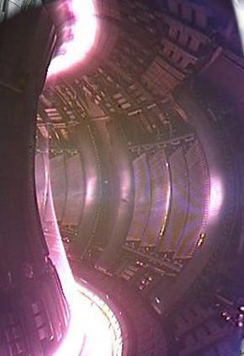
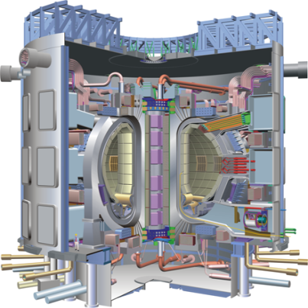
Developments in Shattered Pellet Technology and Implementation on JET and ITER
L.R. Baylor, S.J. Meitner,
S.K. Combs, G.E. Gebhart,
D. Rasmussen*, M. Lyttle*, P.B. Parks#
ORNL, *USITER, #GA
M. Lehnen, S. Maruyama, U. Kruezi
ITER
J. Wilson, G. Ellwood, A. Muir
JET- CCFE
Theory and Simulation of Disruptions Workshop, PPPL
17-July-2017

Slide 2
Outline
SPI R&D overview
SPI Deployment on JET
ITER DMS Issues for SPI
JET SPI experimental opportunities
U.S. input to the JET disruption taskforce: proposal titles due Aug. 4, full proposals in Sept.

Slide 3
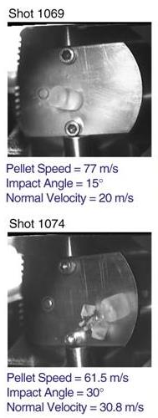
SPI: History
Pellets are known to shatter when hitting a surface with enough perpendicular velocity
D₂ fueling pellets hitting an inclined plate shatter when the normal velocity >30 m/s.
This motivated the development of shatter plates and tubes to form collimated sprays of pellet material that penetrate deeply in a short duration.
The shattered material prevents impact damage to the first wall and increases ablation.
Mixed species D₂/Ne SPI allows control of mitigated disruption properties
Combs, et al.

Slide 4
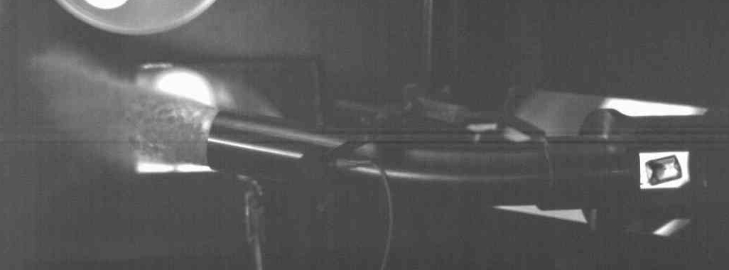
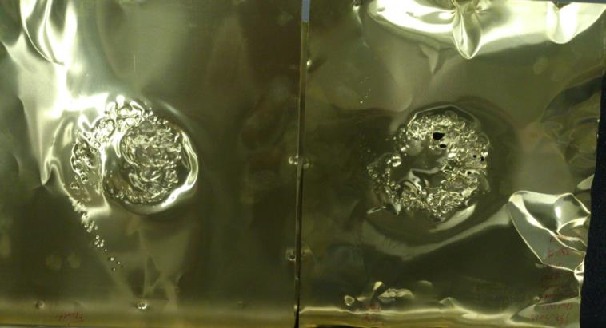
Shattering Occurs from Transit Through Bent Tube Resulting in ~15º Dispersion
Neon Pellet in 20º Shatter Tube
Foil
Impacts

Slide 5
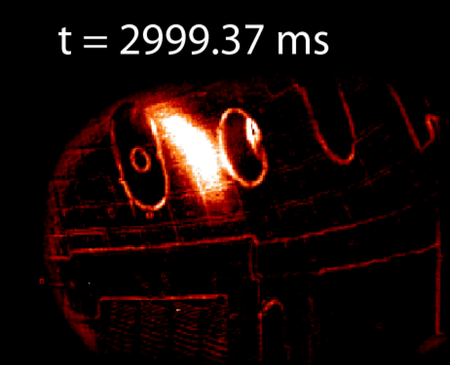
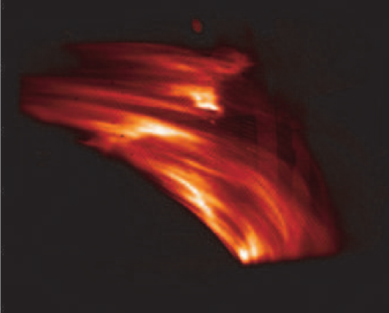
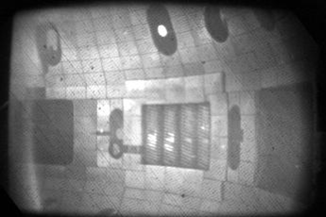
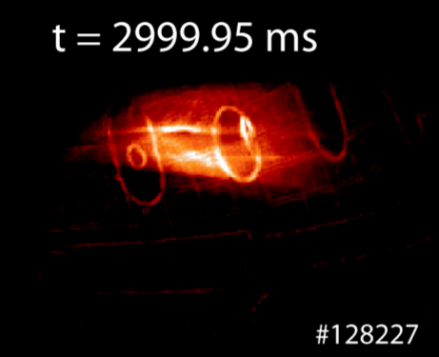
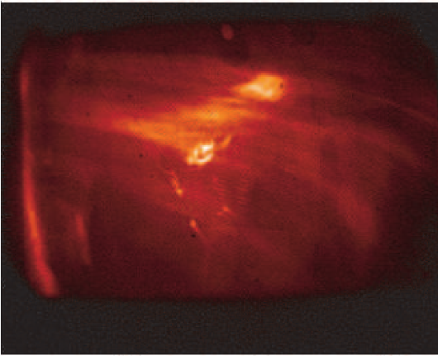
Shattered Pellet Injection (SPI) shows benefits over Massive Gas Injection (MGI) – only used on DIII-D
MGI
SPI
Thermal Quench
TQ
#128227
#138212
“normal” view using the fast framing camera
Current Quench
CQ
Commaux, et al., Nucl. Fus. 2011
#138212
Fast visible camera images

Slide 6
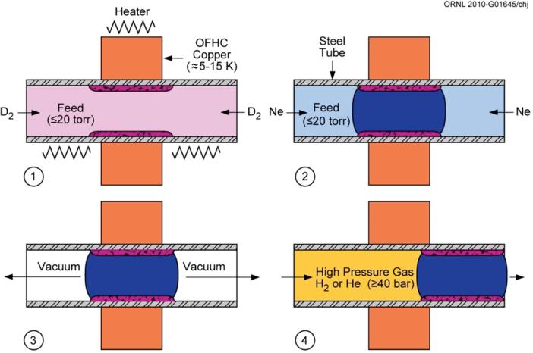
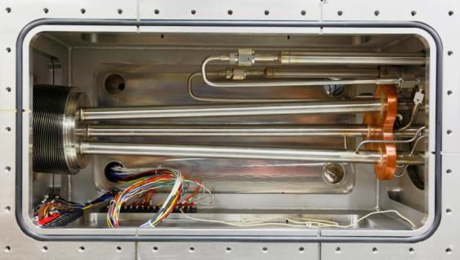
3-Barrel SPI design has been developed for ITER and deployed on DIII-D and soon on JET
Barrel inner diameter can vary in order to study scaling of D₂ and neon SPI
SPI uses MGI like valves to accelerate pellets and can be used as MGI system when no pellet is formed.
D₂, D₂/Ne, Ne, Ar* are possible
View of freezing process from end of barrel

Slide 7
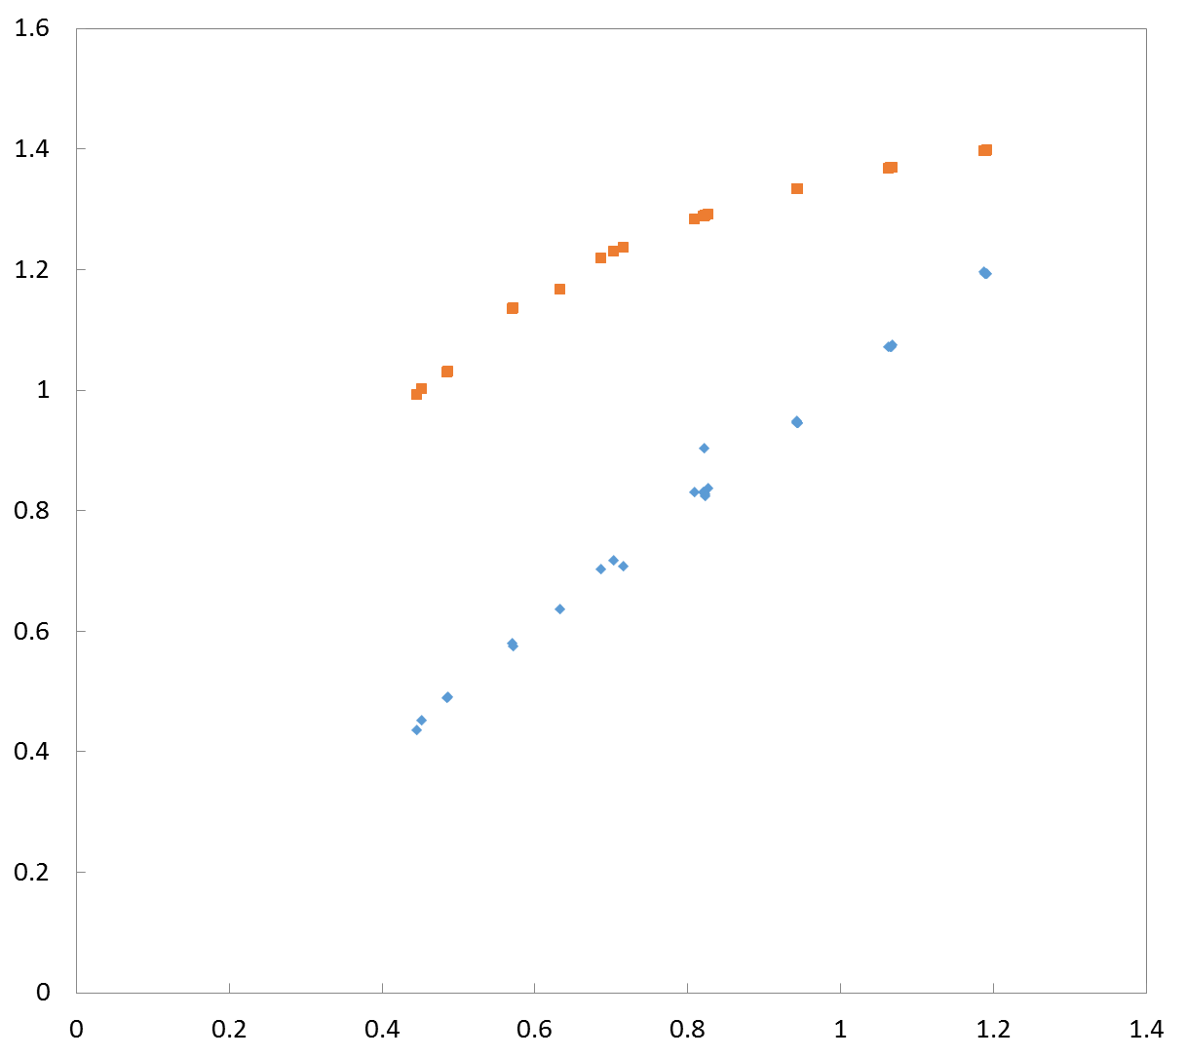
Mixed D₂/Neon Pellet Density Agrees
with the Alloy-Based Model
Average Model
Predicted Density (g/cm³)
Alloy Model
Experimental Density (g/cm³)
The required SPI pellet size for a given mixture ratio and quantity of material is now well understood. (Parks 2017)

Slide 8
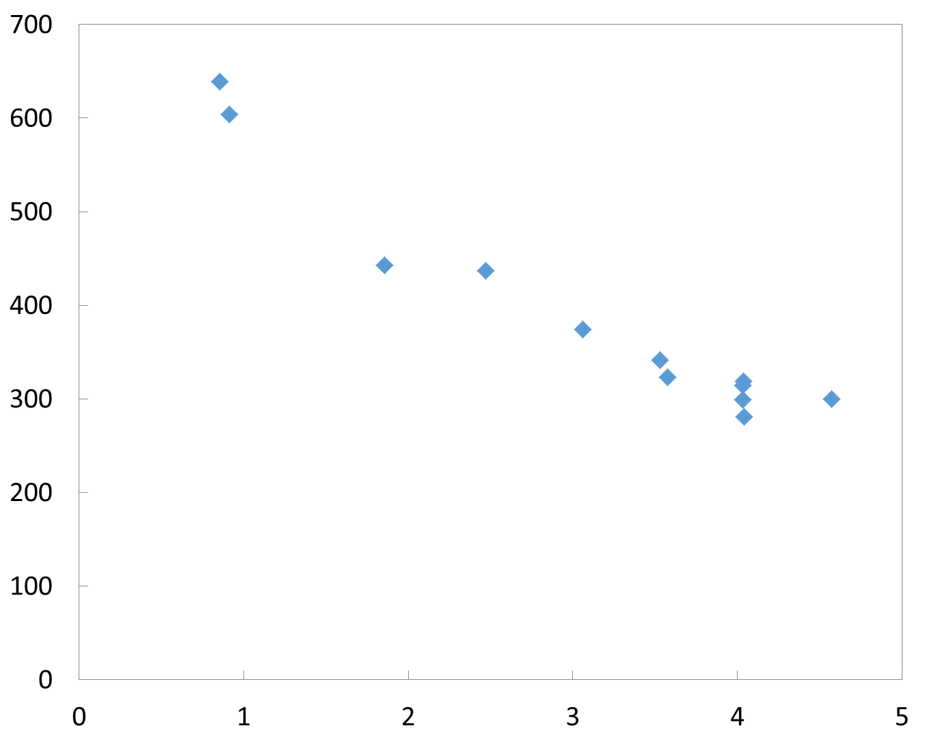
Mixed D₂/Neon Pellet Speed Decreases as the Neon Fraction and Pellet Mass Increases
Speed (m/s)
Mass (g)
The SPI pellet speed is a strong function of the mass for a given pellet size and gas valve pressure as expected from ideal gun theory. A factor of 2 range in speed is expected for SPI D2/Ne mixtures.

Slide 9
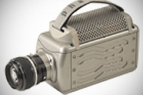
Argon SPI pellets have now been made and shot with the use of a gas driven mechanical punch
Cold Zone
Fast Camera
Argon and pure neon (with no D2 shell) are difficult to break free from the cold barrel with gas. A mechanical punch is employed to break the pellet free, then gas accelerates it.
D₂
Ar
The argon triple point of 87K is much higher than that of Ne (24.5K) and D2 (18.7K). Mixtures with Ar are there not possible. Layered pellets with Ar in front or rear are possible.
Combs, 2015

Slide 10
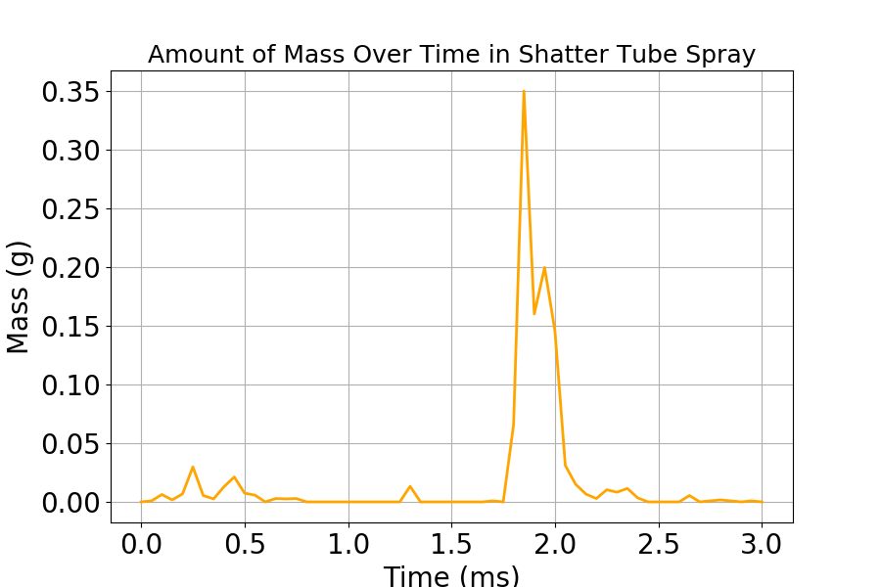
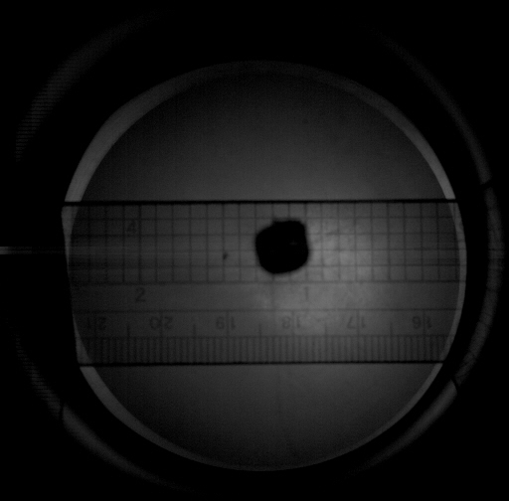
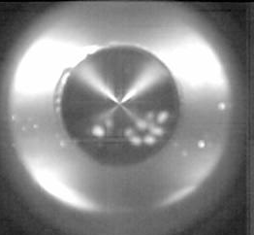
A typical Argon SPI post-shatter particle size distribution determined from the fast camera data
Argon formed at 30 K
650 mbar L of Ar
L/D = 1.51
Fired at 55 K
Speed = 156 m/s
Mass of Pellet = 1.18 g
Mass of Particles = 1.14 g
T. Gebhart, 2017
V = 156 m/s

Slide 11
The particle size distribution compares favorably to a Statistical Fragmentation Model by Parks
Ar SPI
based on Energy and Maximal Entropy

Slide 12
The particle size distribution for D₂ pellets also compares favorably to the Statistical Fragmentation Model
16mm D₂ Test, Commaux 2009
D₂ SPI

Slide 13
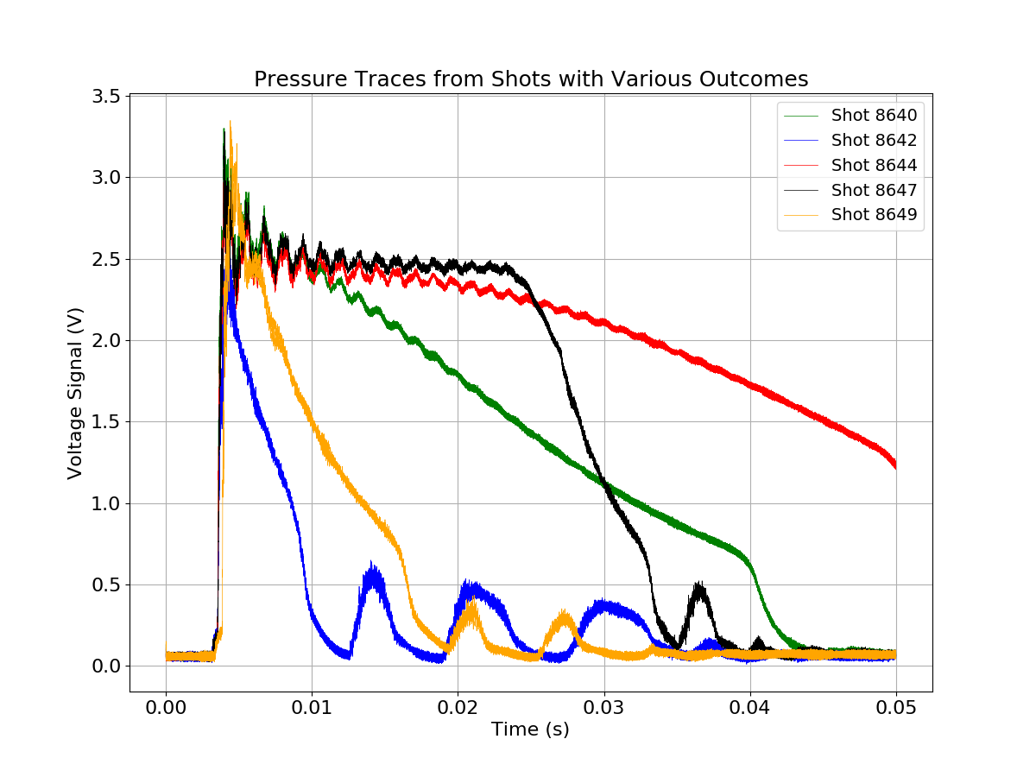
Pressure in the valve can be used to determine whether or not the pellet was successfully fired
System Parameters:
16.5 mm Barrel ID (16.5mm diameter pellets)
Large Orifice Valve Operated at 600 PSI , 0.85 L
1 Volt = ~13.8 Bar (200 PSI)
Explanation of Shots:
Shot 8640 (Green) – Pellet stuck and gas penetrated through center.
Shot 8642 (Blue) – Valve shot with no pellet or mass in barrel.
Shot 8644 (Red) – Pellet stuck and pressure slowly released.
Shot 8647 (Black) – Pellet fired after sticking in the barrel for 25 ms.
Shot 8649 (Yellow) – Good shot, 50-50 D₂-Ne mix, 405 m/s.

Slide 14
Outline
SPI R&D overview
SPI Deployment on JET
ITER DMS Issues for SPI
JET SPI experimental opportunities
U.S. input to the JET disruption taskforce: proposal titles due Aug. 4, full proposals in Sept.

Slide 15
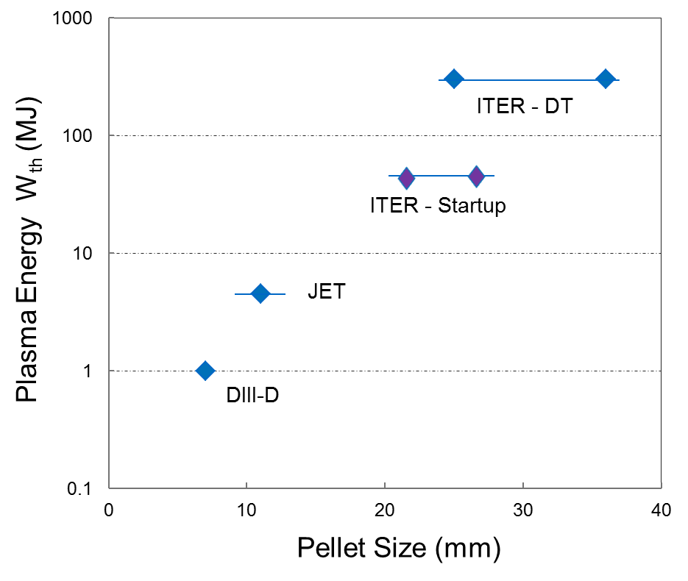
JET provides extrapolation toward ITER and future fusion system energy dissipation needs
10²²
10²³
10²⁴
10²⁵
Pellet Atoms (Neon)

Slide 16
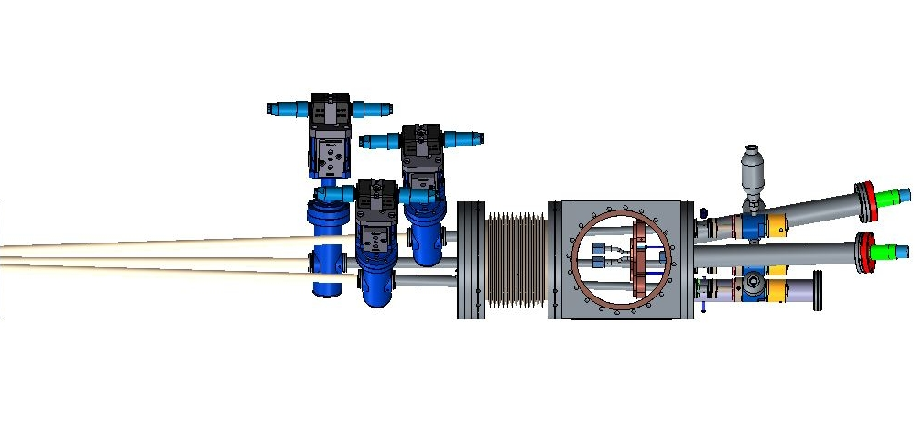
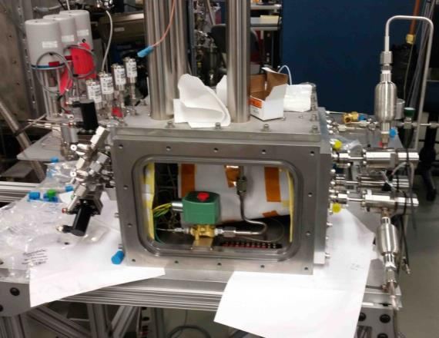
SPI 3-barrel concept for ITER to be deployed on DIII-D and JET to help answer key questions for ITER
An SPI for JET has been designed based on the same design. Limits
pellet size to 12.5mm (6 bar-L of neon).
Major difference is Tritium compatibility requiring more rigorous QA. Good practice for ITER.
SPI2 has been installed and on DIII-D in February 2017– initial experiments under way. (D. Shiraki, N, Eidietis)
3 pellets can be fired together or serially.

Slide 17
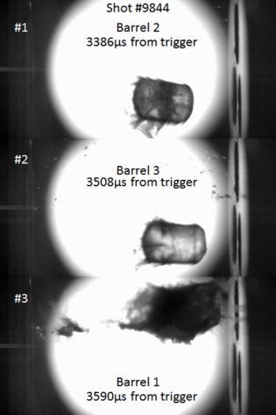
JET SPI capabilities
Three pellets of different sizes
D₂/Ne/Ar or D₂/Ne mixture
~0.1 bar.L to 6 bar.L (10²¹ – 10²³) per pellet
12.5*, 8, 4 mm sizes - *argon punch
Independent firing
timed or simultaneous (±0.2ms)
(signal delay TBC)
Pellet speed ~100–250m/s (max 500m/s with D₂)
flight time ~20-50ms
Plasma edge arrival time known to <2 ms
Notes:
Layered pellets possible (D2 jacket, front/back doping)
No. of atoms roughly similar for all three gases for the same barrel. Middle barrel payload is approximately the geometric mean of the largest and smallest.

Slide 18
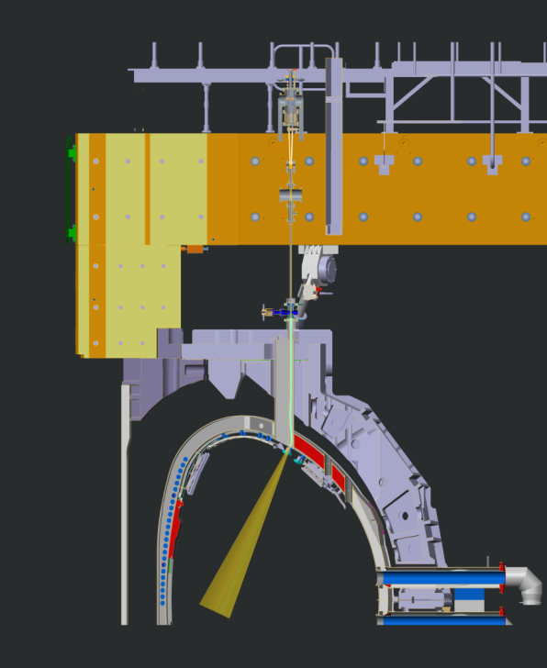
SPI Configuration on JET
The 40mm opening constrains the shatter tube geometry that can be employed.
JET SPI to be located where DMV1 was installed for vertical injection

Slide 19
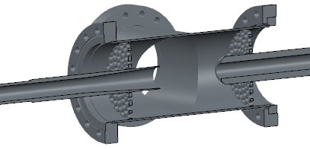
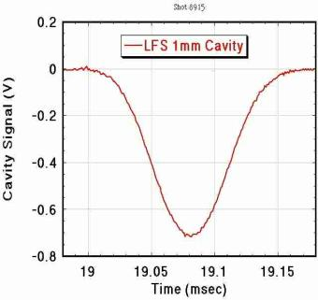
JET SPI capabilities
Microwave cavity diagnostic
Pellet mass* (amplitude ~ mass)
Velocity ± 10% (perturbation width)
Pellet integrity (early/late peaks)
*Pellet mass determined by reservoir ΔP during formation
J. Caughman, 2017

Slide 20
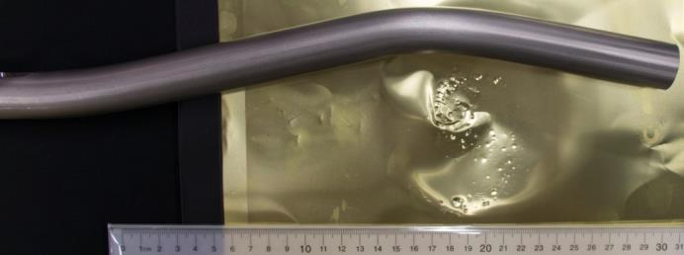
JET SPI capabilities
Shatter cone facing High Field Side
20 degree bend in injection tube pointed to HFS
Intercept/disperse REs created by DMV3
Tube geometry: good collimation
Fragments too small to damage PFCs
Large enough for good penetration

Slide 21
The JET shatter tube was tested at ORNL using argon pellets launched with a prototype mechanical punch
Cut away model of the JET shatter tube
Punch Schematics
Punch Face
JET shatter tube installed on test stand in Pellet Lab
Connection to Propellant Valve
Pellet
Exit of shatter tube as viewed by the fast camera
S. Meitner,

Slide 22
JET SPI capabilities
Pellets of <15 m/s survived the shatter tube intact
12.5mm argon pellet of 6g has only 1 J of kinetic energy – no danger to JET inner wall
Largest pellet could have up to 180J of kinetic energy, must be interlocked to prevent hitting the closed TIV

Slide 23
Outline
SPI R&D overview
SPI Deployment on JET
ITER DMS Issues for SPI
JET SPI experimental opportunities
U.S. input to the JET disruption taskforce: proposal titles due Aug. 4, full proposals in Sept.

Slide 24
ITER SPI Configuration
Pellet sizes chosen based on IO requirements, available space, and lab results
Pellet | OD (mm) | L/D | Qty | Location
Size 1 | 13.39 | 1.5 | 3 | One each UPP 2, 8, 14
Size 2 | 16.56 | 1.5 | 4 | One each UPP 2, 8, 14 EPP 08
Size 3 | 19.74 | 1.5 | 4 | One each UPP 2, 8, 14 EPP 08
Size 4 | 28.45 | 2.0 | 14 | All in EPP08
Injectable amounts for Ne shell pellet
TLM: up to 9.6 kPa*m³
RES: up to 76.6 kPa*m³
Requires ~90 kPa*m³ of He propellant gas required to maximize speed (challenges vacuum system)

Slide 25
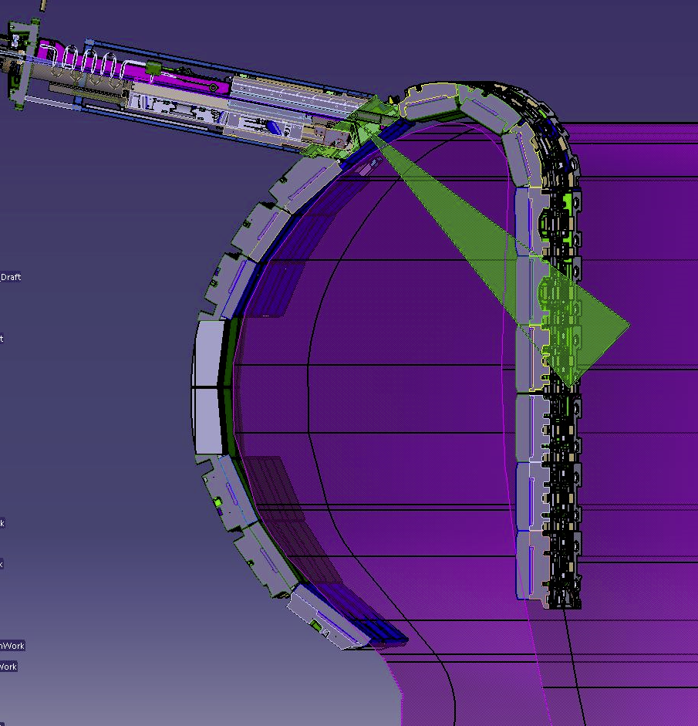
Design Issue #1 - Upper Port Exit Angle
Upper ports do not aim towards center of plasma
SPI requires 20 degrees or less for proper shattering
This angle only hits the top of the plasma
Experiment is planned on DIII-D to determine if UPP SPI geometry is viable
20º

Slide 26
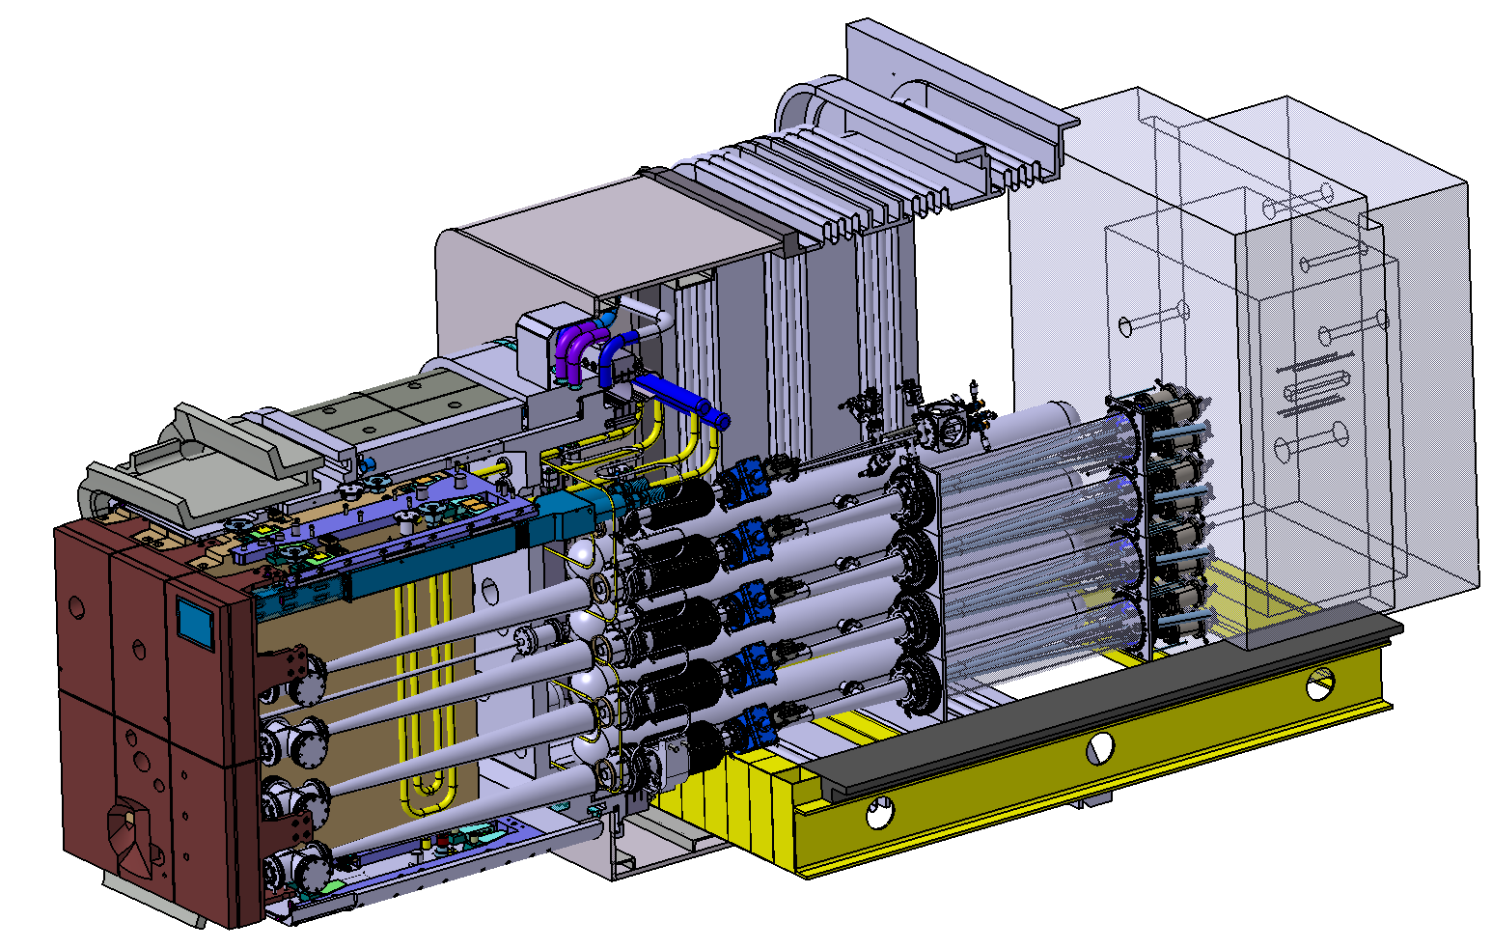
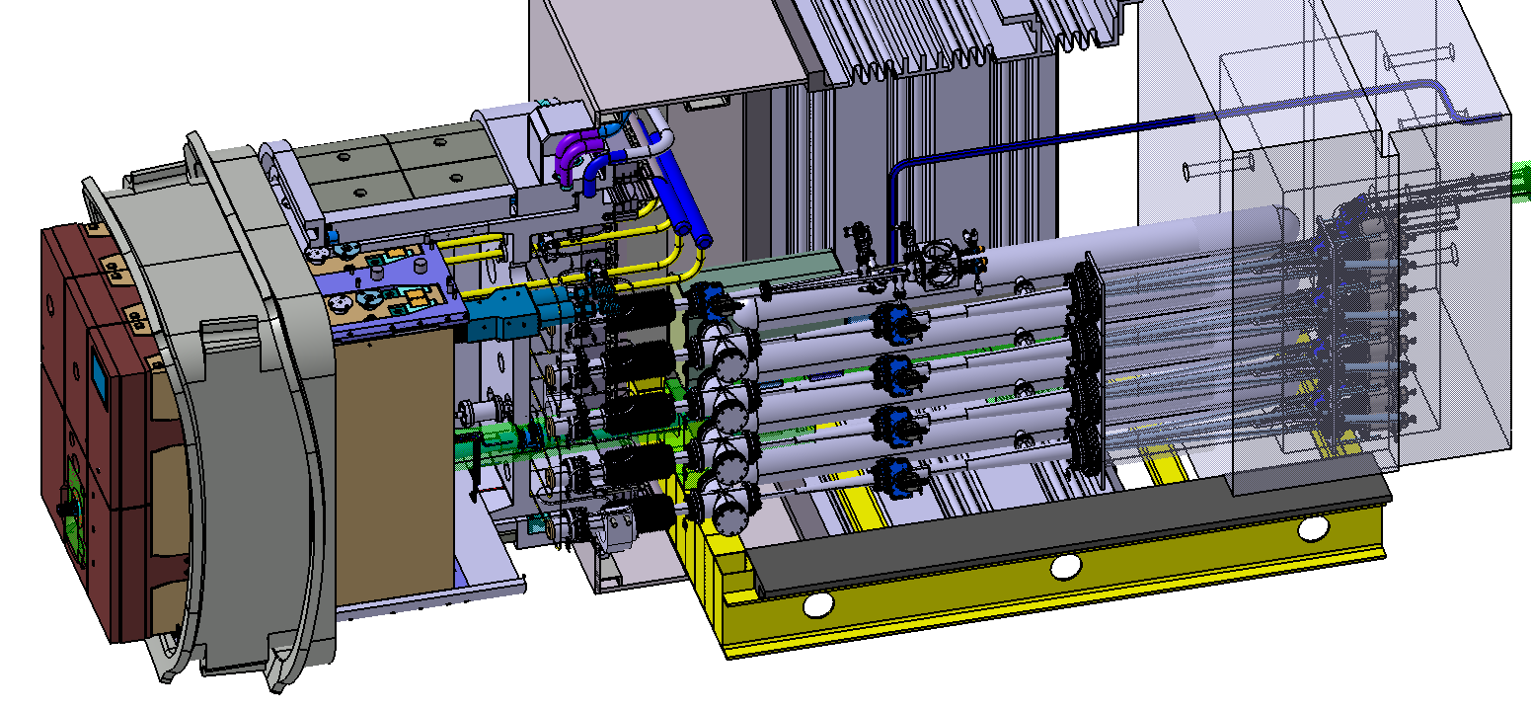
Design Issue #2 – No space for Microwave Cavity
MW Cavity causes clashes
MW Cavity not included in the baseline design
Other diagnostics are needed (e.g. pressure trace, Vis-IR plasma view)
MW Cavity In Port
Clash w/ Bioshield
Shielding compromised
Iso View
Not shown: transport through port plug
MW Cavity Out of Port

Slide 27
Design Issue #3 – Upper Port Path
Funnel (2º)
Coupling/funnel
Funnel (2º)
Valve
Bends (2º)
Bellows/Funnel
Bends (2.5º)
Pellet speed and/or pellet survivability are likely to be limited by this configuration
Previous testing at ORNL shows bends over 2º are likely to break pellets
New tests underway to expand on previous testing and to verify ITER geometry

Slide 28
Outline
SPI R&D overview
SPI Deployment on JET
ITER DMS Issues for SPI
JET SPI experimental opportunities
U.S. input to the JET disruption taskforce: proposal titles due Aug. 4, full proposals in Sept.

Slide 29
JET SPI Experimental opportunities
RE Studies
RE dissipation with Ar/Ne SPI using punch
Working on variation of particle size as function of speed – possible knob
Multiple pellets possible – Ar, Ne
JET is working on vertical position control to allow results
RE Avoidance – D2/Ne mixtures, possible Ar-D2 layer pellets
High current operation?

Slide 30
JET SPI Experimental opportunities
Thermal Mitigation – Small pellet sizes
Optimization of D2/Ne mixture
May need punch for small pellet size to vary pellet speed
TM with fixed amount of Ne and different amounts of D2 (vary pellet size)
Mitigation of a near disrupting plasma – wounded duck
Dependence on locked mode location WRT SPI location

Slide 31
Summary
SPI R&D is ongoing to quantify shattering and capabilities for ITER configurations.
The need for a reliable DMS on ITER have motivated a strong international effort on JET (ITER, USITER, USDOE, EUROfusion, CCFE all working well together)
SPI will be installed on JET in Sept. for experiments starting in 2018, and could be integrated into JET DMS in future.
JET SPI Benefits to ITER
Commissioning and Operational Experience
Data on TM heat loads, halo currents, and RE mitigation
Modeling, simulation, extrapolation to ITER
U.S. input to the JET disruption taskforce: proposal titles due Aug. 4, full proposals in Sept.

