Slide 1

Overview of the DIII-D Disruption Mitigation Experimental Program
by
N.W. Eidietis
for the
DIII-D Disruption Mitigation Physics Group
with thanks to
D. Spong (ORNL) & K. Thome (ORAU)
Presented at the
Theory & Simulation of Disruptions Workshop
PPPL
July 17, 2017
NW Eidietis/TSDW/July 2017

Slide 2
Outline
Studies of runaway f(E) evolution in the quiescent runaway electron (QRE) regime
RE plateau dissipation
Observation of RE generated whistler waves
Shattered pellet injection (SPI) studies
Future directions
NW Eidietis/TSDW/July 2017

Slide 3
Outline
Studies of runaway f(E) evolution in the quiescent runaway electron (QRE) regime
RE plateau dissipation
Observation of RE generated whistler waves
Shattered pellet injection (SPI) studies
Future directions
NW Eidietis/TSDW/July 2017

Slide 4
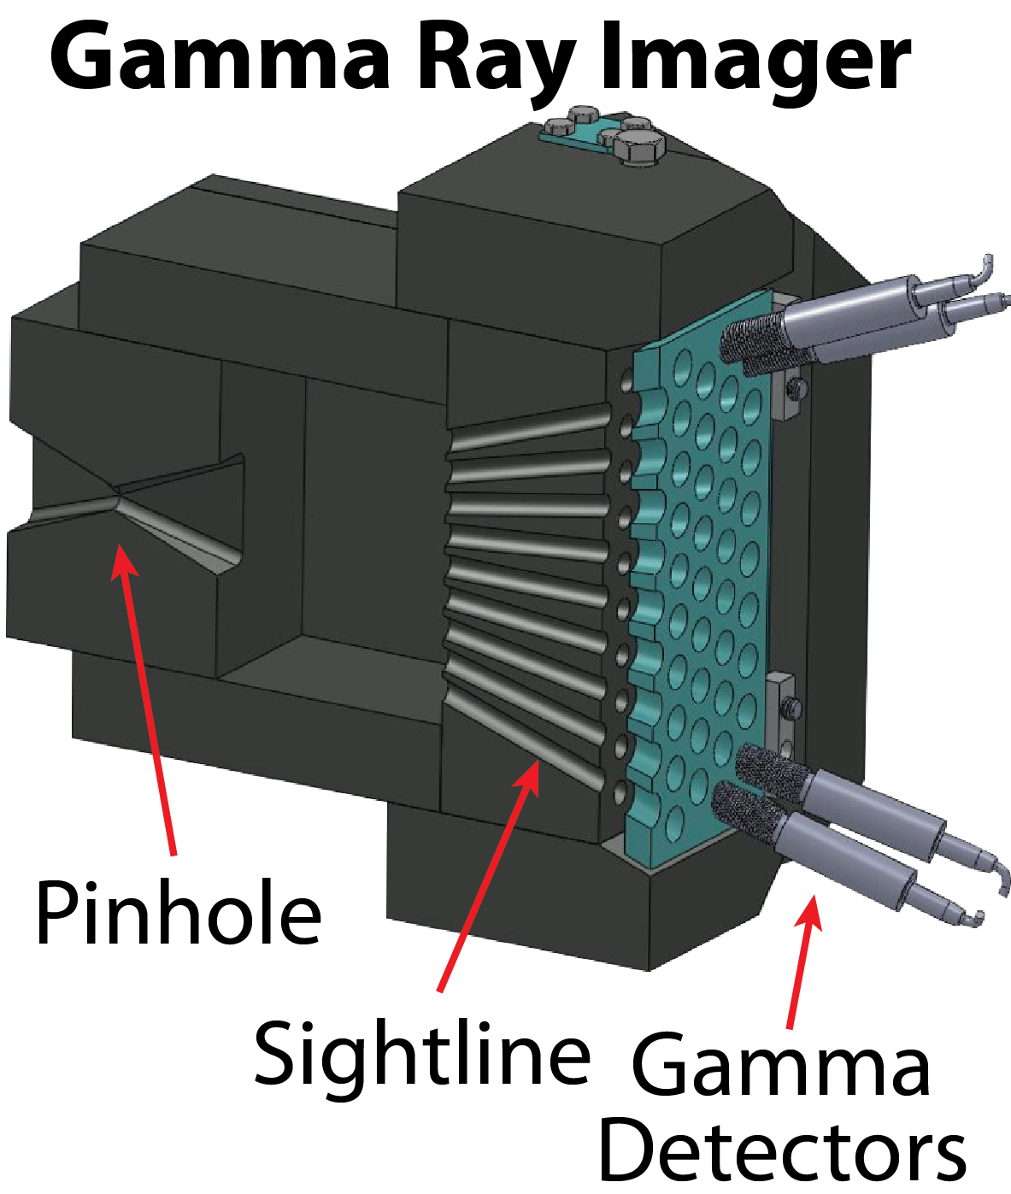
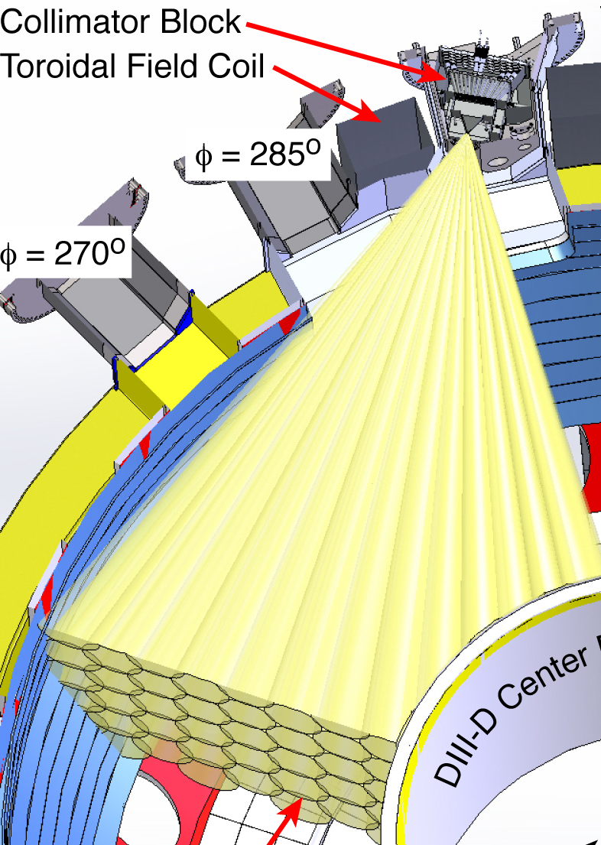
DIII-D Gamma Ray Imager (GRI) allows HXR spectra to be measured from parallel-going runaway electrons
Pinhole camera made of lead digitizes individual HXR pulses
Binning in time demonstrates energization of HXR population:
γ
e⁻
NW Eidietis/TSDW/July 2017

Slide 5
Considering views on same flux surface reveals first pitch-angle (and energy) resolved measurements
γ distribution
Increasing pitch angle fall-off as energy increases
Focus of 2017 experiments was to change E/(Z+1) to isolate angular effects
New opportunity for model validation – stay tuned
NW Eidietis/TSDW/July 2017

Slide 6
Energy-dependent radial fall-off observed: hard to model but RE transport may be important
γ distribution
Can be used to validate RE radial transport models
  Ex: ”diffusion coefficient” to match experimental data
In this area experiment is now far ahead of modeling
  Challenge: codes that treat both spatial and phase-space effects
2017 experiments also attempted to change RE spatial gradients … stay tuned
NW Eidietis/TSDW/July 2017

Slide 7
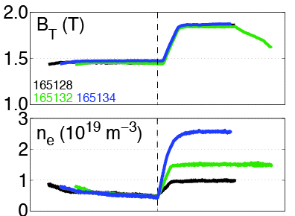
In order to affect synchrotron, collisions, and scattering
Experimental approach is to vary B_{T}, density, Z_{eff}
Density scan @ High B_{T}
B_{T} scan @ low density
B_{T}
scan
Grow
Dissipate
n_{e}
scan
Grow
Dissipate
NW Eidietis/TSDW/July 2017

Slide 8
Time-dependence also reveals effects occur at lower energy than predicted ... and show anomalous loss
Detailed comparison of expected HXR growth rates @ single energy as BT (synchrotron) varied
Low energy growth rates are negative while model predictions are positive !
Negative rates can be recovered by turning off avalanche (unphysical)
Indicates anomalous loss (problem not solved yet)
1.9 T
1.4 T
1.0 T
NW Eidietis/TSDW/July 2017

Slide 9
Increasing electron density lowers E/E_{crit} and shows fewer REs at high energy due to slower RE growth rate
HXR distributions are different with E/E_{crit}, show non-monotonic features when inverted for f(E)
Modeling shows consistent changes in “bump” energy
High B_{T}, high Z_{eff}
NW Eidietis/TSDW/July 2017

Slide 10
Increasing electron density lowers E/E_{crit} and shows fewer REs at high energy due to slower RE growth rate
HXR distributions are different with E/E_{crit}, show non-monotonic features when inverted for f(E)
Modeling shows consistent changes in “bump” energy
High B_{T}, high Z_{eff}
See
C. Paz-Soldan 2017 APS invited,
PRL 118, 255002 (2017)
NW Eidietis/TSDW/July 2017

Slide 11
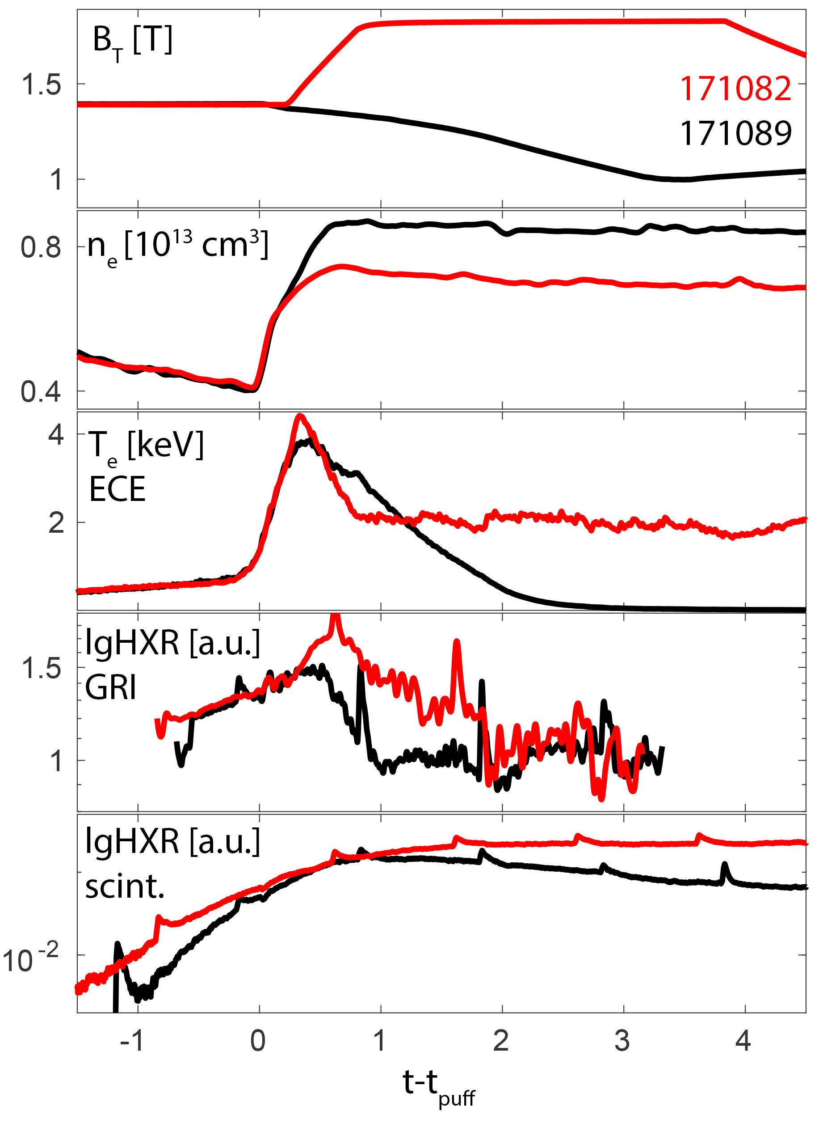
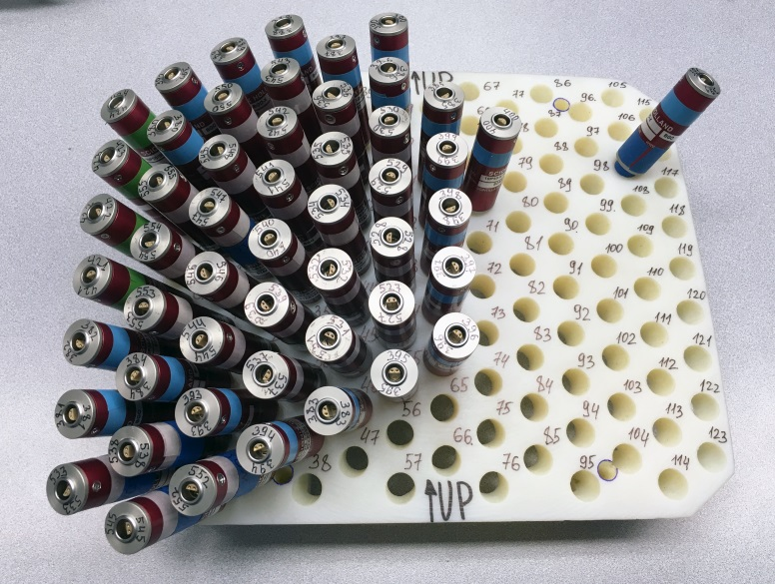
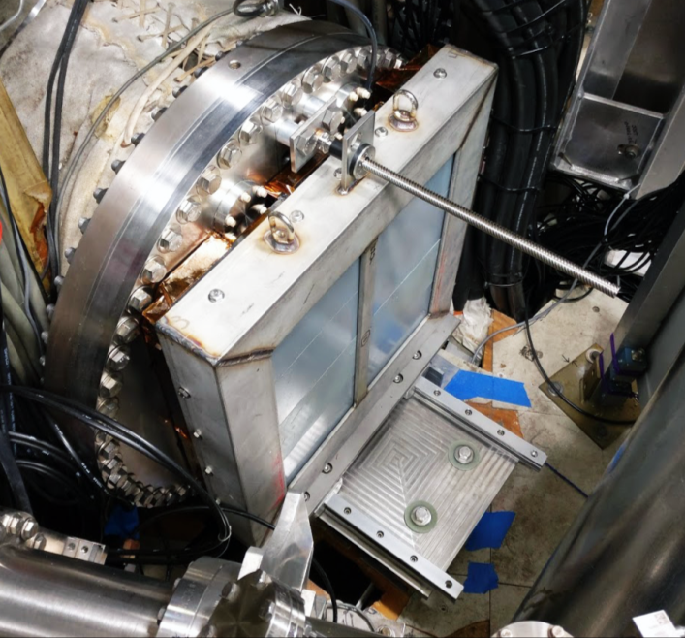
Gamma Ray Imager has been upgraded to provide better spatial coverage , sensitivity, and shielding against uncollimated gammas for 2017 run period
The number of GRI channels has been doubled (up to 55) to increase spatial coverage in the poloidal plane
Additional rear shielding (5 of lead, attenuation by 10x) against backscattered gammas has been designed and installed
Successful measurements in QRE regime have been done
New insulated
detector holder
Rear shielding
(220 kg of lead)
RE at high and low B_{T}
in Whistler experiment
Courtesy A. Lvovskiy, ORAU

Slide 12
Outline
Studies of runaway f(E) evolution in the quiescent runaway electron (QRE) regime
RE plateau dissipation
Observation of RE generated whistler waves
Shattered pellet injection (SPI) studies
Future directions
NW Eidietis/TSDW/July 2017

Slide 13
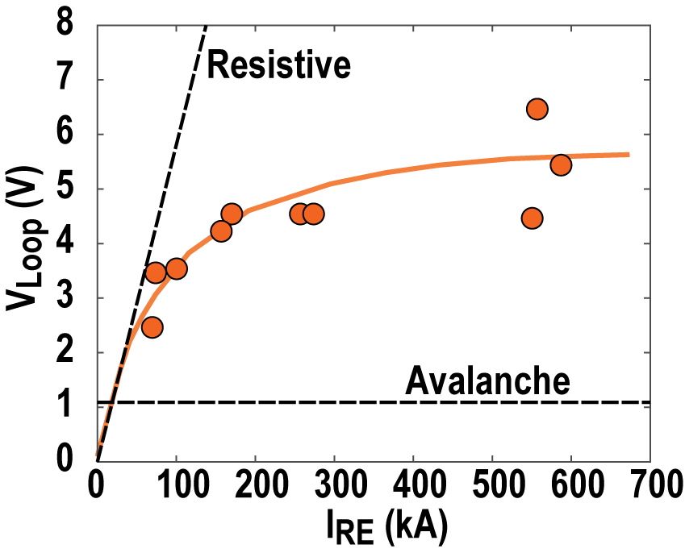
Expanded operating space allows clearer view of anomalous RE plateau dissipation
RE plateau I-V characteristic
Assimilation of high Z impurities injected into RE plateau is important RE mitigation strategy for ITER.
Experiments in DIII-D aim to understand dissipation of RE plateau using Ar.
Plateau current dissipation (resistivity) not clearly resistive or avalanche in character.
New operating
space 2017
dI_{RE}/dt = 0, N_{Ar} = 20 Torr-L
(formation Ar pellet only)
NW Eidietis/TSDW/July 2017

Slide 14
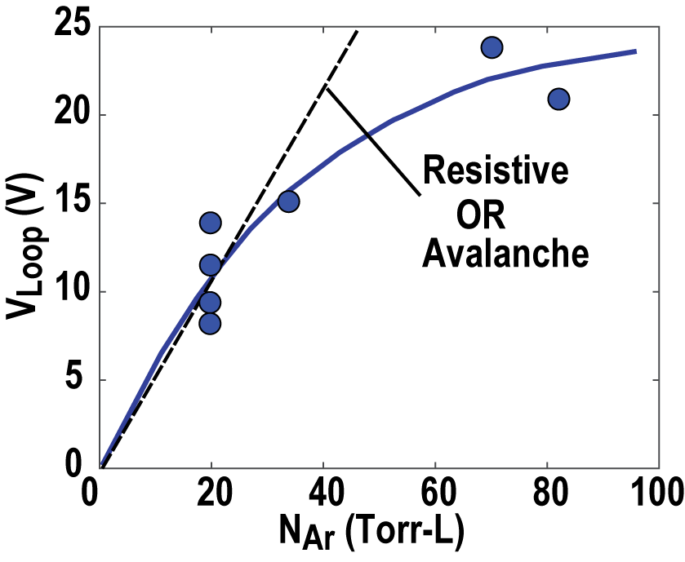
High-Z impurity assimilation studies into RE plateau (2)
RE plateau I-V characteristic
RE plateau resistivity does not increase linearly with amount of Ar in vacuum vessel.
Results suggest that Ar not being mixed uniformly into RE plateau but is being excluded from center of beam.
Profile analysis is underway to try to extract radial profile of Ar and effect of changing RE current.
See E. Hollmann, 2017 APS
I_{RE} = 530 – 570 kA
NW Eidietis/TSDW/July 2017

Slide 15
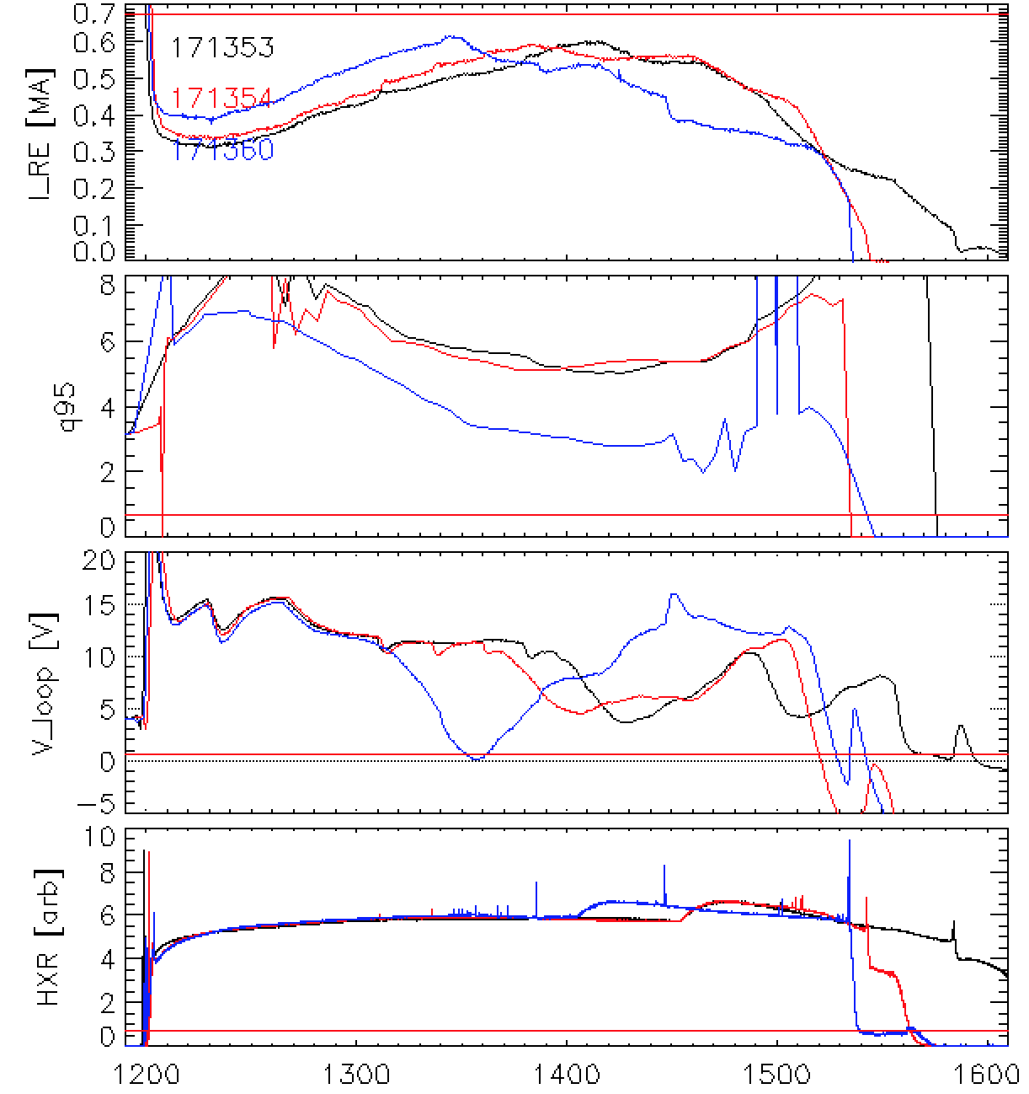
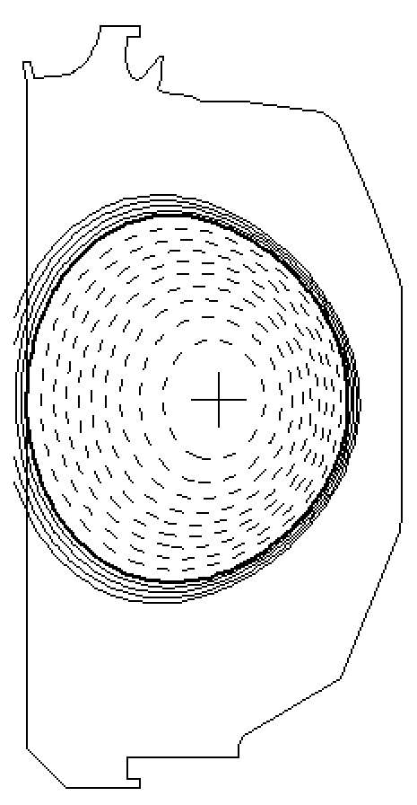
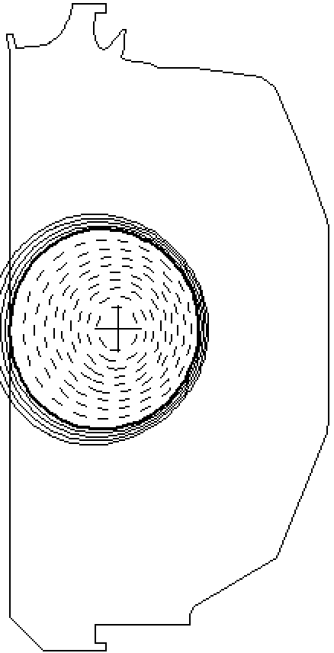
Initial attempts at low q₉₅ RE plateau dissipation show no clear difference versus high q₉₅
Doubled I_{RE} operating space in 2017 allows lower q95 dissipation
Additional compression of x-section brings q_{edge} ~3
No obvious evidence of disruptive MHD prior to solenoid flux limit
Flux limit
171353 @ 1.4s
171560 @ 1.4s
Time [ms]
NW Eidietis/TSDW/July 2017

Slide 16
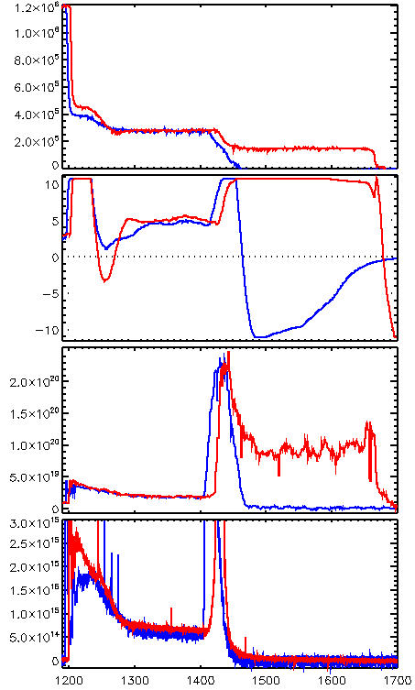
Initial Tests: Neon SPI & Neon MGI Equally Effective for Runaway Electron (RE) Plateau Dissipation
Test Scenario:
  Small(~10 torr-L) Ar pellet injection induces CQ, forms RE plateau
  Active Ip control sustains plateau
  1200 Torr-L Neon MGI or SPI injected at 1.4s
SPI/MGI exhibit nearly identical initial dissipation rates
Longer timescale: SPI displaces residual Argon from RE → Dissipation slows
Hypothesis: D₂ “grease” around Ne SPI pellet may be displacing high-Z impurities
  Grease enables simple pipe-gun SPI
  Mechanical punch may be necessity
Small
Ar pellet
induces CQ,
forms RE plateau
I_{p} (A)
SPI
MGI
V_{loop} (V)
#164409
#164388
Density (m⁻³)
Residual
Argon
Ar-II (arb)
Neon
Ice
Argon
displaced by SPI
D2 “grease’

Slide 17
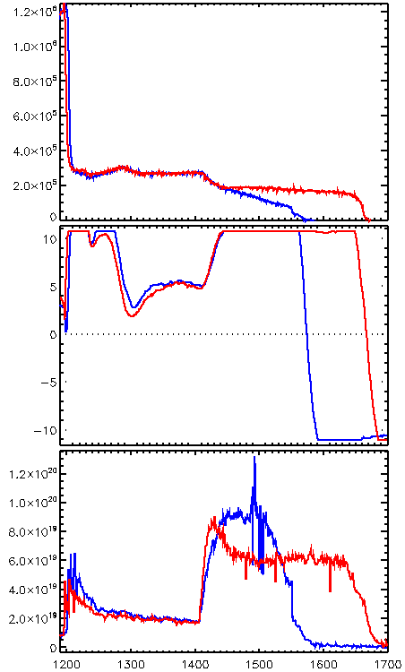
RE Dissipation by Mixed Species MGI Supports Hypothesis of D₂ Displacing Higher Z Impurities
Test Scenario: 100 Torr-L pure Ar MGI or 90/10 Ar/D₂ MGI injected into RE plateau at 1.4s
Initial dissipation: Pure Ar & mixed species MGI nearly identical
Longer timescale: Mixed species MGI results in significantly reduced dissipation rate
  Small quantity D₂ drastically reduces dissipation rate
Presence of D₂ appears to effect dissipation far more than injection technology (SPI or MGI)
Small
Ar pellet
induces CQ,
forms RE plateau
I_{p} (A)
90/10 Ar/D₂ MGI
Pure Ar MGI
V_{loop} (V)
Density (m⁻³)
#165383
#165380

Slide 18
Outline
Studies of runaway f(E) evolution in the quiescent runaway electron (QRE) regime
RE plateau dissipation
Observation of RE generated whistler waves
Shattered pellet injection (SPI) studies
Future directions
NW Eidietis/TSDW/July 2017

Slide 19
First measurement of RE generated whistlers as part of DIII-D “Frontier Science” experimental sessions (D. Spong)
Frontier Science allocation enables interdisciplinary studies on DIII-D (astrophysics, in this case) that would normally not be possible
Whistler measurements of significant interest for ionospheric physics and space weather
Two varieties
  Electron whistlers: 𝛚_{lh} < 𝛚 < 𝛚_{ce}
  Hydrodynamic whistlers 𝛚_{ci} < 𝛚 < 𝛚_{lh}
Latter is the range diagnosed in the DIII-D experiments
Experiments pursued using DIII-D QRE scenario to generate modes
NW Eidietis/TSDW/July 2017

Slide 20
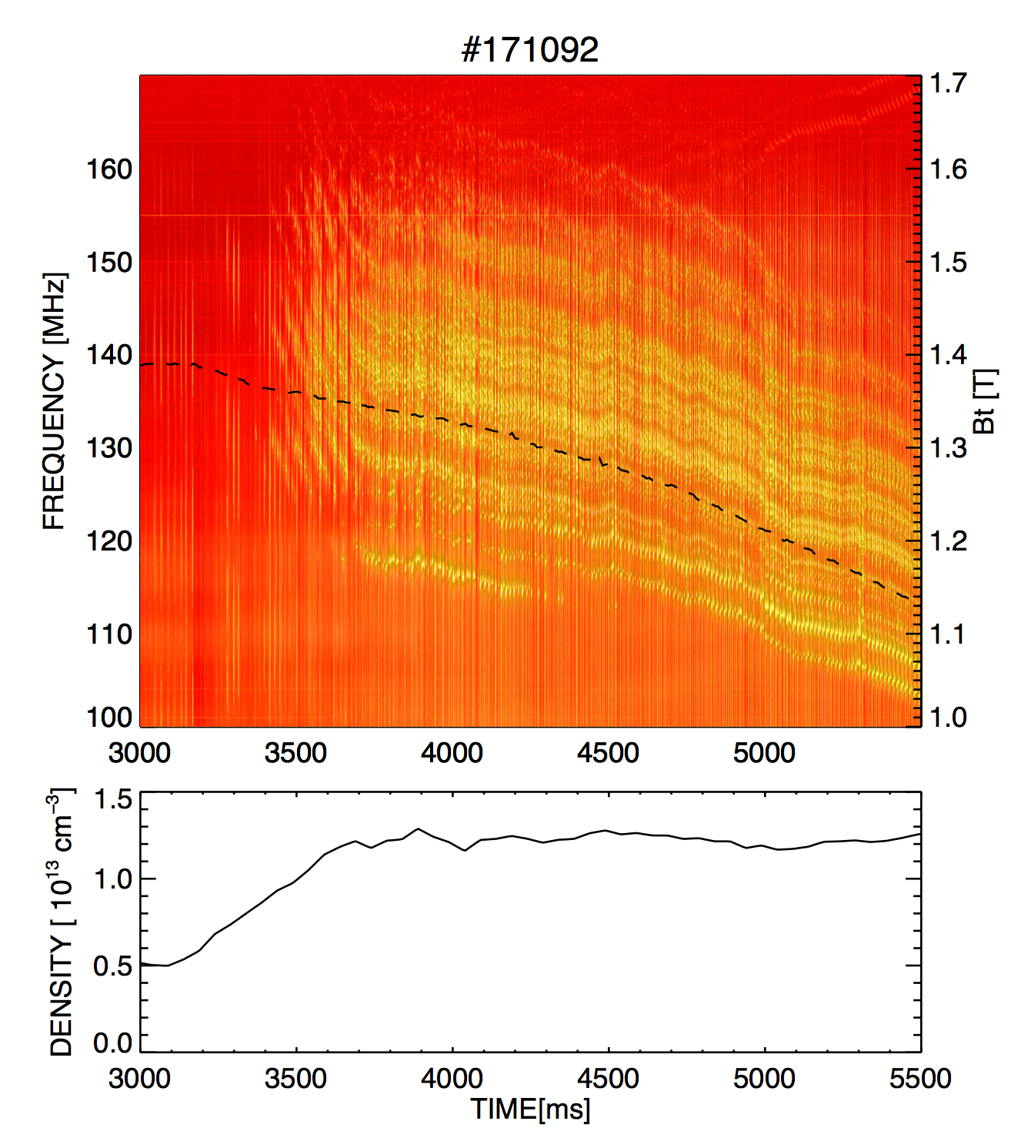
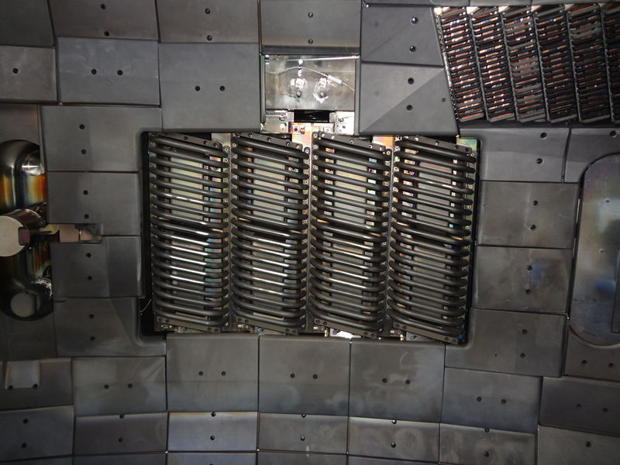
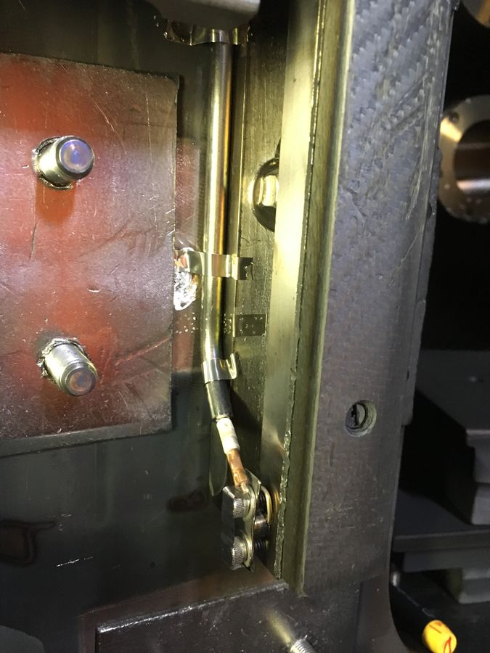
Ion Cyclotron Emission (ICE) measurements consistent with whistler dispersion relation
Whistlers observed on fast wave antenna straps & toroidal RF loops
  At midplane, 185-248°
Aliasing used for Whistler experiment
  100 MHz high pass filters
  Used mixer to confirm signal is in 100-200 MHz band
B_{T}
180 Antenna
RF Loop
See D. Spong for all the details…
NW Eidietis/TSDW/July 2017

Slide 21
Outline
Studies of runaway f(E) evolution in the quiescent runaway electron (QRE) regime
RE plateau dissipation
Observation of RE generated whistler waves
Shattered pellet injection (SPI) studies
Future directions
NW Eidietis/TSDW/July 2017

Slide 22
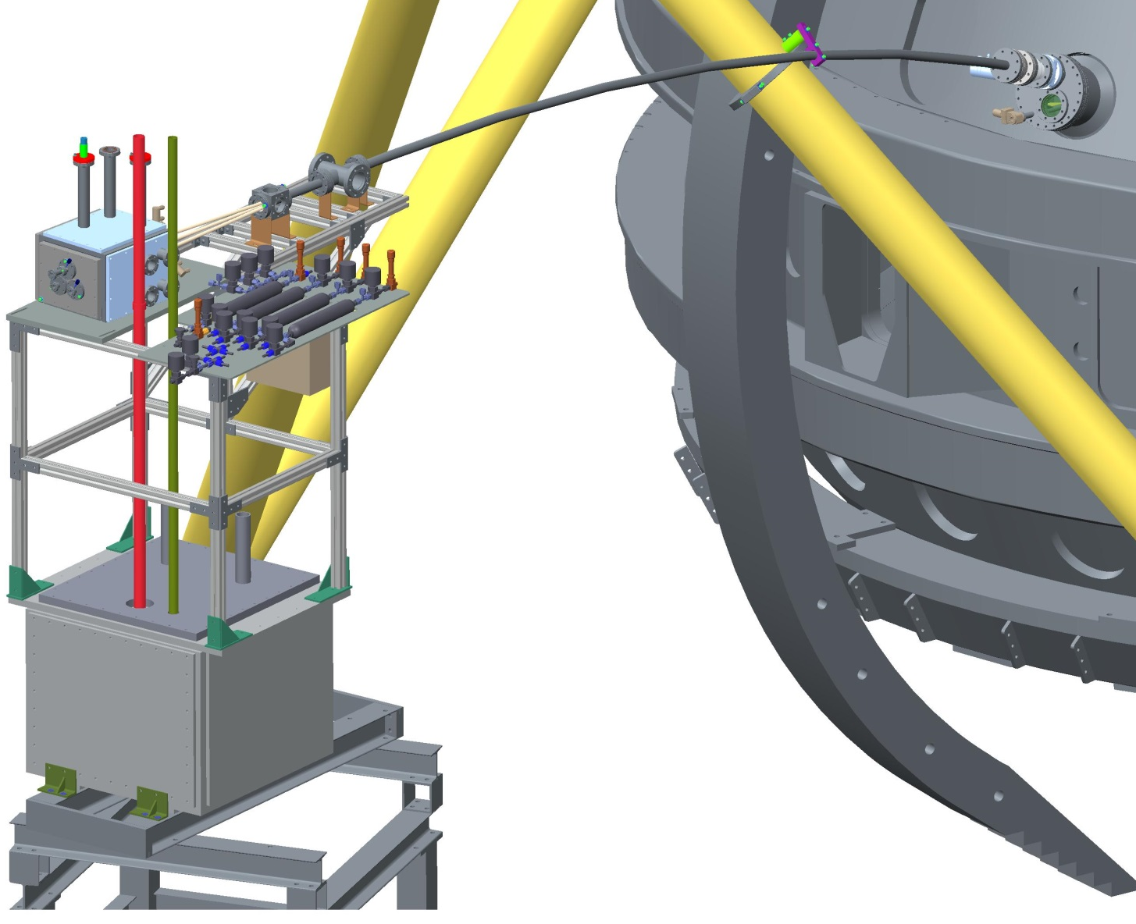
DIII-D continues to aggressively study shattered pellet injection
Second SPI system installed for FY17 experimental period
  ITER-prototype triple barrel system
Pursuing empirical & modeling basis for deployment on ITER
First tests of multiple SPI synchronization from multiple locations + multiple SPI from same location
SPI015
See D. Shiraki Tuesday PM,
P. Parks Wed AM
SPI135
(new)
NW Eidietis/TSDW/July 2017

Slide 23
Outline
Studies of runaway f(E) evolution in the quiescent runaway electron (QRE) regime
RE plateau dissipation
Observation of RE generated whistler waves
Shattered pellet injection (SPI) studies
Future directions
NW Eidietis/TSDW/July 2017

Slide 24
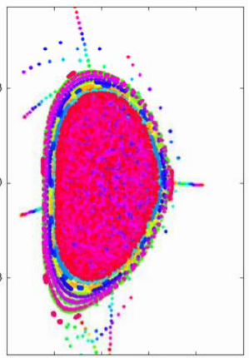
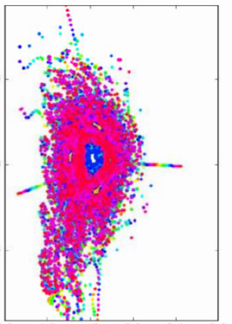
DIII-D pursuing shell pellet injection to improve efficacy of active disruption mitigation
Key Issues
  Present SPI/MGI cool from edge inwards, rely upon MHD to mix in impurities
  This limits assimilation (density) & requires high-Z radiators that speed CQ, keeping ITER near engineering thresholds
  Minimizing role of MHD impurity transport would avoid undesirable tradeoffs
Approach
Low-Z dust-filled shell : transport payload to core before inducing TQ
    ”Inside-out” TQ mitigation + stochastic RE deconfinement & high n_{e} suppression + maintains moderate CQ rate
Experiments with boron/W filled diamond shells planned in FY18
Parks & Wu NF 51 (2011)
Parks & Wu NF 54 (2014)
0.3ms
0.7ms
See V. Izzo, Tuesday PM
Izzo & Parks, PoP 24, 060705 (2017)

Slide 25
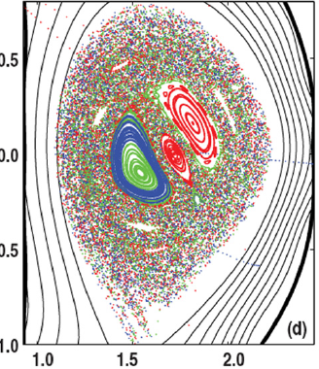
Understanding where and how RE seed produced will be significant feature of next DIII-D 5YP
Key Issues
  Where spatially do RE seed form during TQ/early CQ?
  What processes dominate seed formation/loss?
  How do various mitigation schemes modify location/population/deconfinement of RE seed?
V. Izzo et al Nucl. Fusion 51 (2011) 063032
Approach
  Implement diagnostics to image formation & loss of low-energy (10’s keV) RE seed
  Self-consistently model coupled RE seed production & MHD to predict real sources & locations of RE formation (SCREAM effort)
  Compare measured/modeled RE seed under perturbed conditions (3D fields, density, shape)
NW Eidietis/TSDW/July 2017
New Diagnostics: EUV camera, RE loss tile

Slide 26
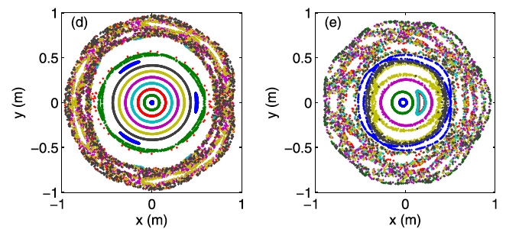
DIII-D considering studying passive mitigation of RE production
Key Issues
How can we handle disruptions that defy reliable prediction?
Can we simplify requirements for active mitigation by passively removing RE?
Approach
Model stochastization required to deconfine RE seeds across plasma cross-section
Design passive inner-wall 3D coil that provides required field when driven by TQ/CQ loop voltage
  Spark gap → magnetically transparent except in disruptive scenario
Measure loss of RE seed under RE-producing scenarios
Plasma
Spark gap
Stochastic fields during early CQ
Smith et al PoP 20 (2013)
Boozer PoP 53 (2011)
Analysis: NIMROD 3D-MHD
Facility: Passive 3D solenoid

Slide 27
DIII-D continues to support a strong disruption mitigation program & encourages your collaboration
RE generation & evolution
Developing ITER injection technologies
Basic science studies
Looking to the future to provide the most robust DMS system possible
Theory & modeling community plays critical role in guiding & interpreting experiment

