Slide 1
Physics of the creation and mitigation of runaway electron beams in presence of their background plasma
C. Reux, S. Jachmich, E. Joffrin, I. Coffey, O. Ficker, S. Gerasimov, V. Kiptily, U. Kruezi, M. Lehnen, U. Losada, A. Martin, J. Mlynář, E. Nardon, V. Plyusnin, V. Riccardo, F. Saint-Laurent, G. Szepesi, S. Silburn, C. Sommariva and JET contributors.
Theory and Simulation of Disruptions Workshop – 18/07/2017 – Princeton

Slide 2
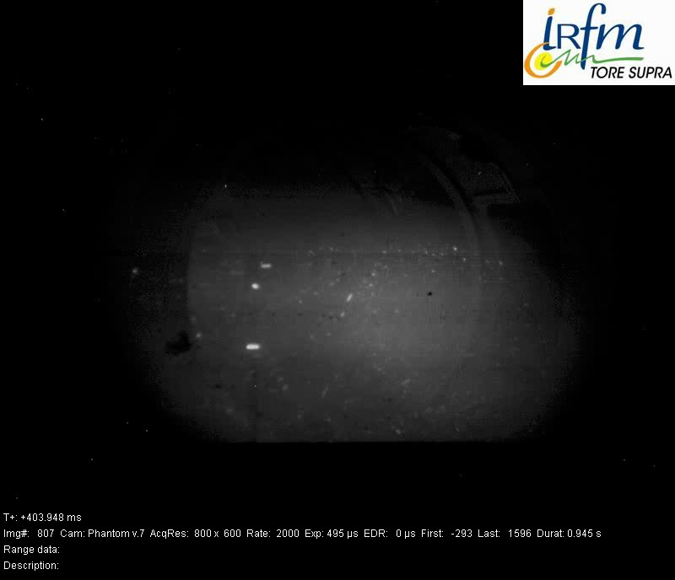
Disruptions and runaways
Disruptions: threat to a reliable operation of future devices including ITER
3 kinds of effects : heat loads, electromagnetic forces, runaway electrons
Most difficult consequence to mitigate: runaway electrons (MAs at 5-20 MeV)
  RE generation gain through avalanche: 10⁴ at JET, 10¹⁶ on ITER.
  But large uncertainties on the generation conditions and loss mechanisms.
  ➔ We might be too pessimistic about ITER runaways (remember JET-C vs. JET-ILW)
2 options to mitigate runaways:
  Prevent their initial generation.
  Suppress the runaway beam once it has
  appeared
ITER possible strategy:
  One injection to mitigate heat/EM loads
  Second injection to suppress runaways
Main question to be addressed: under which conditions runaway beam suppression is feasible ?

Slide 3
Outline
JET Runaway experiments – runaway electrons and their background plasma
  Experimental setup and background
  Mitigation efficiency: geometry effect and current effect
  Background plasma characterization
  Mitigation efficiency: background plasma effects
  Vertical stability and link to mitigation efficiency
Bonus: JET runaway kinetic + MHD simulations – C. Sommariva’s work
  Magnetic topology during a disruption
  Runaway survival following thermal quench
  Effect of the effective electric field

Slide 4
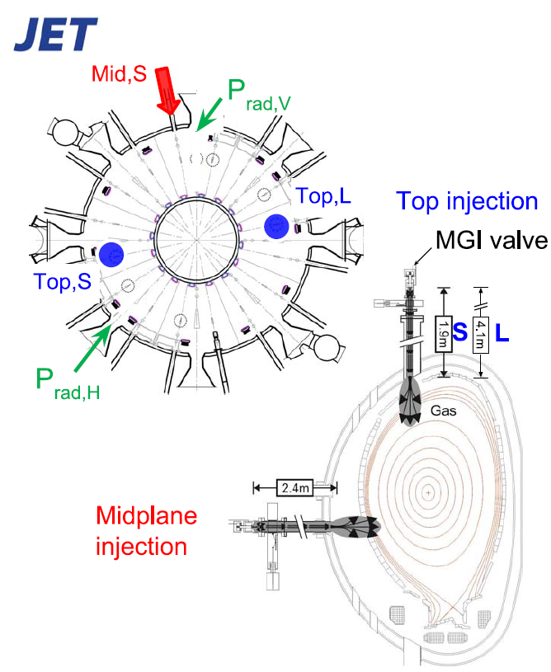
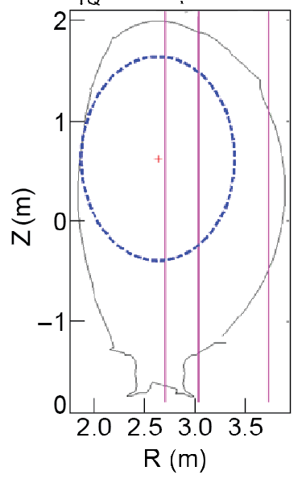
JET experimental setup
JET equipped with 3 Disruption Mitigation Valves (DMVs)
  2 on top (DMV1 & DMV3)
  1 on midplane (DMV2)
DMV2
S. Jachmich [TSDW 2016]
DMV3
 | DMV1 | DMV2 | DMV3
Volume [l] | 0.65 | 0.975 | 0.35
P_{inj} [bar] | 36 | 50 | 50
Gas [Pa.m³] | 1000 | 4500 | 1700
Tube [m] | 4.1 | 2.4 | 1.9
Orifice [mm] | 10 | 30 | 30
ToF (D₂+Ar)[ms] | 2.0 | 1.2 | 1.0
DMV1
Typical runaway beam shape
Midplane injection

Slide 5
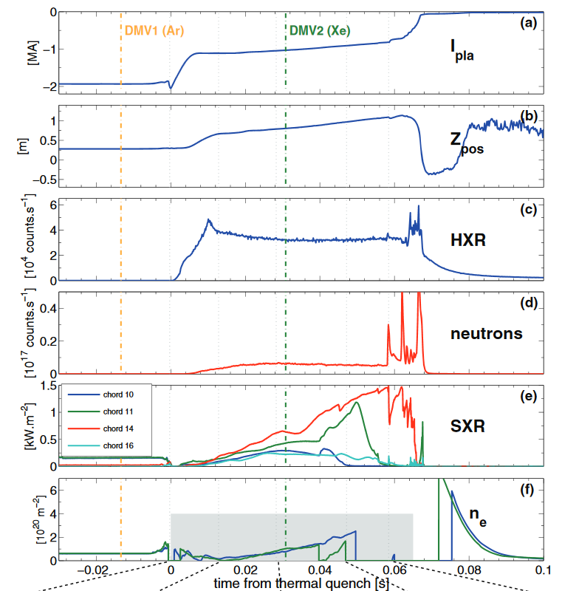
JET-ILW runaway experiments - background
JET runaway experiments in 2014: first mitigation attempts using massive gas injection
  Runaway beam created using massive argon injection (Disruption Mitigation Valve n°1)
  RE beam mitigation using Ar, Kr, Xe injection in the beam phase (DMV2 → 4400 Pa.m³)
Result: no apparent effect of the second injection on the RE beam
Only effect seen in visible radiation range
Presence of a cold dense background plasma
No penetration of the second injection neutrals into the runaway beam region
[Reux et al, Nuclear Fusion 2015]

Slide 6
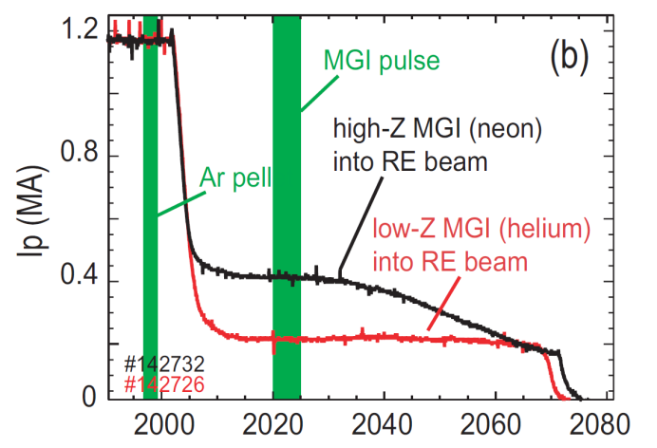
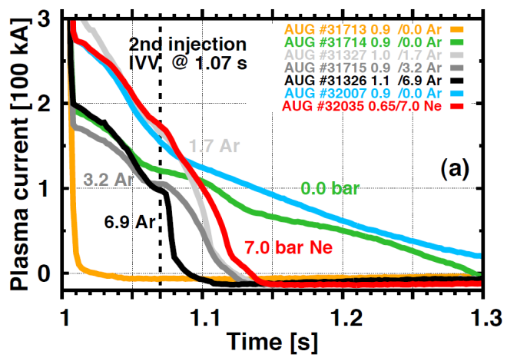
JET runaway experiments – context
Other smaller devices: better efficiency of second « killer » injection
  DIII-D: RE beam triggered with Ar pellet, killed with MGI (12 Pa.m³ atoms)
  Asdex-U: RE beam triggered with Ar MGI, killed with MGI (70 Pa.m³ atoms)
[Hollmann et al., Nuclear Fusion 2013]
[Papp et al., IAEA FEC 2016]
Why is JET different? ➔ Bad penetration of the second injection. Why?
  Geometry effect : the gas plume misses the beam?
  Current screening effect?
  Shielding by the background plasma?

Slide 7
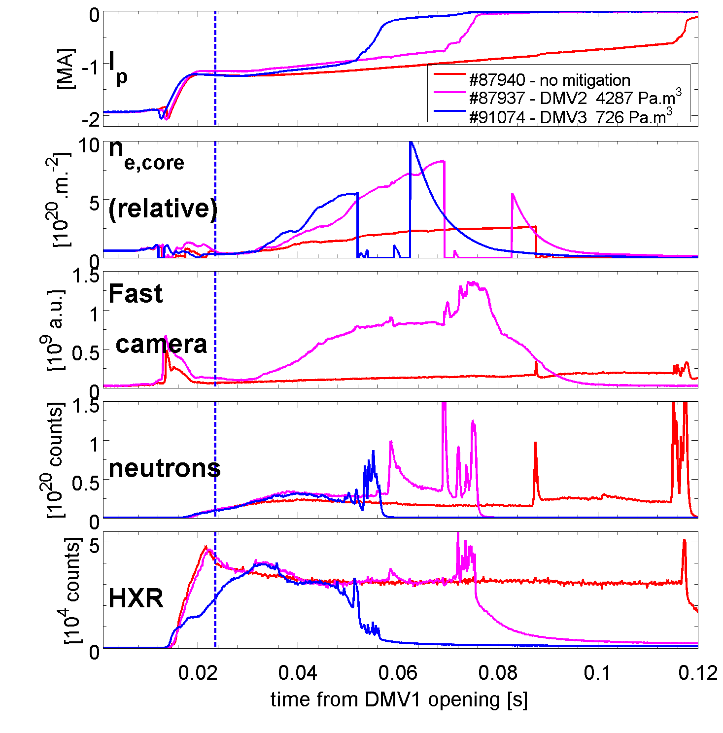
Geometry effect: upper port vs. midplane injection
Mitigation attempts on the same target runaway beam:
  DMV2 (midplane port)
  DMV3 (upper port)
Runaway beam duration 15 ms shorter with DMV3, but within the uncertainties of the runaway beam duration
Similar density rise following the injections
No effect on HXR and neutrons, no soft landing of the runaway beam
top
midplane
Gas plume geometry is not responsible for the lack of efficiency

Slide 8
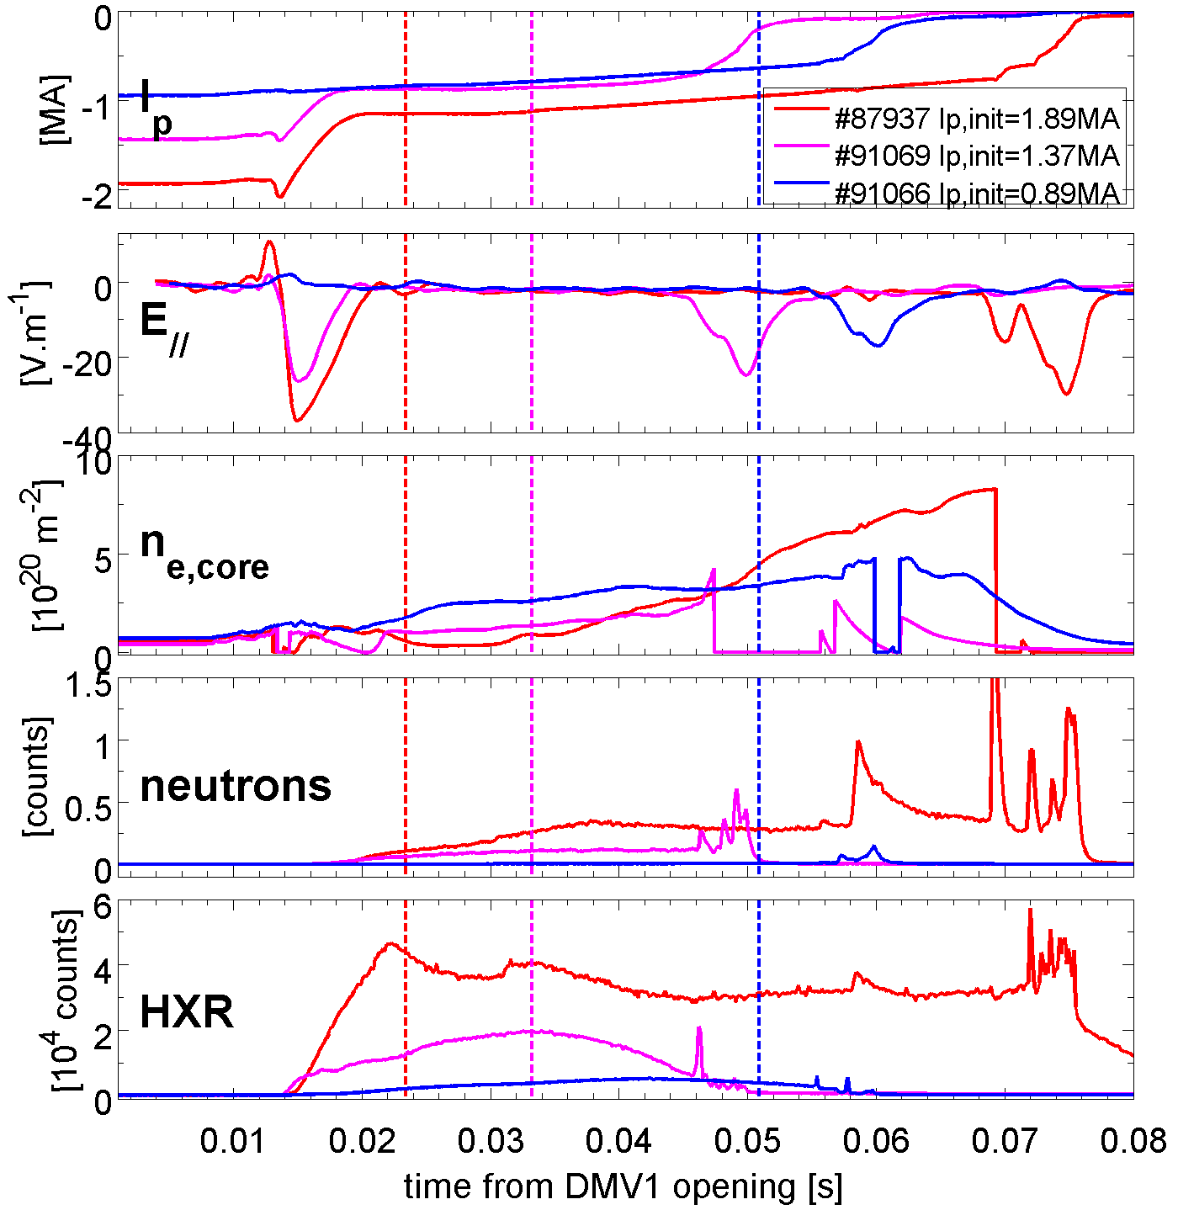
Current screening effect
JET RE currents are higher than in any other device
Reduction of the RE current by reducing the pre-disruption plasma current
Major change on the runaway population: much lower energies
  HXR counts twice lower for 2.0MA/1.5MA
  Almost no neutrons for 1.0 MA
➔ Runaway population at lower energy, but no easier penetration of the killer gas
Ability of MGI to suppress RE not directly related to their current/energy

Slide 9
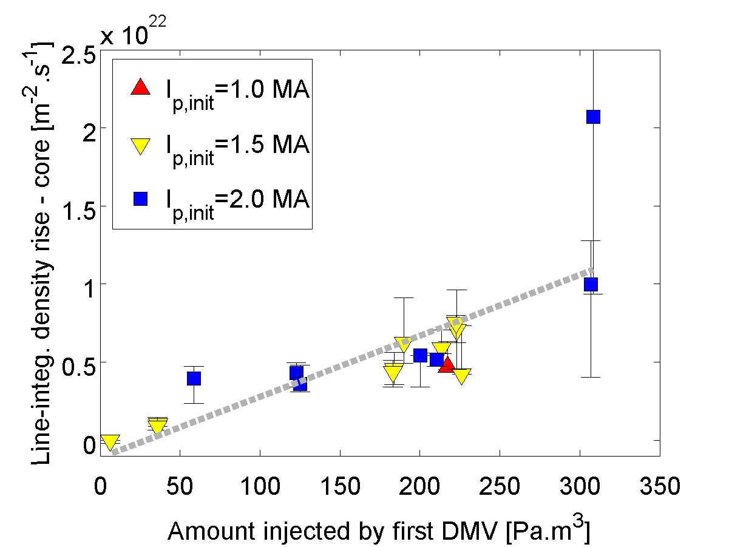
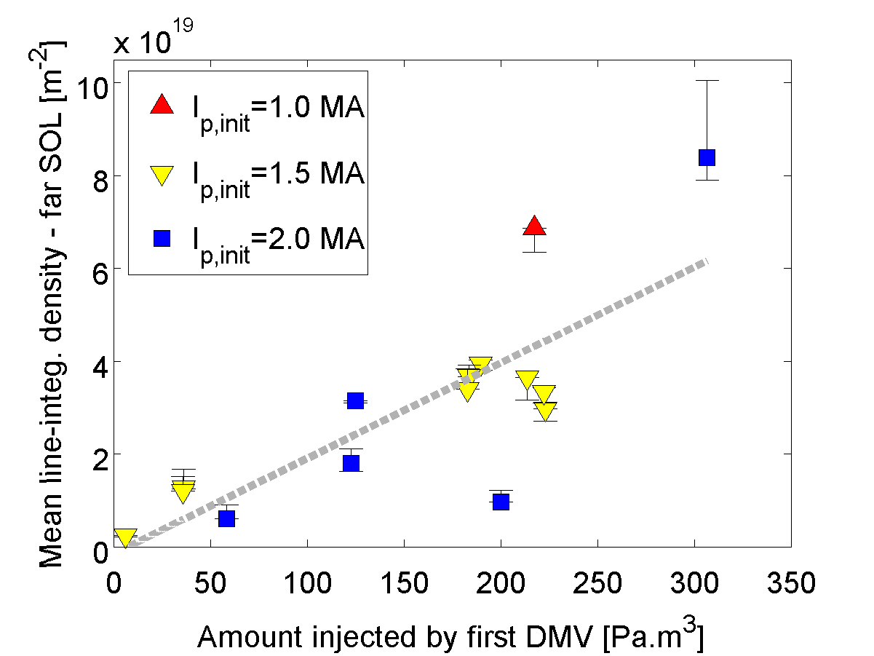
Background plasma density
Background plasma evolution during the RE beam phase (without any second « killer » injection)
  Density increase in the core
  Constant density in the far-SOL
Density increases with increased triggering-injection content
<dn_{e,core}/dt>
<n_{e,SOL}>
Background plasma density determined by the initial injection

Slide 10
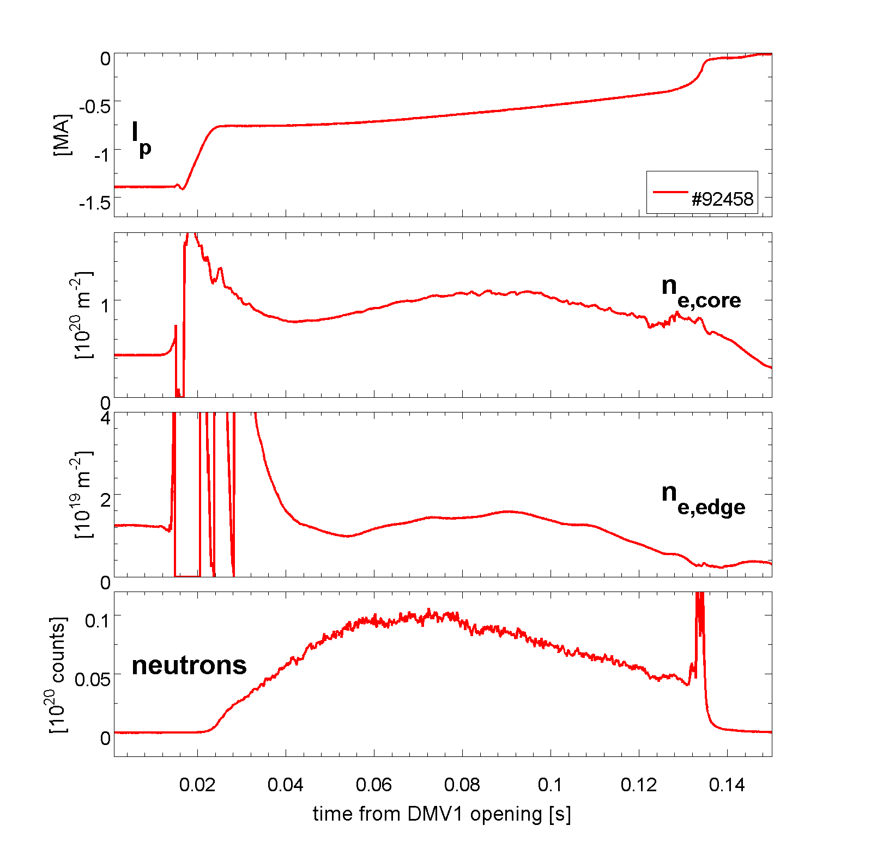
Background plasma neutral content
n_{Ar}=0.5 10²⁰ m⁻³
Acceleration
10²⁰ m⁻² ≈ 5x10¹⁹ m⁻³
≈1x10¹⁹ m⁻³
n_{Ar}=1.0 10²⁰ m⁻³
Acceleration/deceleration
n_{Ar}=2.0 10²⁰ m⁻³
Braking
Stopping power from ESTAR calculations + synchrotron losses
neutral density not higher than 1.0 10²⁰ m⁻³: (otherwise RE are braked)
Background plasma: most likely mainly ions
Power transfer from runaway collisions large enough to sustain the background plasma (5-20 MW)
Low neutral content in the background plasma

Slide 11
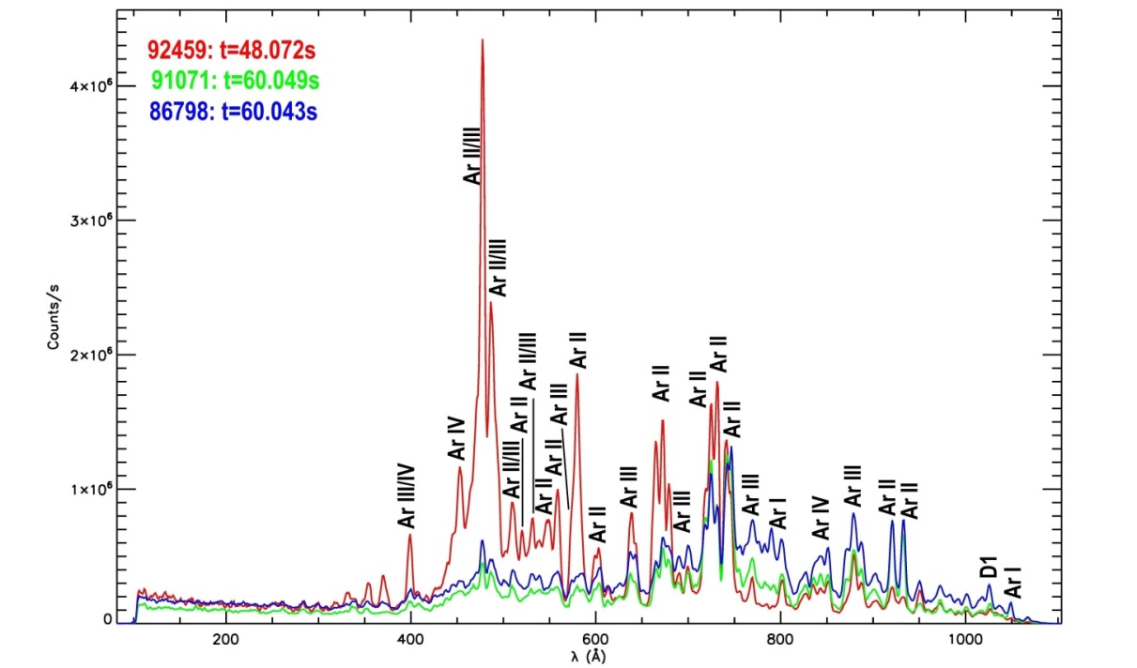
Background plasma temperature
VUV spectra during the RE beam phase: indicates Ar II, III, IV lines, no Ar I.
Assuming collisional radiative equilibrium: T_{e} ~ 5-15 eV.
  ➔ hotter than DIII-D background plasma (1-2eV) [Hollmann et al, Nuclear Fusion 2013]
Temperature constant during the beam phase
Low density plasma
High density plasma
Background plasma temperature: 5-15 eV

Slide 12
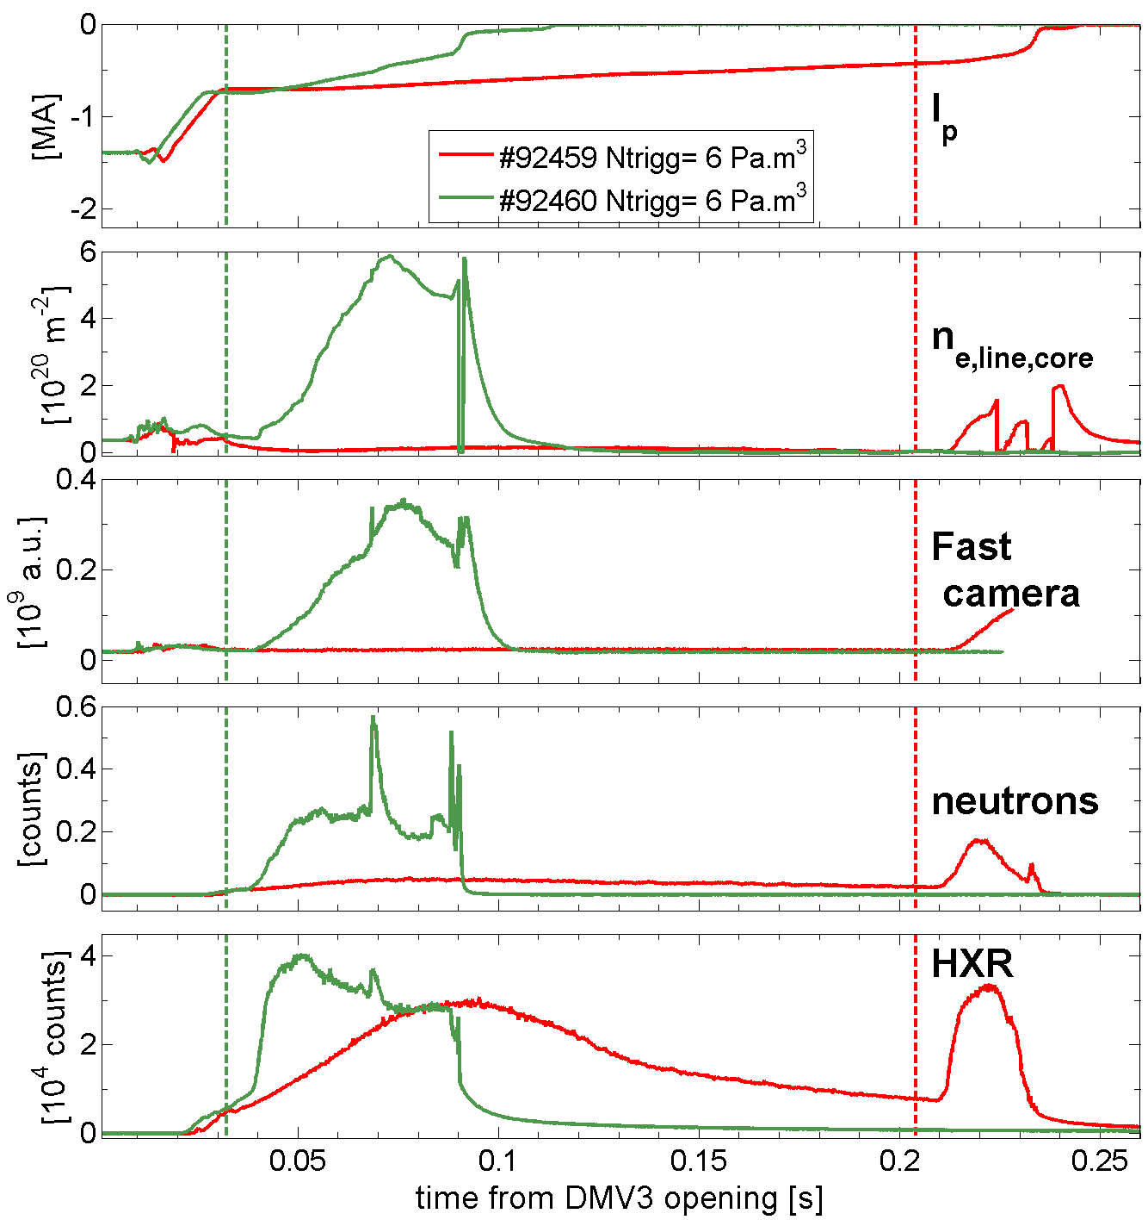
Injection in a lower density background plasma
RE beam responds to the injection:
  Current decays more quickly
  Shortening of the runaway beam
  Density rise (Δn_{e,l} > 5x10²⁰ m⁻² in 40 ms)
  Increase of HXR and neutrons indicating RE losses.
Better penetration of the Krypton mitigation injection
First time at JET that a RE beam can be acted upon with MGI

Slide 13
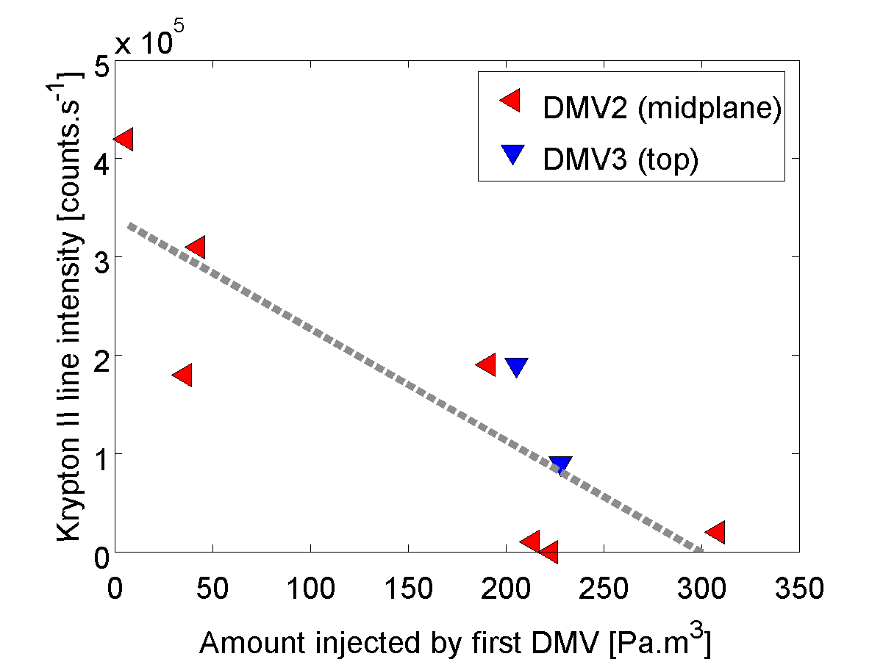
Second injection mixing efficiency
Krypton line visible following the second (killer) injection.
Kr⁺ line (no neutrals) ➔ consistent with the plasma temperature
The lower the background plasma density is, the more intense is the Kr line
Penetration of the second injection more efficient in low-density background plasmas
Kr⁺ line intensity

Slide 14
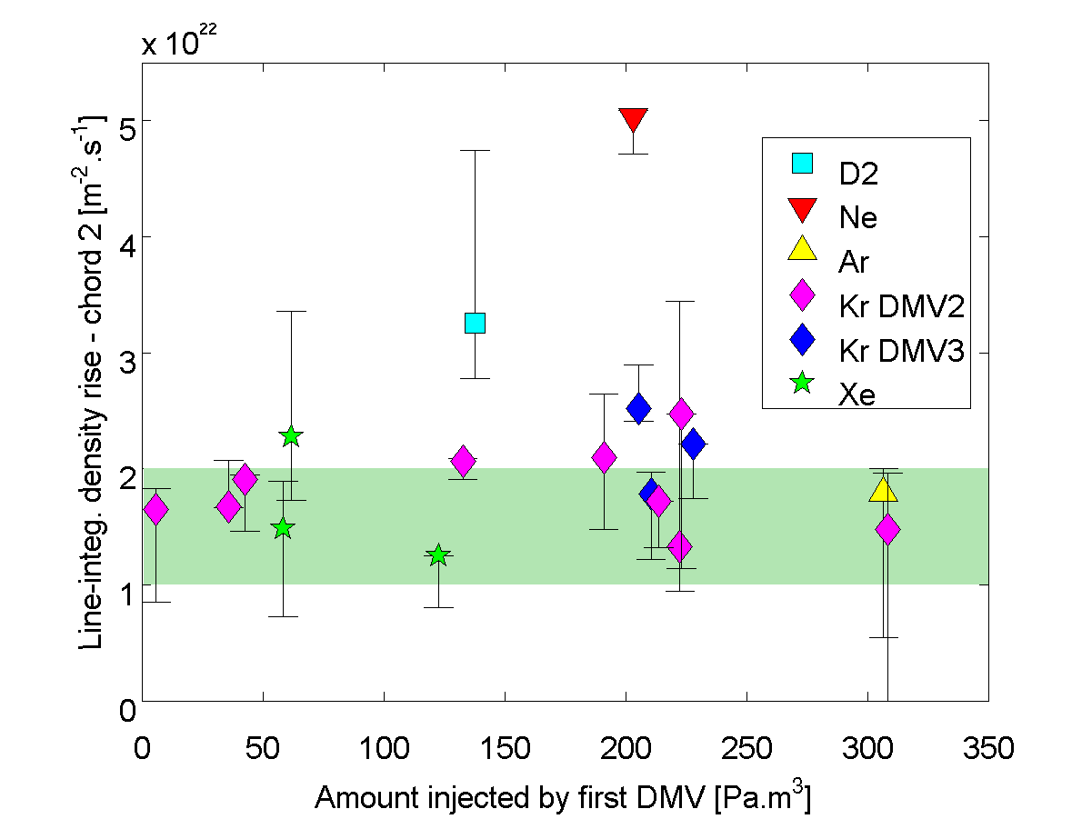
Second injection mixing efficiency
Density rise following the second injection: only moderately faster than the « natural » density rise of a dense background plasma
Mitigation gas mixed only if the background plasma is low enough in density
Self-limiting penetration as the density builds up.
Better with Ne and D2?
Density rise after 2nd injection
Natural density rise range
For dense BG plasmas
For a given gas: saturation of the maximum rate at which the density increases

Slide 15
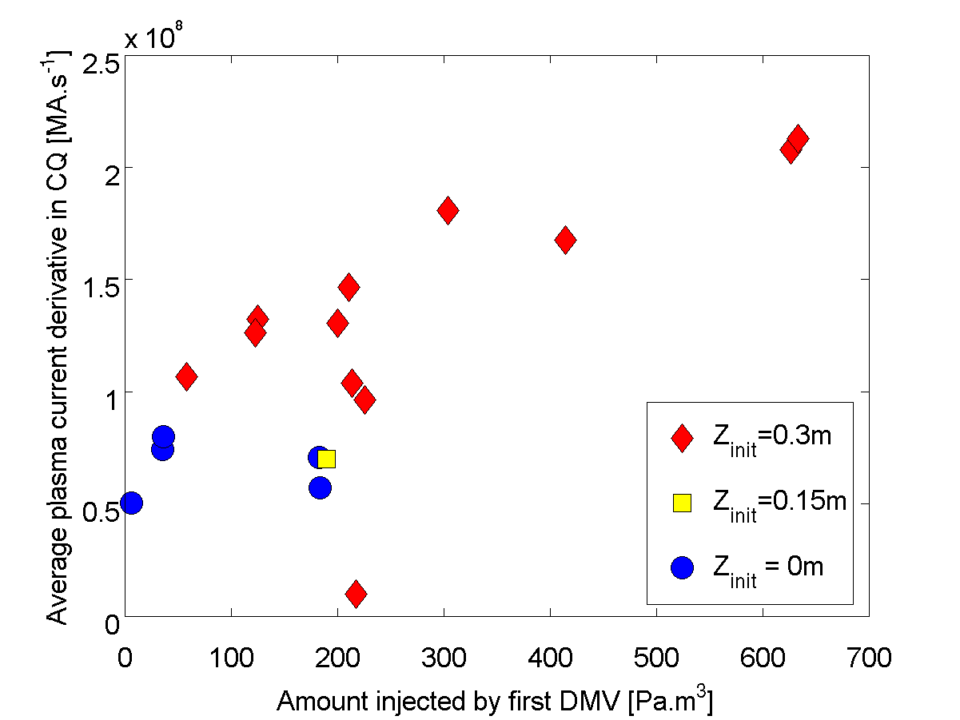
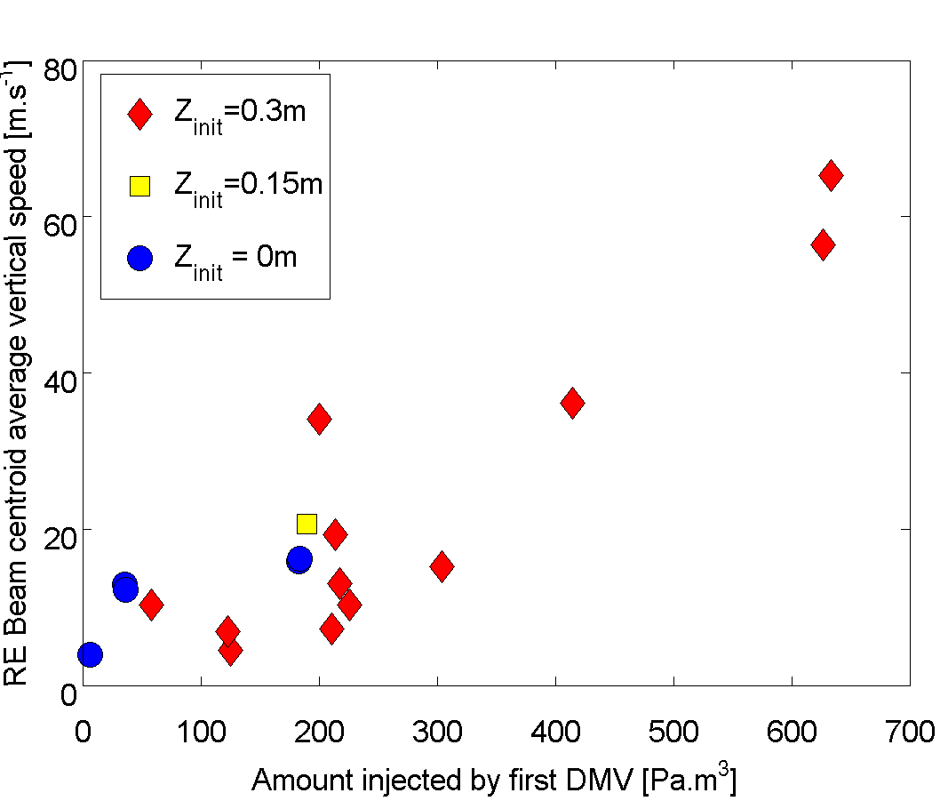
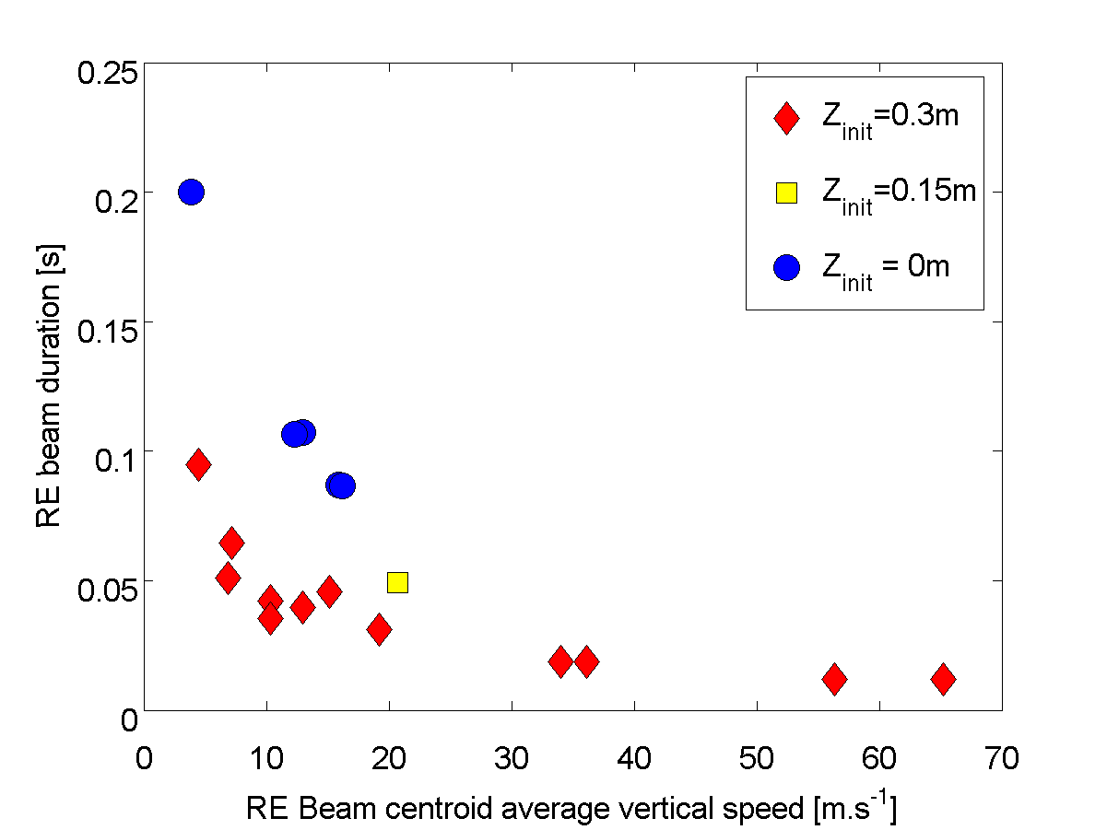
Vertical stability and background plasma
JET runaway beams: vertically unstable
The more gas is used to trigger the disruption, the more unstable.
  Larger disruption-triggering injection ➔ more impurities at thermal quench ➔ faster current quench
  ➔ more difficult for the control system to catch up
  ➔ shorter beam
Also holds for second injection: vertically destabilizing
dIp/dt vs. initial injection
dZ/dt vs. initial injection
Beam duration vs. dZ/dt
Vertical stability, RE beam lifetime and background plasma are linked

Slide 16
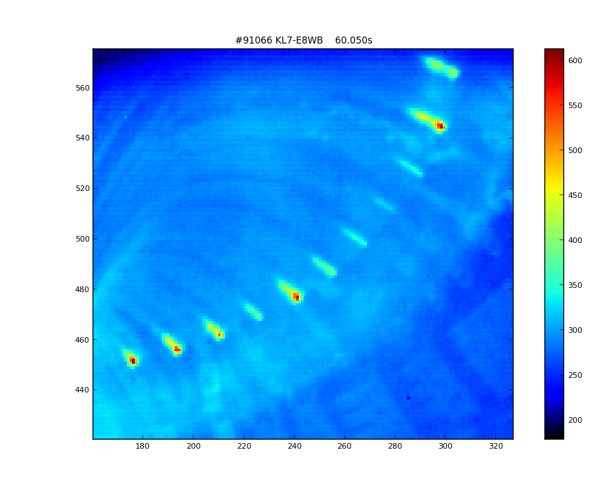
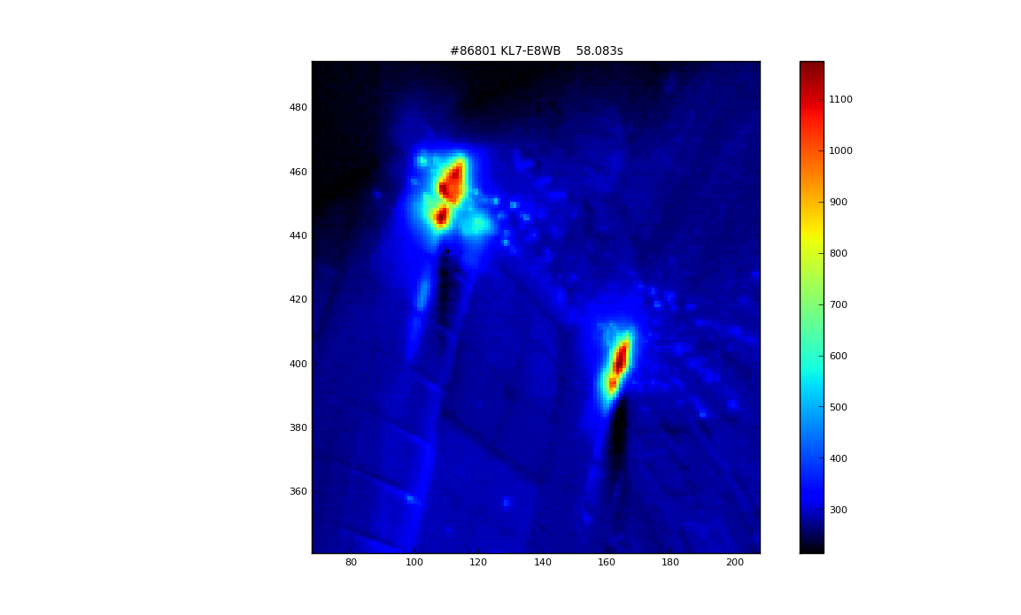
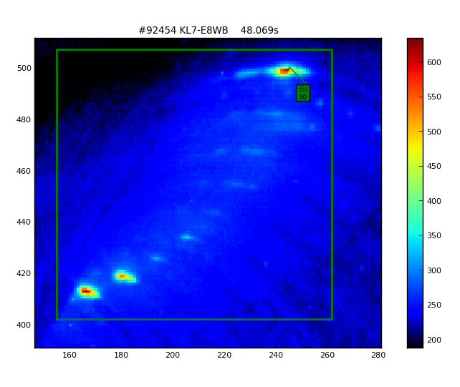
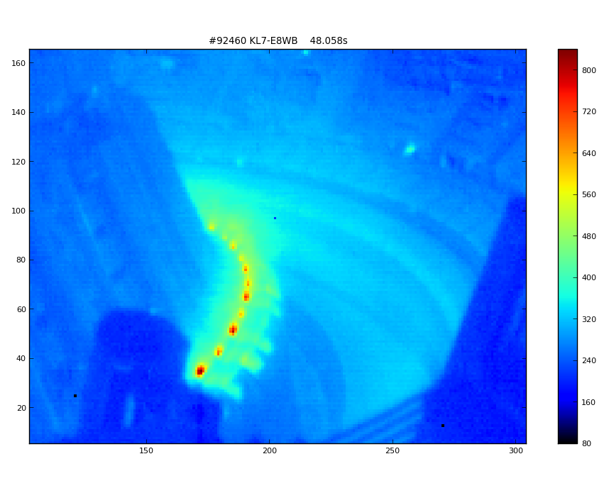
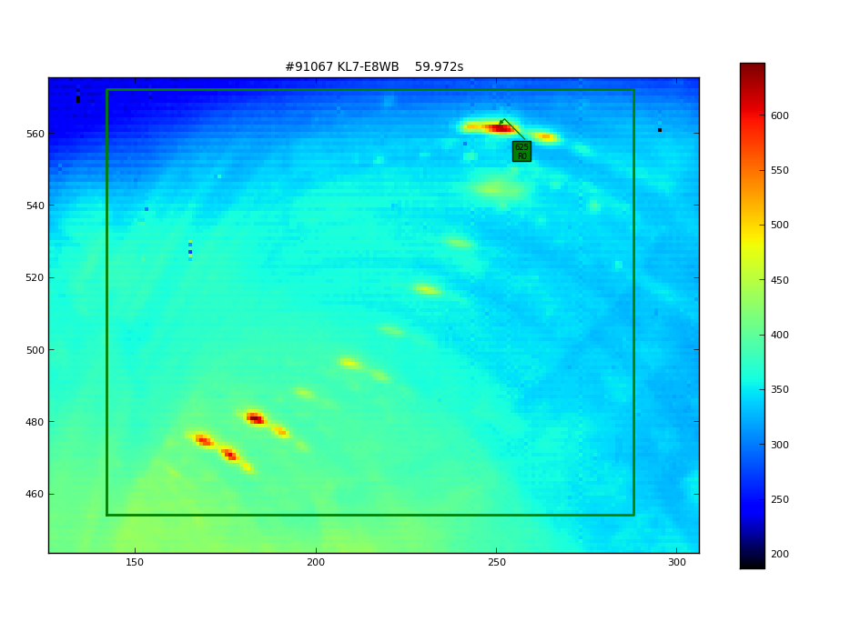
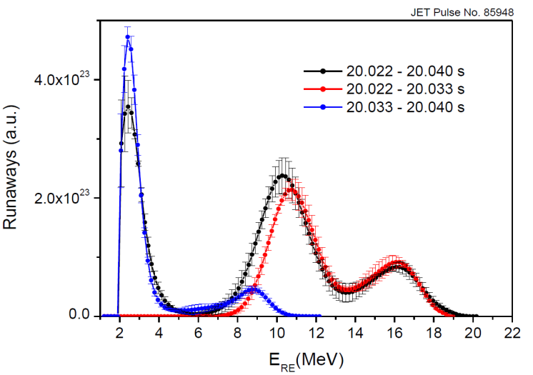
Beam mitigation: when is the best time to act?
Vertically unstable beams at JET always end up with a final collapse
  Still unclear what triggers the collapse (and why some experiments manage to lead the runaway current down to zero without it)
  Most of the impact damage associated with the final loss
#91066 – 1.0MA
I_{collapse}~550kA
Tmax = 530°C
Location: top
#92460 – 1.5 MA
I_{collapse} ~330kA
T_{max} = 730°C
Location: divertor
2nd injection: not clear how it affects the beam final collapse and runaway damage
  Seems to be more dependent on the initial runaway current, runaway energy and background plasma
  Mitigation injection makes the collapse happen quicker
  Unclear trends on runaway damage because of various locations, currents and energies
#91067 – 1.5 MA
I_{collapse}~650kA
Tmax = 625°C
Location: top
#92454 – 1.5 MA
I_{collapse} ~400 kA
T_{max} = 552°C
Location: top
#86801 – 2.0 MA
I_{collapse} ~770 kA
T_{max} = 1170°C
Location: inner wall
Some growing evidence that the runaway energy decays along the beam phase
  Should MGI/SPI wait until runaway energy has decayed enough?
  But fire before the « natural » collapse?
Reconstruction of the RE energy spectrum
End of the beam
Start of the beam
Mitigation strategy to be assessed not only with shortening RE beam or Ip @ final collapse

Slide 17
Conclusions
Background plasma characteristics (density, temperature) determined by the initial injection triggering the disruption:
  Less gas used for the disruption ➔ lower density background plasma
  Temperature and density for JET BG higher than on other machines
Penetration of the second (mitigation injection) highly dependent on the background plasma
  Better penetration in low-density background plasma
  Saturation of the density rise (self-limiting)
Vertical stability and background plasma are related
  The denser the background plasma, the more vertically unstable
  Figure of merit to decide when firing MMI to be defined
Shattered Pellet Injection may enhance penetration but effect on vertical stability to be assessed. ➔ 2018 JET campaigns
Ad: More at APS 2017 (C. Reux, invited talk)

Slide 19
Outline
JET Runaway experiments – runaway electrons and their background plasma
  Experimental setup and background
  Mitigation efficiency: geometry effect and current effect
  Background plasma characterization
  Mitigation efficiency: background plasma effects
  Vertical stability and link to mitigation efficiency
Bonus: JET runaway kinetic + MHD simulations – C. Sommariva’s work
  Magnetic topology during a disruption
  Runaway survival following thermal quench
  Effect of the effective electric field

Slide 20
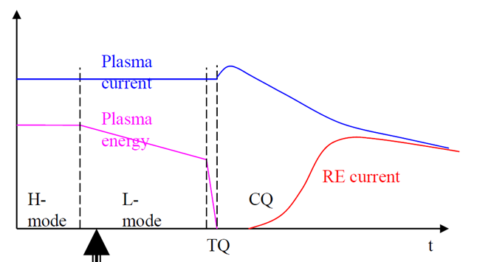
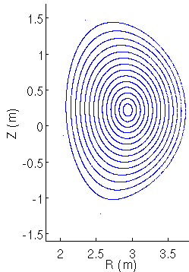
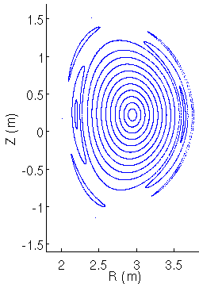
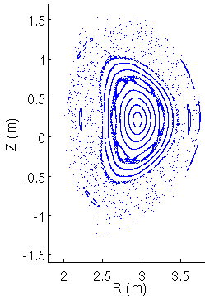
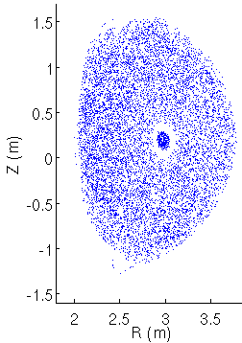
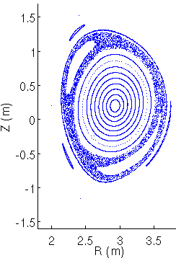
Disruption phenomenology (Simulation of JET #86887)
4: Δt ~ 1(ms)
1: Equilibrium
2: Magnetic islands
1
3
5: Δt ~ 10(ms)
2
3: MHD excitation
4: Thermal quench
5: Current quench
MHD activity + decrease in plasma current during the CQ → generation of toroidal electric field → electron acceleration → Runaway Electron production

Slide 21
Context and contribution of the present work
Interactions between MHD in disruption thermal quench (TQ) and primary RE generation (runaway seed for avalanche) are still poorly understood
  These interactions are critical especially for :
    Hot Tail mechanism → How many pre-TQ hot electrons remain confined through the TQ phase?
    Dreicer mechanism → Can electrons be accelerated due to MHD-related electric fields during the TQ phase?
  These questions are addressed introducing test particles in JOREK:
    Both guiding center [3] (GC) and full orbit (FO) [4] models have been implemented and tested
    A simple model of drag force is implemented [5] (for GC only)
    3D-time varying MHD fields are used
    No feedback on the MHD solutions is considered
[3] J.R. Cary, A.J. Brizard, Rev. Mod. Phys., p.693, 2009
[4] R.Zhang et al., Phys. Plasmas, vol.22, p.044501, 2015
[5] J. R. M.-Solis et al., Phys. Plasmas, vol.22, p.092512, 2015

Slide 22
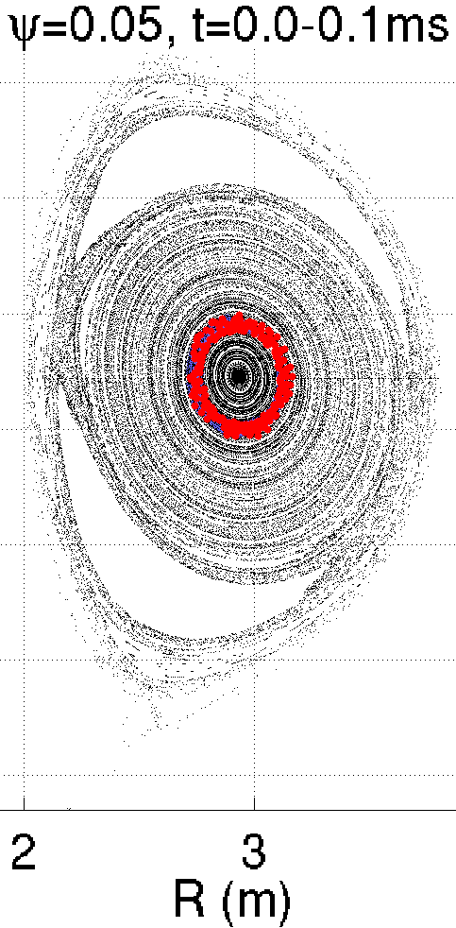
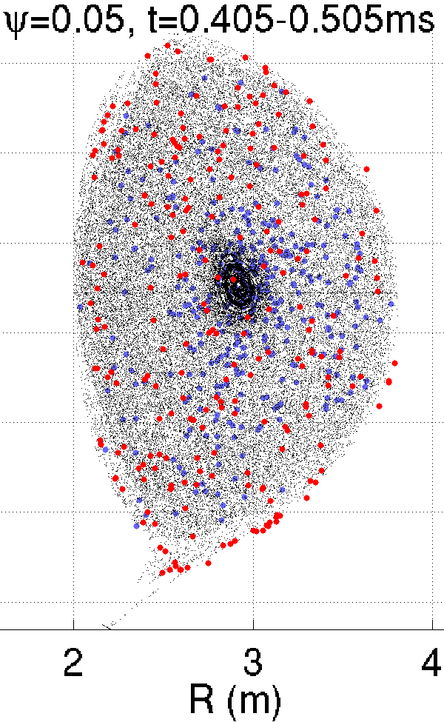
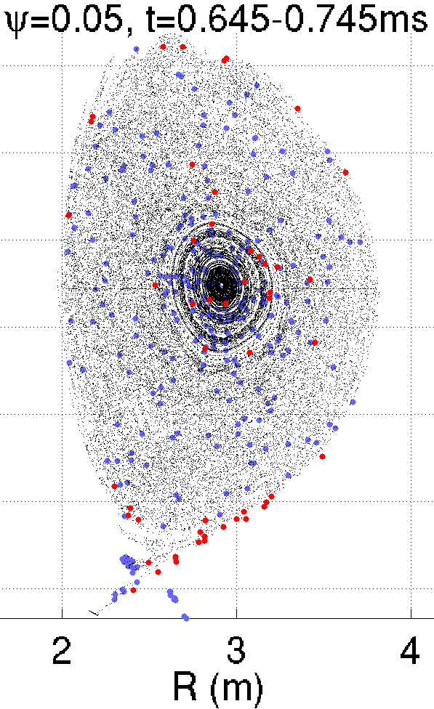
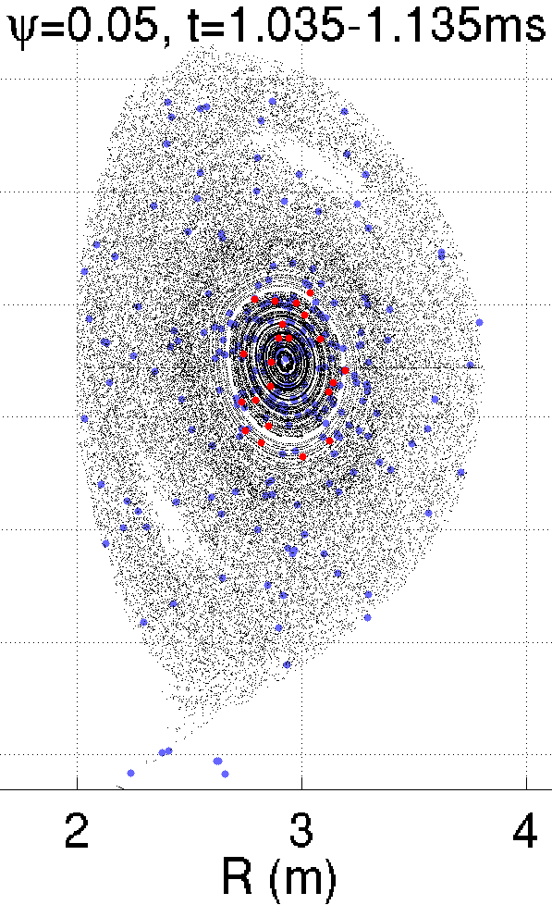
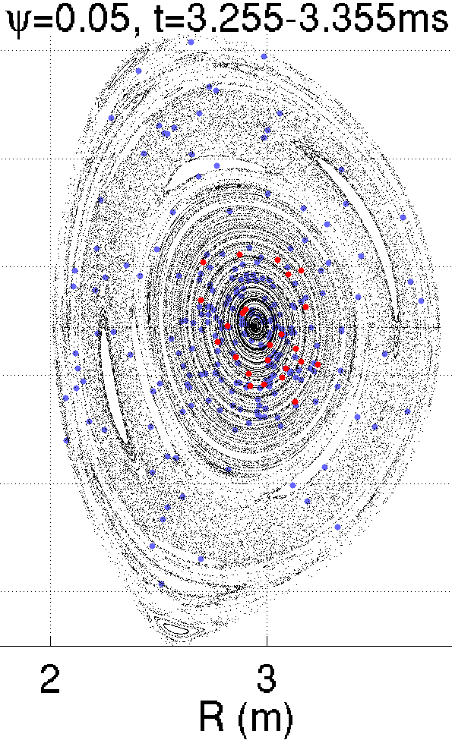
Overview of electron dynamics in the JET #86887 simulation
Electric field from dψ/dt are turned off → no GC acceleration before TQ
Mono-energetic, mono-pitch angle, deeply passing electrons initialized on a magnetic surface
1keV
10MeV
1keV
10MeV
1keV
10MeV
Electrons are reconfined due to reformation of closed magnetic flux surfaces during the CQ phase
Reformation of magnetic surfaces in two steps: (1st) fast generation in the core, (2nd) later formation at the edge
1keV
10MeV

Slide 23
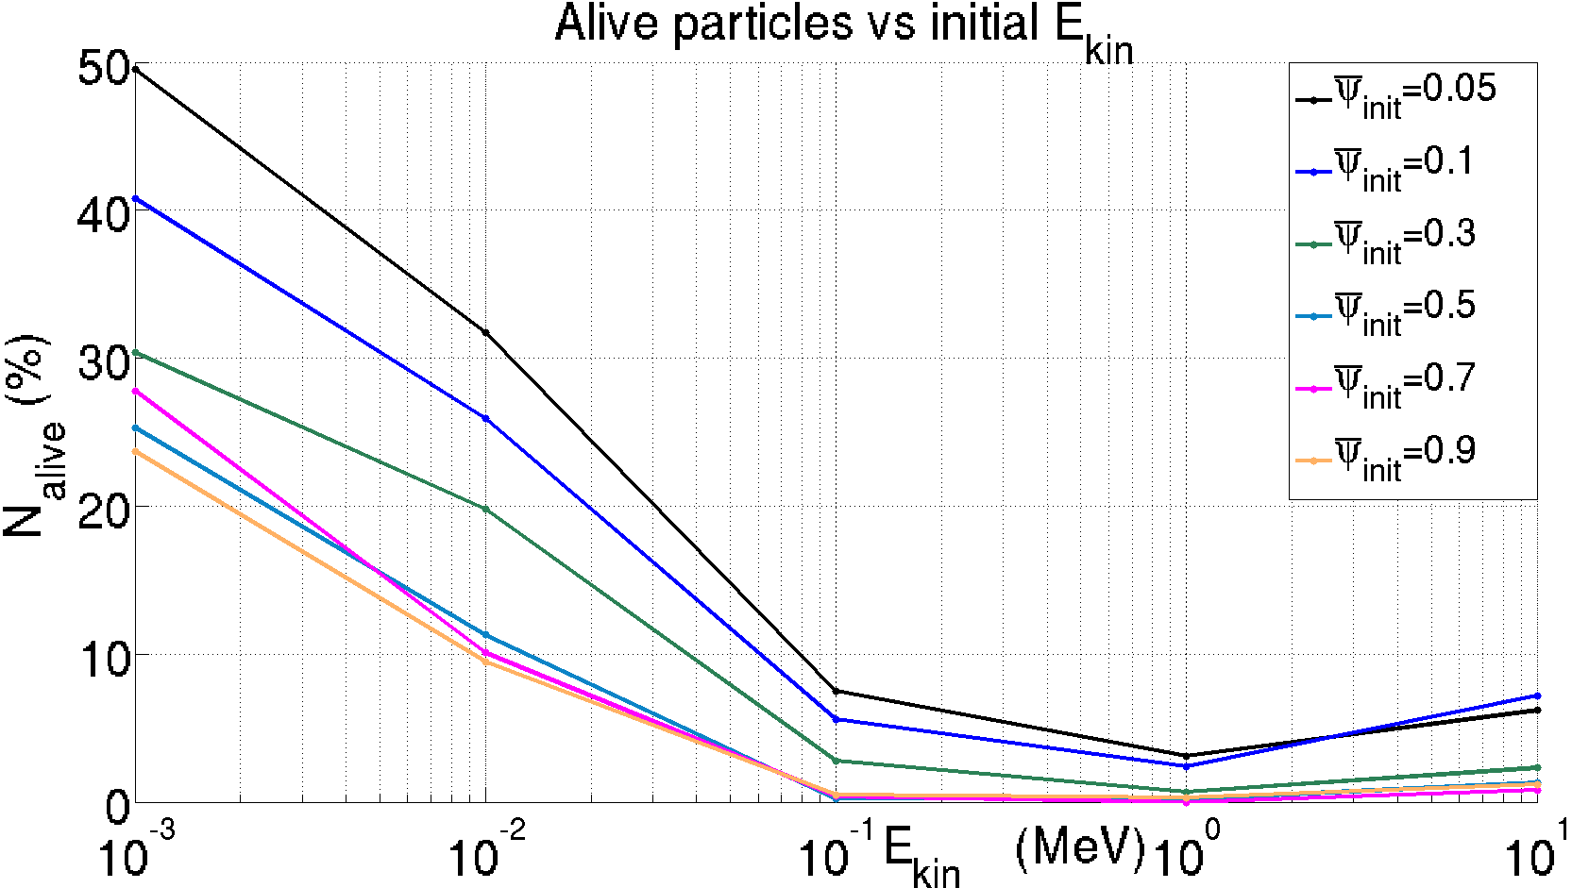
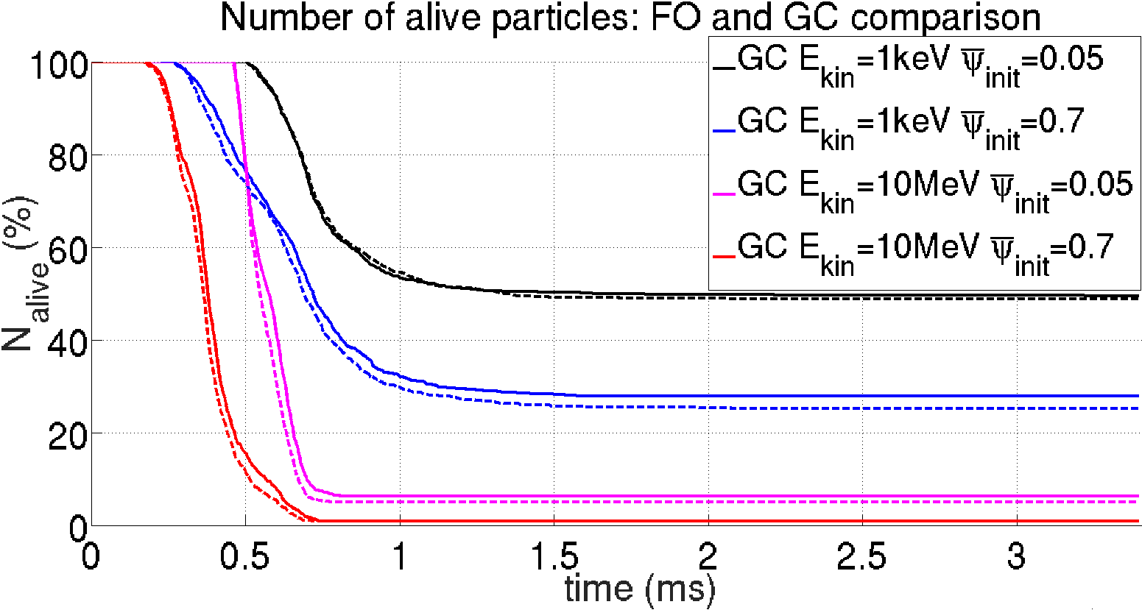
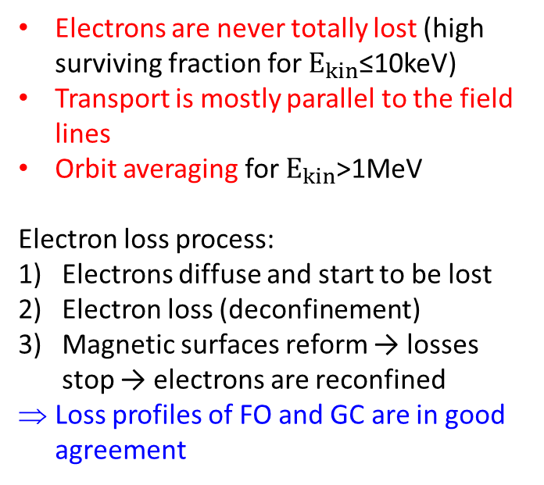
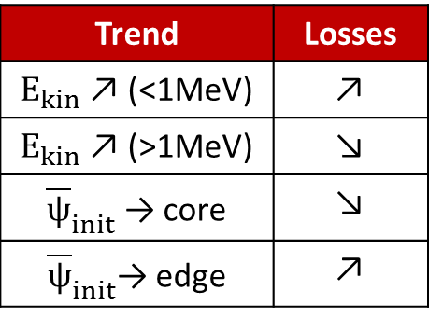
Fraction of surviving electrons vs initial energy and position
Trend | Losses
$E_{kin}$ ↗ (<1MeV) | ↗
$E_{kin}$ ↗ (>1MeV) | ↘
${\overline{ψ}}_{init}$ → core | ↘
${\overline{ψ}}_{init}$→ edge | ↗
core
Electrons are never totally lost (high surviving fraction for $E_{kin}$≤10keV)
Transport is mostly parallel to the field lines
Orbit averaging for $E_{kin}$>1MeV
Electron loss process:
Electrons diffuse and start to be lost
Electron loss (deconfinement)
Magnetic surfaces reform → losses stop → electrons are reconfined
Loss profiles of FO and GC are in good agreement
edge
2
3
1

Slide 24
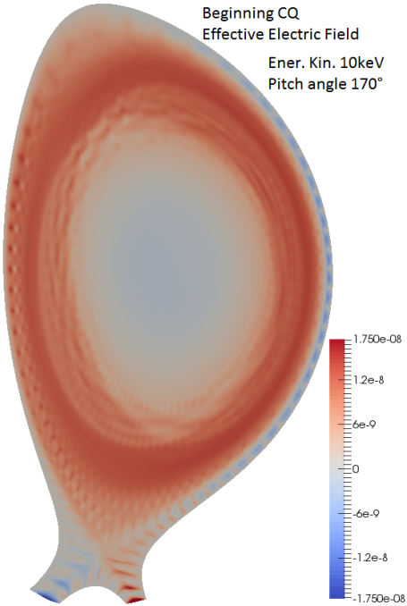
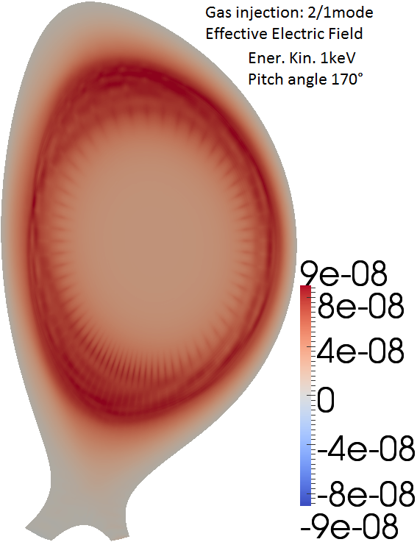
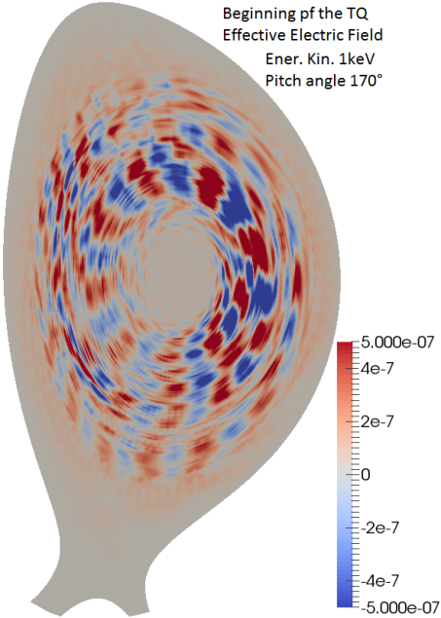
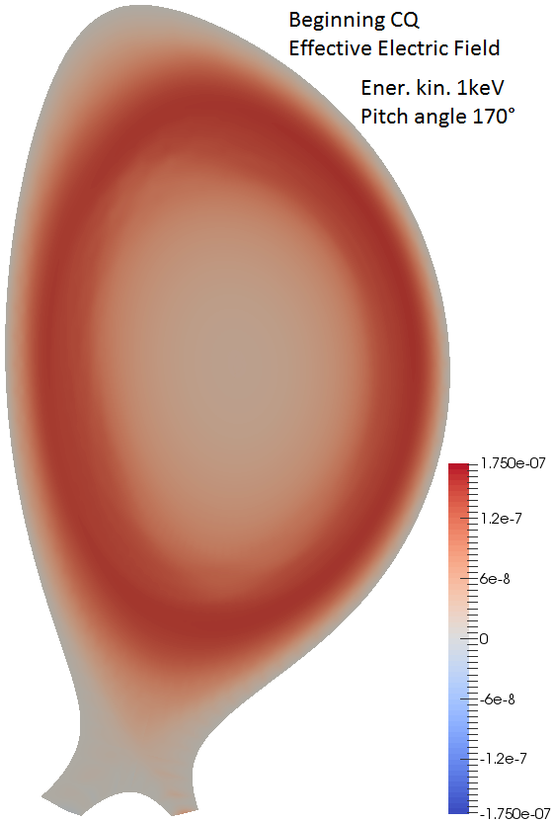
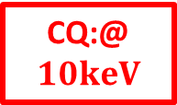
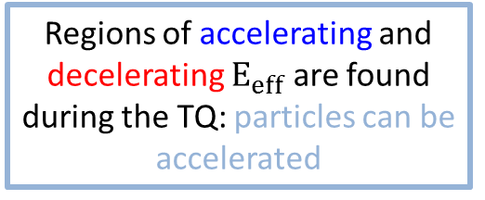
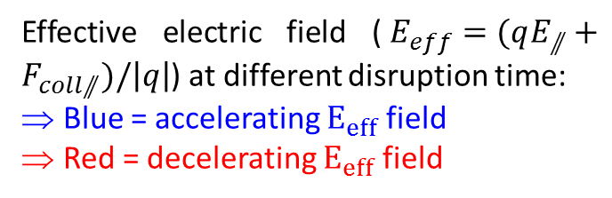
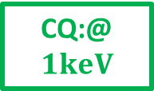
A possible mechanism for RE generation in TQ: Accelerating effective electric field
Effective electric field ($E_{eff}=(qE_{⫽}+F_{coll⫽})/\left|q\right|$) at different disruption time:
Blue = accelerating $E_{eff}$ field
Red = decelerating $E_{eff}$ field
If particles are accelerated during the TQ, they can become RE during the CQ
CQ:@$10keV$
TQ
CQ:@$1keV$
No acceleration before TQ
Regions of accelerating and decelerating $E_{eff}$ are found during the TQ: particles can be accelerated
If particles are not accelerated during the TQ, the collisional drag does not allow RE generation

Slide 25
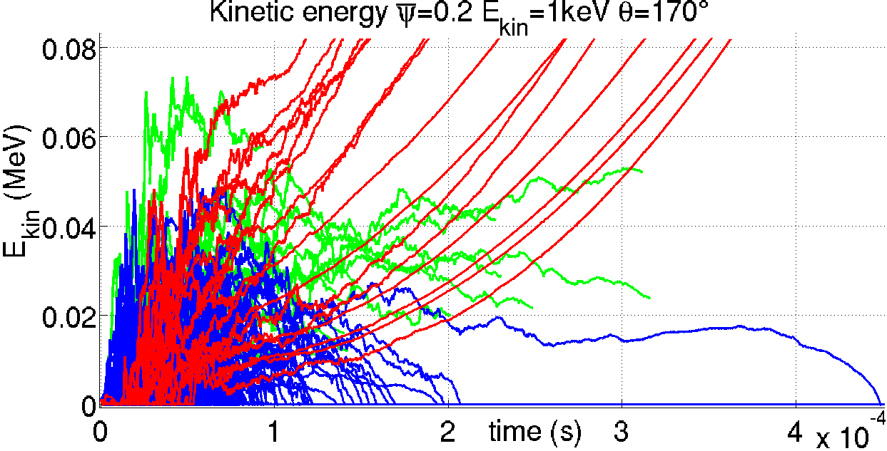
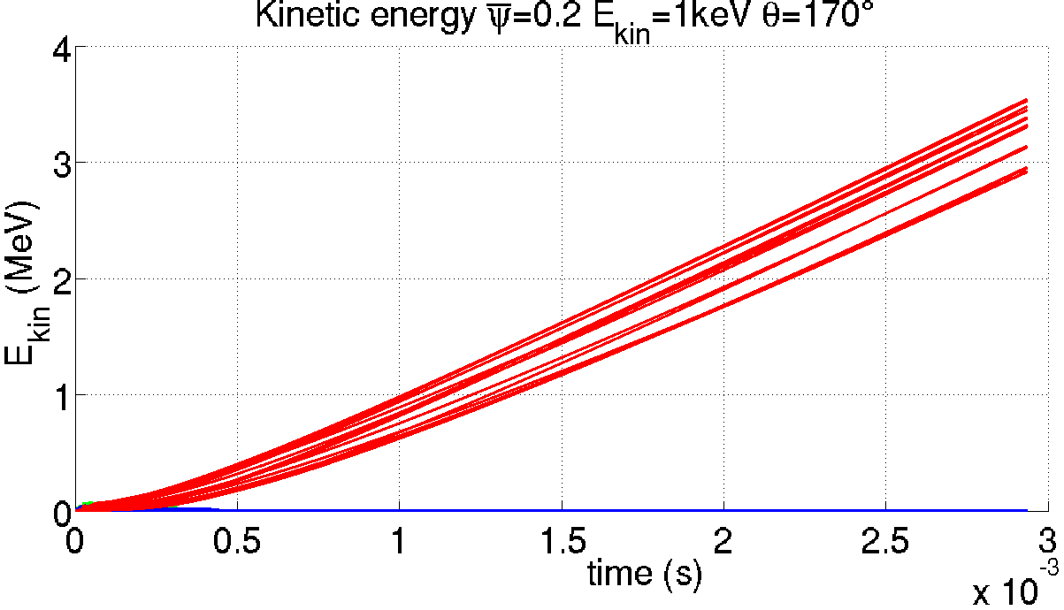
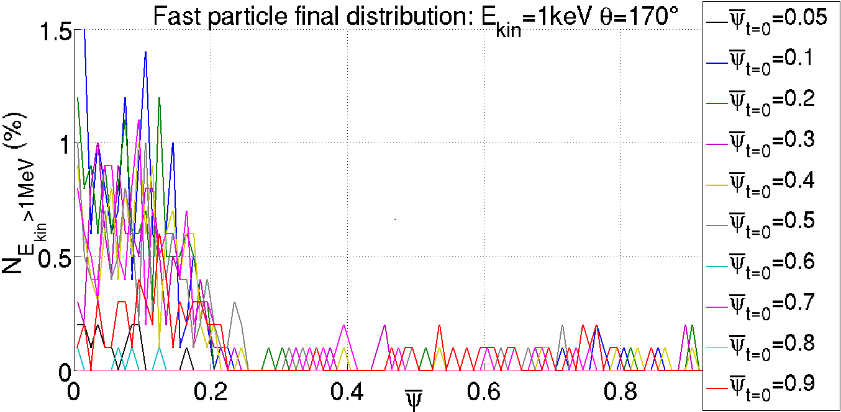


1keV electrons initialized just before the TQ: full E field and drag force
Electrons can interact with cells of accelerating $E_{eff}$ → increase of electron energy during the TQ
If not deconfined during the TQ → electrons become REs during the CQ
Reformation of closed magnetic flux surfaces centers the RE seed at plasma core
Lost electrons
Electrons > 1MeV
TQ
Electrons at
min($E_{kin}$)
Accelerated electrons are focused at the plasma core region
| PAGE 25

Slide 26
Summary – runaway simulations
Simulations suggest that Hot Tail mechanism is possible
  Closed magnetic surfaces reform before the complete loss of fast electrons to the wall/divertor regions
Direct electron acceleration (Dreicer mechanism) is observed during the disruption TQ phase:
  Electrons can interact with accelerating electric filed during the TQ phase
  After acceleration they can remain confined due to reformation of closed magnetic surfaces
  Surviving accelerated electrons become RE during the CQ phase
Electrons can have three possible ‘fates’ during the TQ:
  Being deconfined (lost to the wall)
  Being confined and thermalized
  Being confined and accelerated → Primary RE generation
In JET experiments REs are not always seen while in these simulations they frequently appear:
  Deconfinement mechanisms can be underestimated
  Acceleration mechanism can be overestimated

