Slide 1
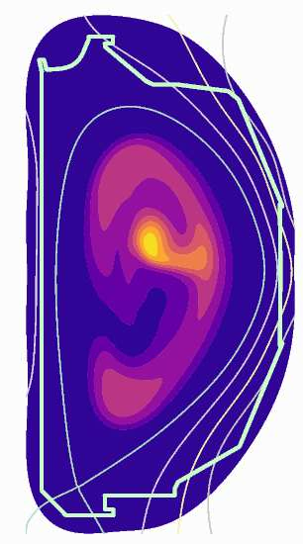
Shell-pellet injection modeling and runaway electron pitch-angle scattering effects
V.A. Izzo (University of California San Diego)
P.B. Parks (General Atomics)
E. Hirvijoki (Princeton Plasma Physics Laboratory)
2017 PPPL Workshop: Theory and Simulation of Disruptions
18 July 2017
Princeton, NJ

Slide 2
Outline
Description of shell-pellet injection concept and previous work
NIMROD modeling: evolution of thermal quench and current quench, species dependence
Recent upgrades to NIMROD runaway electron orbit integration model
Runaway electron results including pitch angle scattering effects
Summary

Slide 3
Outline
Description of shell-pellet injection concept and previous work
NIMROD modeling: evolution of thermal quench and current quench, species dependence
Recent upgrades to NIMROD runaway electron orbit integration model
Runaway electron results including pitch angle scattering effects
Summary

Slide 4
“Shell Pellet” concept* seeks to deliver radiating payload directly to center of plasma
Shell pellet concept:
Hard, low-Z shell ablates as it passes through the edge plasma then breaks open in the plasma center, producing “inside-out” thermal quench (TQ)
In this talk I will alternately refer to it as EPPI (Encapsulated Payload Pellet Injection)
Payload
Low-Z shell
Dispersive payload may consist of dust or compressed gas with impurity species dependent on desired TQ characteristics
*P. B. Parks, “Dust ball pellets for disruption mitigation,” Invention Disclosure DOE Case No. S-113–472 (2007).

Slide 5
Future DIII-D experiments will build on previous proof of principle experiments [1,2]
Small pellets demonstrated ability to deliver payload to core
Large pellets did not break open, needed thinner shell, improved ablation model
[1] E. M. Hollmann, N. Commaux, N. W. Eidietis, T. E. Evans, D. A. Humphreys, A. N. James, T. C. Jernigan, P. B. Parks, E. J. Strait, J. C. Wesley, J. H. Yu, M. E. Austin, L. R. Baylor, N. H. Brooks, V. A. Izzo, G. L. Jackson, M. A. van Zeeland, and W. Wu Physics of Plasmas 17, 056117 (2010)
[2] N. Commaux, L.R. Baylor, S.K. Combs, N.W. Eidietis, T.E. Evans, C.R. Foust, E.M. Hollmann, D.A. Humphreys, V.A. Izzo, A.N. James, T.C. Jernigan, S.J. Meitner, P.B. Parks, J.C. Wesley and J.H. Yu, Nucl. Fusion 51, 103001 (2011).

Slide 6
Some advantages and challenges of the shell pellet concept
Advantages:
Outer flux surfaces are not (substantially) perturbed before radiative cooling begins in the core→ less core heat conducted to the divertor, high radiated energy fraction
High assimilation efficiency of material in the core→ possibility of runaway electron suppression and faster post-mitigation recovery
Challenges: (experiments needed)
Will shell be truly non-perturbative? What about pre-existing MHD
Better model for shell ablation is needed. Can we reliably deliver the payload close to the center? What about changes in plasma parameters?

Slide 7
Outline
Description of shell-pellet injection concept and previous work
NIMROD modeling: evolution of thermal quench and current quench, species dependence
Recent upgrades to NIMROD runaway electron orbit integration model
Runaway electron results including pitch angle scattering effects
Summary

Slide 8
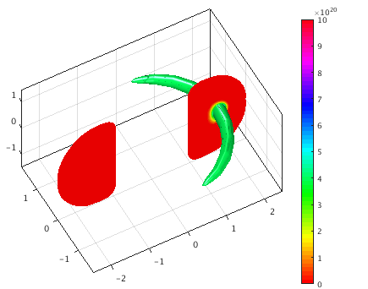
High-Z case uses Ar impurities deposited directly into the core very rapidly
Ar is used as a proxy for any high-Z material (highest Z available in NIMROD)
Impurities are deposited in a localized plume with 15cm radius and 1.5 m half-width in the toroidal direction.
Neutral Ar is deposited during a short 0.1 ms time window
Total of 20 Torr-l Ar is deposited; smaller than total quantities for MGI, but assimilated quantity is similar due to 100% core assimilation by design for EPPI
Ar density (m⁻³)

Slide 9
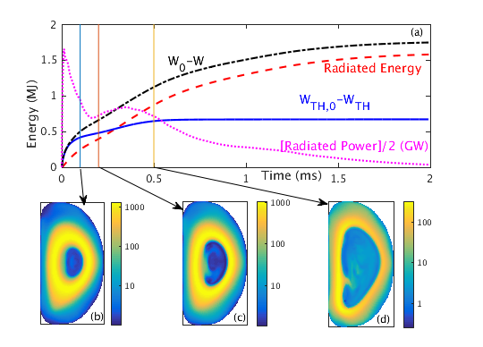

Plasma cools from the inside out, with most of the thermal energy radiated in first 0.1 ms
TQ is complete within 0.5 ms
Radiated energy fraction
=
ultimately
exceeds 90%
$$\frac{W_{rad}}{W_{0}−W}$$
T_{e} (eV)
T_{e} (eV)
T_{e} (eV)
V. A. Izzo , P. B. Parks ,
Physics of Plasmas 24, 060705 (2017)

Slide 10
In comparison, MGI produces slower TQ and lower radiated energy fraction
MGI simulation has 1ms pre-TQ as plasma cools edge
TQ begins when MHD is triggered and breaks up flux surfaces
Radiated energy fraction is closer to 75%
V.A. Izzo, Phys. Plasmas 24, 056102 (2017)

Slide 11
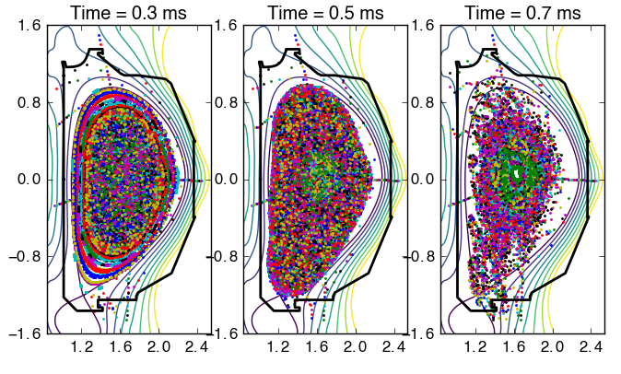
Shell pellet injection breaks up flux surfaces from the inside out
Outermost surfaces remain intact until the end of the TQ, resulting in minimal conduction of core heat to the divertor
V. A. Izzo , P. B. Parks ,
Physics of Plasmas 24, 060705 (2017)

Slide 12
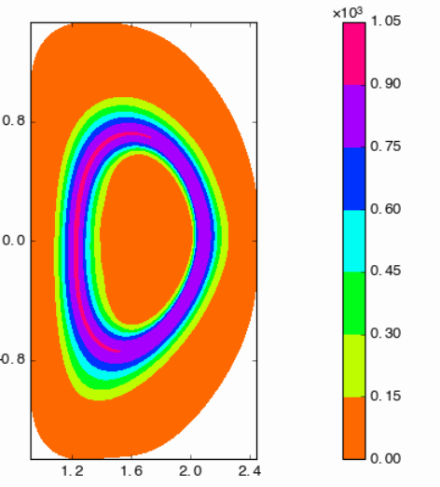
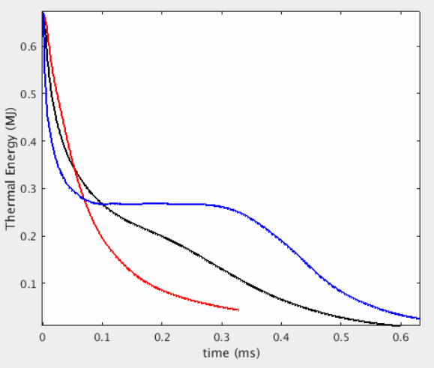
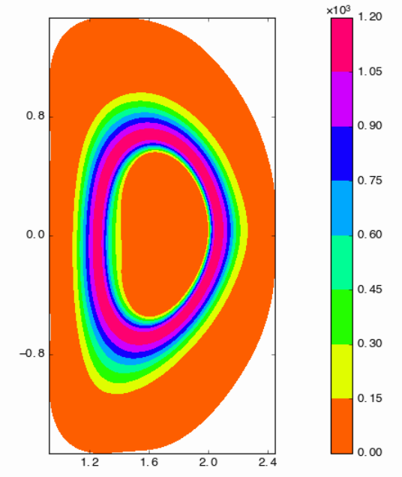
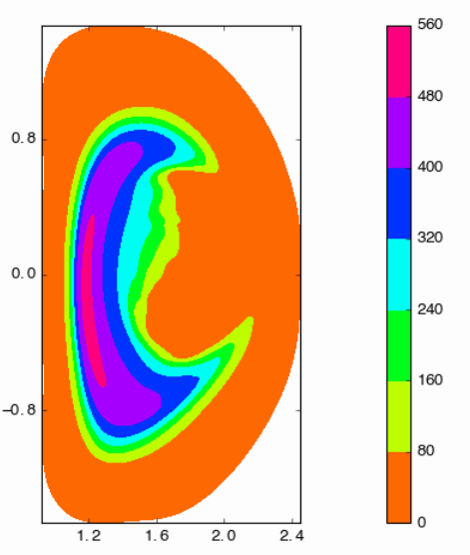
Species and pellet centering can effect the TQ rate
On-center Be
On-center Ar
Off-center Ar

Slide 13
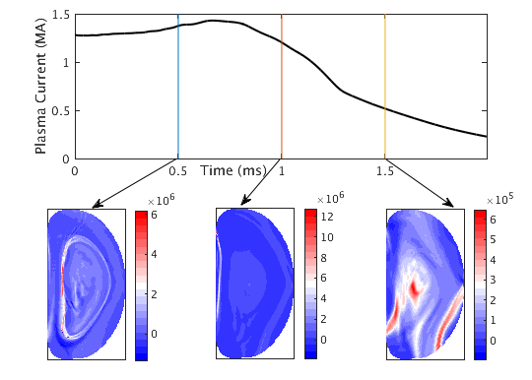
Current quench starts fast due to narrow current channel then slows as current redistributes
Toroidal Current Density (A/m²)
V. A. Izzo , P. B. Parks ,
Physics of Plasmas 24, 060705 (2017)

Slide 14
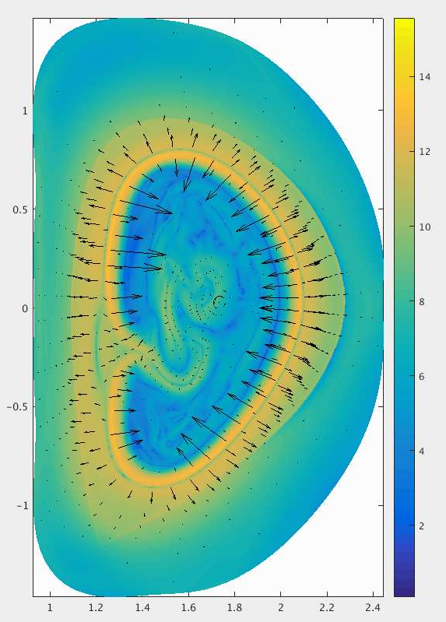
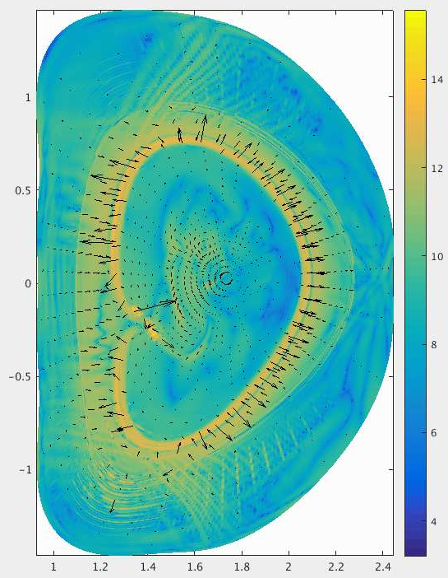
As pressure collapses from the inside out, outward jxB force keeps current ring expanding
-grad(P)
jxB

Slide 15
Outline
Description of shell-pellet injection concept and previous work
NIMROD modeling: evolution of thermal quench and current quench, species dependence
Recent upgrades to NIMROD runaway electron orbit integration model
Runaway electron results including pitch angle scattering effects
Summary

Slide 16
NIMROD RE orbit model designed to follow drift orbits of RE test particles during disruption simulations
Previous model included E-field acceleration, deceleration due to (small-angle) collisions, synchrotron and bremsstrahlung radiation, but..
Assumed small pitch angle, neglected pitch angle scattering, neglected distribution function of bulk (assumed v_{re}>>v_{th})
Primary aim of model was to examine losses due to field stochastization during the TQ.

Slide 17
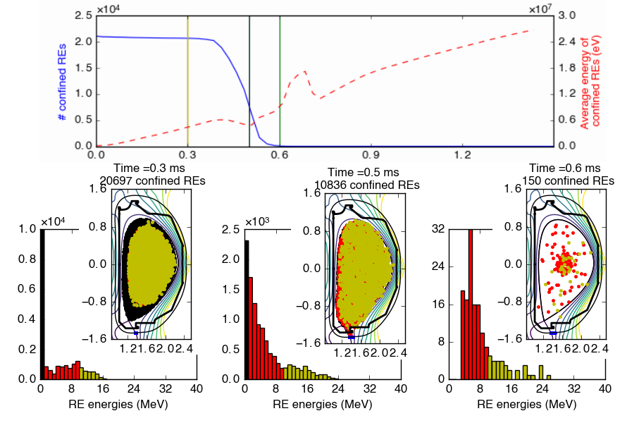
In Ar EPPI case, rapid losses are seen at end of TQ
V. A. Izzo , P. B. Parks ,
Physics of Plasmas 24, 060705 (2017)

Slide 18
MGI simulations of DIII-D retain from 5%-80% of seed REs
Variation over a range of DIII-D diverted equilibria due to differences in MHD
Compare to 0.01% in Ar EPPI simulation

Slide 19
New model couples NIMROD with AMCC code*
AMCC code from Eero Hirvijoki (PPPL) working within SCREAM collaboration
Mote Carlo code to calculate effects of small and large angle collisions with an arbitrary number of species, with the bulk plasma distribution function accounted for
After following drift orbit for one NIMROD time step (~1 microsecond), AMCC is called once to update the parallel and perpendicular momentum using average values of densities and temperatures over the integrated orbit.
*“Adaptive time-stepping Monte Carlo integration of Coulomb collisions”
Konsta Särkimäki, Eero Hirvijoki, Juuso Terävä, https://arxiv.org/abs/1701.05043

Slide 20
Outline
Description of shell-pellet injection concept and previous work
NIMROD modeling: evolution of thermal quench and current quench, species dependence
Recent upgrades to NIMROD runaway electron orbit integration model
Runaway electron results including pitch angle scattering effects
Summary

Slide 21
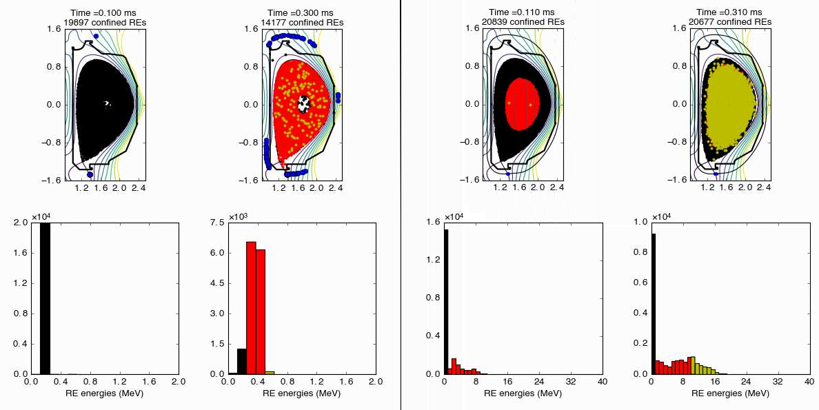
With Ar a dramatic difference is seen in early time energy evolution (NB: different color scale)
w/ pitch angle scattering
original model

Slide 22
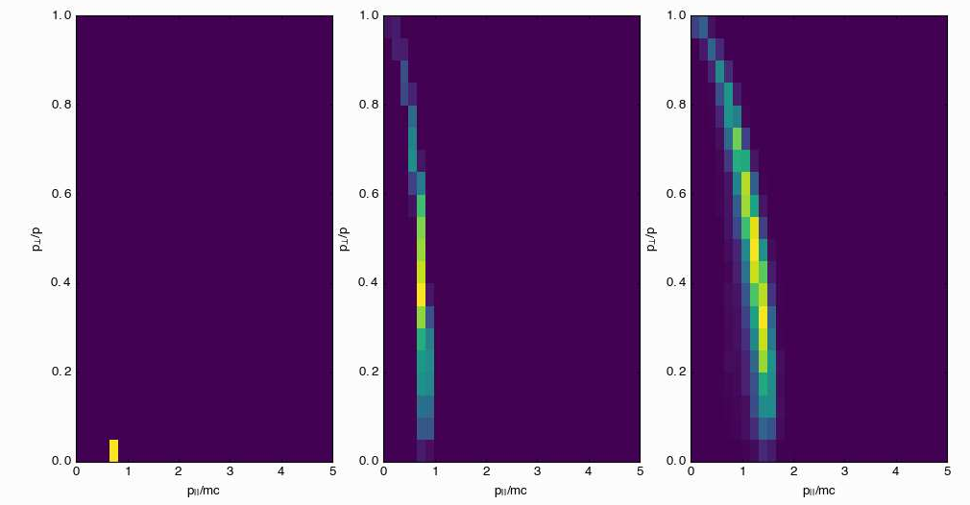
Most test electrons have scattered to pitch angle between 0.2 - 0.5
0.0 ms
0.1 ms
0.3 ms

Slide 23
Outline
Description of shell-pellet injection concept and previous work
NIMROD modeling: evolution of thermal quench and current quench, species dependence
Recent upgrades to NIMROD runaway electron orbit integration model
Runaway electron results including pitch angle scattering effects
Summary

Slide 24
Summary
Shell pellets concept designed to deliver radiating impurities to the core without strongly perturbing edge flux surfaces
Proof of principle shell pellet experiments have already been performed on DIII-D
NIMROD simulation demonstrate many of the potentially promising features of shell pellet injection, including inside-out break up of flux surfaces leading to high radiated energy fraction and fast loss of seed REs at the end of the TQ
NIMROD has recently been coupled with AMCC Monte Carlo code for better treatment of RE collisions.
Inclusion of pitch angle scattering effect with Ar EPPI results in significantly lower energies and faster losses of RE seeds after a short time

Slide 25
References
Shell pellet concept:
P. B. Parks, “Dust ball pellets for disruption mitigation,” Invention Disclosure DOE Case No. S-113–472 (2007).
Shell pellet experiments:
E. M. Hollmann, N. Commaux, N. W. Eidietis, T. E. Evans, D. A. Humphreys, A. N. James, T. C. Jernigan, P. B. Parks, E. J. Strait, J. C. Wesley, J. H. Yu, M. E. Austin, L. R. Baylor, N. H. Brooks, V. A. Izzo, G. L. Jackson, M. A. van Zeeland, and W. Wu Physics of Plasmas 17, 056117 (2010)
N. Commaux, L.R. Baylor, S.K. Combs, N.W. Eidietis, T.E. Evans, C.R. Foust, E.M. Hollmann, D.A. Humphreys, V.A. Izzo, A.N. James, T.C. Jernigan, S.J. Meitner, P.B. Parks, J.C. Wesley and J.H. Yu, Nucl. Fusion 51, 103001 (2011).
EPPI (shell pellet) modeling:
V.A Izzo, P.B. Parks, Physics of Plasmas 24, 060705 (2017)
AMCC Code:
“Adaptive time-stepping Monte Carlo integration of Coulomb collisions” Konsta Särkimäki, Eero Hirvijoki, Juuso Terävä, https://arxiv.org/abs/1701.05043
RE modeling with NIMROD:
V.A. Izzo, et al, Plasma Phys. and Control. Fusion 54 (2012) 095002
MGI modeling with NIMROD:
V.A. Izzo, Phys. Plasmas 24, 056102 (2017)
Two-stage process with central-fueling:
P.B. Parks and W. Wu, Nucl. Fusion 51 (2011) 073014
P.B. Parks and W. Wu, Nucl Fusion 54 (2014) 023002

