Slide 1
Bucket transport for control of runaway electrons
TSDWorkshop, PPPL, July 17-19, 2017
H.E. Mynick, PPPL
Collaborators: E.Hirvijoki, E.Valeo, PPPL

Slide 2
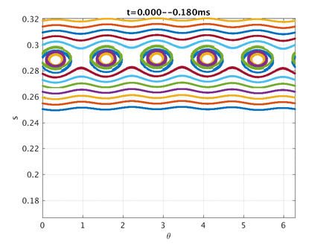
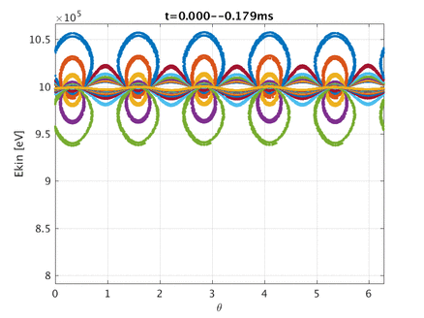
-Test numerically , using VENUS[2] relativistic gc code (Hirvijoki):
-ITER equilibrium, [q₀,q_{a}]=[1.65,3.25], K₀= 1 MeV, cosξ=0.8, [m,n,B_{mn}/B₀]=[5,3,1.3e-3],
sweep ω= 1 → 0 MHz in 10 msec:
[2] Pfefferle, Cooper, Graves, Misev, Computer Physics Commun. 185 , 3127 (2014).

